Slide 1
Access Network Technologies for Future Internet
Deokjai Choi
2008. 10

Slide 2
Outline
Changes of Networking
Access Network Technologies
  Current
  Coming: Sensor Networks, WMNs, DTN
  Future ?
Discussions

Slide 3
Changes of Networking
Environment
  Trusted => Untrusted
Users
  Researchers => Customers => Things
Operators
  Nonprofits => Commercial
Usages
  Host-oriented => Data-centric
Connectivity
  E2E IP => Intermittent Connection

Slide 4
New Networks and Services
Home Networks
PANs
BANs
Sensor Networks
Intelligent Things
Context Aware Services

Slide 5
Access Networks
Current Access Networks
  For home: ADSL,
  For Organization: T1, T3
  For mobile user: Wi-Fi, WiMAX, …
Coming Access Networks
  For Sensor Networks: …, DTN
  For Intelligent things: WMN
  For Mobile User: WMN

Slide 6
Characteristics for Future Customers/Networks
Sensor Networks
  Will be scattered thru wilderness.
  Most likely, they will have sink node.
  SpoVNet, Our Approach, IPUSN
Extending Reachability (WMN)
  Intelligent Things (gadget)
  Some of them are carried by human.
  Some of them are fixed in the street or things such as appliances
Delay Tolerant Networks (DTN)
  Heterogeneous Networks

Slide 7
Sensor Network

Slide 8
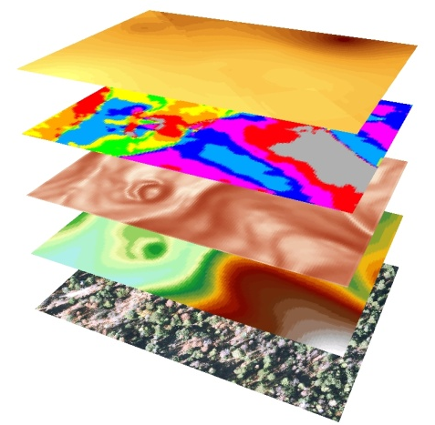
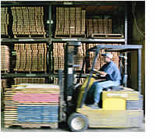

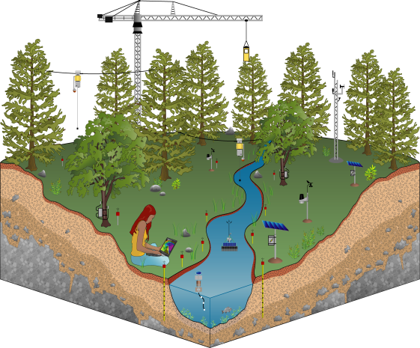
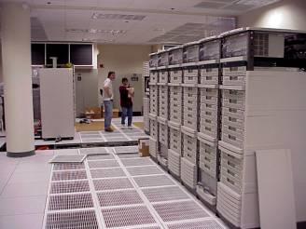

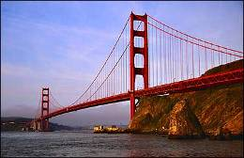
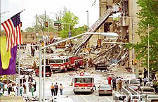
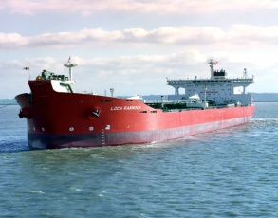
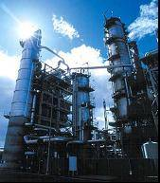
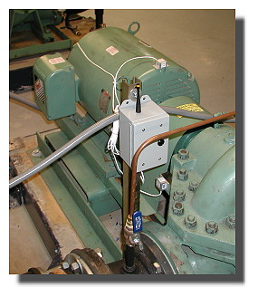
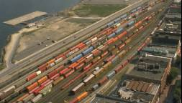
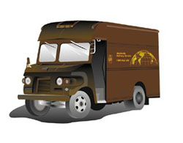

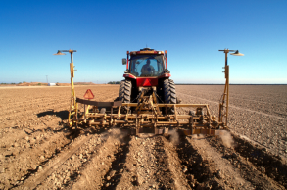

Why “Real” Information is so Important?
Save Resources
Improve Productivity
Enable New Knowledge
Increase
Comfort
Enhance Safety & Security
Preventing Failures
High-Confidence Transport
Improve Food & H20
Protect Health

Slide 9


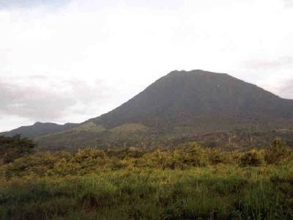

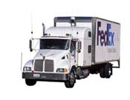
WSN Applications
Monitoring Spaces
  Env. Monitoring, Conservation biology, ...
  Precision agriculture,
  built environment comfort & efficiency ...
  alarms, security, surveillance, EPA, OSHA, treaty verification …
Monitoring Things
  automated meter reading
  condition-based maintenance
  disaster management
  Civil infrastructure
Interactions of Space and Things
  manufacturing, asset tracking, fleet & franchise
  context aware computing, non-verbal communication
  Assistance - home/elder care
Action and control
  Optimizing processes
  Automation

Slide 10
How to connect sensor networks
IP/USN
SpoVNet
P2P Overlay

Slide 11
IP/USN

Slide 12

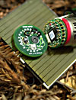
Canonical SensorNet Network Architecture
Patch
Network
Sensor Node
Sensor Node
Sensor Patch
Gateway
Gateway
Transit Network
(IP or not)
Client Data Browsing
and Processing
Access point
- Base station
- Proxy
Verification
links
Intranet/Internet (IP)
Other information
sources
Data Service

Slide 13
Lesson 1: IP
Separate the logical communication of information from the physical links that carry the packets.
  Naming
    Hostname => IP address => Physical MAC
  Routing
  Security
Diverse Object and Data Models (HTML, XML, …)
Application (Telnet, FTP, SMTP, SNMP, HTTP)
Transport (UDP/IP, TCP/IP)
Internet Protocol (IP) Routing
Internet Protocol (IP) Routing
Serial
Modem
GPRS
X3T9.5
FDDI
802.3
Ethernet
802.5
Token Ring
802.11
WiFi
802.15.4
LoWPAN
802.3a
Ethernet
10b2
802.11a
WiFi
Sonet
802.3i
Ethernet
10bT
802.11b
WiFi
ISDN
802.3y
Ethernet
100bT
802.11g
WiFi
802.3ab
Ethernet
1000bT
802.11n
WiFi
DSL
802.3an
Ethernet
1G bT

Slide 14
But, …
isn’t IP too heavyweight for low-power, wireless, microcontroller based devices?
No!
6lowpan compression with high quality multihop routing
  Reliability and lifetime of the best mesh
  Interoperability of IP

Slide 15

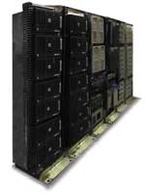
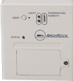

Our goal: Ubiquitous Real Internet
< get temp …
set sample_rate
set alarm … >
www.weather.com
Web Services
<request
service>
Service
Description
<value>
source=library
time=12:53
temp=26.7
<\value>
<value>
source=library
time=12:31
temp=25.1
<\value>
XML information
Wireless Packets
802.15.4
Sampled Value
11 010010001
11 010110111
int temp;
010010001
Physical Signal

Slide 16
SpoVNet
Spontaneous Virtual Networks
  Connecting Sensor Network Islands to the Future Internet using the SpoVNet Architecture

Slide 17
Motivation/Objectives
Heterogeneity of network technologies makes the controllability of complex, global communication systems.
SpoVNet follows the approach of providing spontaneous communication by composing algorithms and protocols that allow self-organization in distributed systems.
Self-organizing systems are able to adapt to the given requirements and network loads flexibly, without further involvement of administrative expenditure.
The main objective of spovnets is to provide the actual arising service needs spontaneously, autonomously and adaptively

Slide 18
Cargo Tracking System
Today’s Cargo tracking system
- Consist of GPS receiver and a mobile phone unit - Attached to the actual cargo container - allows tracking of container locations
Online monitoring tracking system
- The GSM unit in current location tracking systems is not limited to the transfer of GPS coordinates - To reduce costly GSM communication, Several containers can use a single GSM unit that is attached to a dedicated container. - Cost and availability of GSM communication is still problematic and only allows transmission of data at large intervals

Slide 19
Cargo Tracking System
However, It is not satisfying
- No continuous connectivity is available, therefore disallowing online monitoring - Communication is costly, making monitoring expensive
So, we employ a new Container Monitoring Application (CMA) on top of SpoVNet that uses SNS to access sensor network islands and perform the actual communication for our monitoring application.

Slide 20
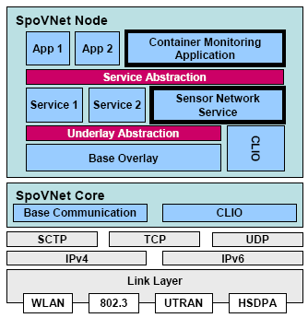
SpoVNet
Sensor Network Service and Container Monitoring Application in the SpoVNet Architecture

Slide 21
P2P Overlay Network for Sensor Network

Slide 22
Using P2P Service Concept
Peer-to-Peer Technology
  Significant autonomy from central servers
  Exploits resources at the edges of the Internet
    Storage and contents
    Computing power
    Connectivity and presence
P2P Service Scenario
  The nodes in P2P networks function as both clients and servers to the other nodes on the network
  A peer node finds other peer nodes which have information it wants
  All content is transferred directly between peer nodes without passing through third party servers.

Slide 23
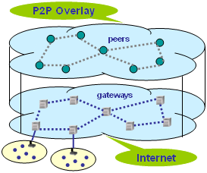
P2P Approach to USN Integration
Adopting P2P techniques, each USN with a gateway act as a peer
The main goal of P2P overlay is to treat the underlying heterogeneous USNs as a single unified network, in which users can send queries without considering the details of the network
User peers communicate with gateway peers in a P2P approach
[Lei Shu, SAINT 2008]

Slide 24
P2P USN Approach
General P2P overlay network for USN Service
  If a P2P peer software is installed in sink nodes, sensor nodes, and users, all USNs can be shared by users and other USNs.
  USN application service is possible without its specific USNs
Service Scenarios
  A peer node (user) can find sensor networks which can provide sensor information it wants.
  A USN can find other USN for collaboration
  A USN can find a peer node (user) which needs its sensory information
Advantages
  Share already deployed sensor networks and need not deploy new sensor networks for specific USN service.
  Exploit various information of USNs
  P2P USN becomes an infrastructure for general service providers.

Slide 25
Sink Node Architecture
Application
Sink
module
1. Service description
P2P Overlay
module
TCP/IP
ZigBee
2. request service
3. Sensing data
4. Clear to service
DB

Slide 26
Sensor P2P Service for Sharing USNs
P2P USN
  finding service providers, service users, corresponding nodes
  forwarding information through multicast tree
P2P USN Service Scenario
  USN’s sink node or a sensor node can be a P2P node and advertize own services / information.
  a P2P node can also advertize services / information it wants.
  a P2P node can find a service / information it wants and ask it to peer node.
  a sink node or sensor node can find a peer node (user or other USN) which wants its service / information and provide that.
(Sensor P2P Layer)
Peer
Node
Overlay Network Layer
(Forwarding)
Overlay
Node
KOREN
Sink
Sensor
Sensor Network

Slide 27
Peer Node’s Architecture
Sharing the stored sensing data
Web Server 등
(Bootstrap node)
USN’s Application
PSN(P2P Sensor Net)
PSN(P2P Sensor Net)
PSN(P2P Sensor Net)
PASTRY
PASTRY
PASTRY
TCP/IP
I/F
sensor
I/F
TCP/IP
I/F
TCP/IP
I/F
sensor
I/F
Zigbee sensors
Zigbee sensors
Monitoring realtime sensed data

Slide 28

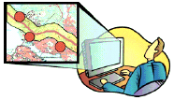

P2P USN Service Scenarios
An Application server finds and gathers information.
Sensor network looks for users, if special events happen
Sensor P2P
Overlay Network
Server
User
Internet
Peer Node
Sensor Network
User
Event
Sensor P2P
Overlay Network
User
Sensor Network
User

Slide 29
WMN

Slide 30
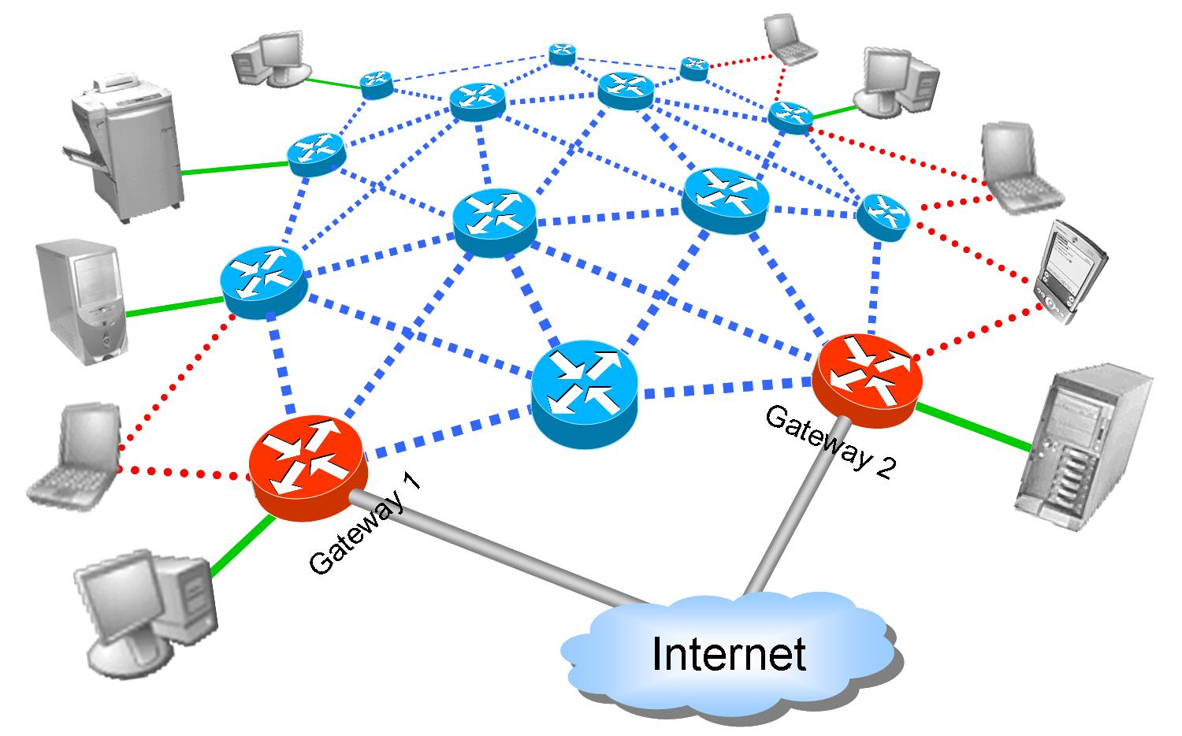
Overview
Node Types
Link Types
Wireless routers
Gateways
Printers, servers
Mobile clients
Stationary clients
Intra-mesh wireless links
Stationary client access
Mobile client access
Internet access links

Slide 31
Mesh vs. Ad-Hoc Networks
Ad-Hoc Networks
Wireless Mesh Networks
Multihop
Nodes are wireless, possibly mobile
May rely on infrastructure
Most traffic is user-to-user
Multihop
Nodes are wireless, some mobile, some fixed
It relies on infrastructure
Most traffic is user-to-gateway

Slide 32
Mesh vs. Sensor Networks
Wireless Sensor Networks
Wireless Mesh Networks
Bandwidth is limited (tens of kbps)
In most applications, fixed nodes
Energy efficiency is an issue
Resource constrained
Most traffic is user-to-gateway
Bandwidth is generous (>1Mbps)
Some nodes mobile, some fixed
Normally not energy limited
Resources are not an issue
Most traffic is user-to-gateway

Slide 33
A NOVEL ARCHITECTURE FOR FUTURE WIRELESS MESH NETWORK
Kejie Lu, Sastri Kota,
Univ of North Texas

Slide 34
Introduction
Challenge
Although Providing Internet access is the main application,
WMN will become a service platform for numerous applications in the Pervasive Computing Age.
- provide sufficient connectivity for a large number of entities
in the network
- support a variety of Quality-of-Service requirements
Proposal
Novel framework to design the future wireless mesh network
- Overlay network architecture that is based on hypernetwork
- Network Coding

Slide 35
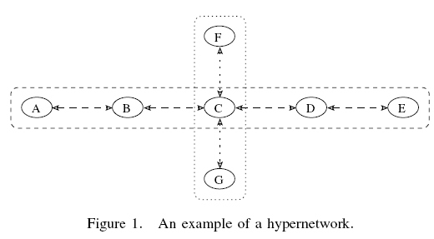
Background and Related works
HYPERGRAPH AND HYPERNETWORKS
Hypergraph H = (V,E)
- a set V = {v1, v2, · · · , vN} of node
- a set E ={e1, e2, · · · , eM} of hyper edges
Within a hyper channel, a predefined schedule in the time domain is used to provide connectivity between two nodes or amongst a group of nodes.

Slide 36
Why Hyperchannel works?

Slide 37
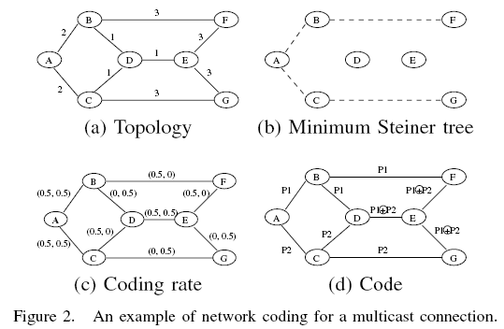
Background and Related works
B. NETWORK CODING
a) Background of Network Coding
yk(t) = ak × xk(t − dk) Input packets
yk(t) = f(xk(t), xk−1(t), · · · , xk−M(t)) Output packets
b) Network Coding for A Single Multicast Connection

Slide 38
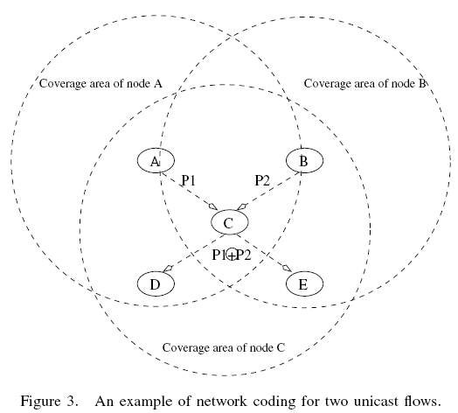
Background and Related works
c) Network Coding for Multiple, Simultaneous, Unicast
Flows

Slide 39
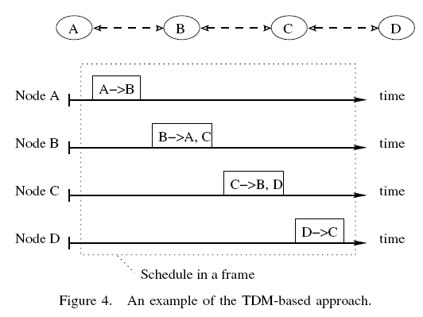
A DESIGN EXAMPLE
A. HYPERGRAPH ESTABLISHMENT
Behaviors of wireless communications
broadcast in nature
The data rate depend on the distance
The interference range is larger than the transmission range
The wireless channels are error-prone

Slide 40
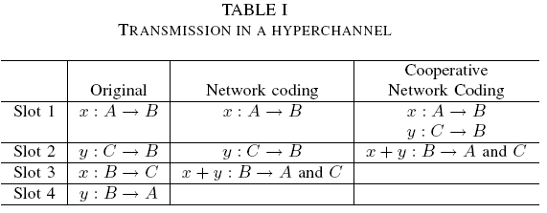
A DESIGN EXAMPLE
B. NETWORK CODING DESIGN
Cooperative network coding, node B does not need to decode the individual message from node A and C

Slide 41
Wireless Access Network
Selection for Live Streaming
Multicast in Future Internet
Jaecheol Kim, Yanghee Choi of SNU, Korea

Slide 42
Introduction
Recently, IP multicast is revisited because many applica -tions are emerging which need the support of multicast. Heterogeneity of radio access networks will be also prevalent in future Internet and almost every mobile host will have multiple radio interfaces, which will pose any challenges on how to select the most appropriate access network in terms of user satisfaction and system resource efficiency.

Slide 43
Proposed Scheme
Our goal is to devise an optimal wireless access network selection scheme for live streaming multicast services to maximize user satisfaction and system profit at the same time.
User satisfactory level is directly impacted by available bandwidth and handoff delay.

Slide 44
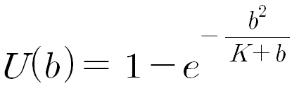
Proposed Scheme
The degree of satisfaction of bandwidth requirement is given by the bandwidth utility function as follows, where K is constant (0.62086) and b is bandwidth.

Slide 45

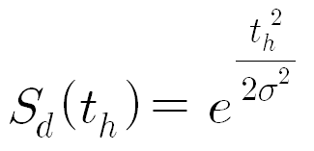
Proposed Scheme
Another factor of user satisfaction is dependent on handoff latency caused by user’s mobility.
Service degradation function is given as follows in equation, where σ is a constant (8.37) that has a larger value for non-real time applications and smaller value for real time applications.

Slide 46



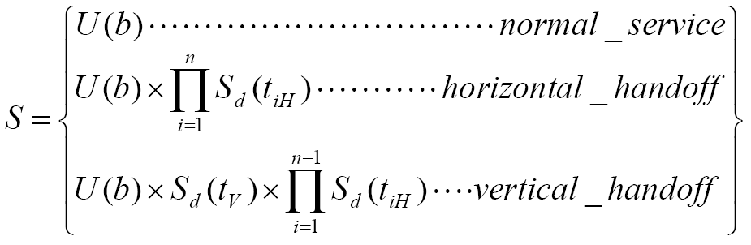
Proposed Scheme
We combine the above two functions into a single value to quantify user satisfaction and we will use this value as the criteria for access network selection. In following equation, tiH is i-th horizontal handoff delay and tV is vertical handoff delay.

Slide 47
Future Internet Access Network Technologies:
Delay Tolerant Network

Slide 48
Motivation
Evolve wireless networks outside the Internet
  Problems with inter-networks having operational and performance characteristics that make conventional networking approaches either unworkable or impractical.
  Accommodate the mobility and limited power if future wireless devices
Examples of wireless networks outside of the Internet:
  Terrestrial civilian networks connecting mobile wireless devices including personal communicators, intelligent highway and remote Earth outposts.
  Wireless military battlefield networks connecting troops, aircraft, satellites and sensors (on land or water)
  Outer-space networks, such as the “Interplanetary communications”.

Slide 49
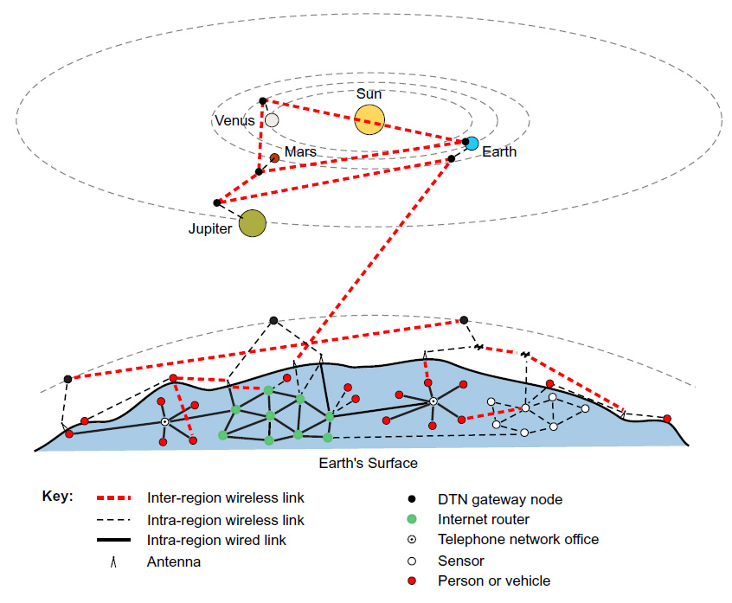
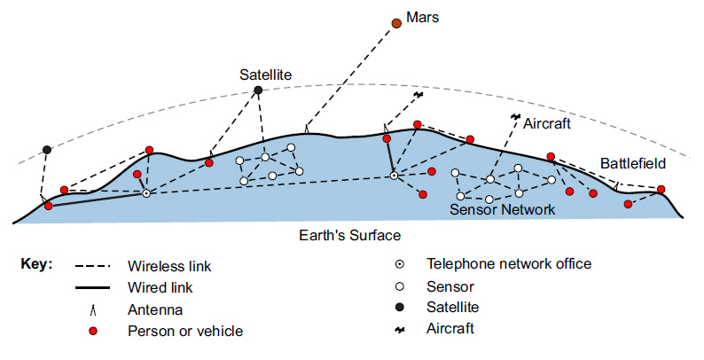
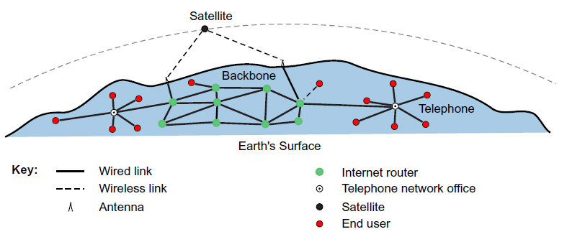
Internet Evolving Concept
Notes:
Today’s Internet: The Internet has been a great success at internet connecting communication devices across the globe. It has done this by using a homogeneous set of communication protocols, called the TCP/IP protocol suite.
Connectivity on the Internet relies primarily on wired links, including the wired telephone network, although new wireless technologies such as short-range mobile and satellite links are beginning to appear. These links are continuously connected in end-to-end, low-delay paths between sources and destinations.
2. Evolving wireless network outside the Internet: Communication outside or the Internet – where power-limited mobile wireless, satellite and interplanetary communications are developing – is accomplished on independent networks, each supporting specialized communication requirements. These networks do not use Internet protocols and they are mutually incompatible – each is good at passing message within its network, but not able to exchange messages between networks.
3. DTN network concept

Slide 50
Why DTNs?
Current Internet was designed for
  Continuous, bidirectional end-to-end path.
  Short round-trips.
  Symmetric data rates.
  Low error rates.
Many evolving and challenged networks do not confirm to the current Internet’s philosophy
  Intermittent connectivity
  Long or variable Delay
  Asymmetric data rates
  High error rates.
Notes:
Intermittent connectivity: If there is no end-to-end path between source and destination – called network partitioning – end-to-end communication using the TCP/IP protocols does not work. Other protocols are required.
Long or variable Delay: In addition to intermittent connectivity, long propagation delays between nodes and variable queuing delays at nodes contribute to end-to-end path delays that can defeat Internet protocols and applications that rely on quick return of acknowledgements or data.
Asymmetric data rates: The Internet supports moderate asymmetries of bidirectional data rate for users with cable TV or asymmetric DSL access. But if asymmetries are large, the defeat conversational protocols.
High error rates: Bit errors on links require correction (which requires more bits and more processing) on retransmission of the entire packet (which results in more network traffic). For a given link-error rate, fewer retransmissions are needed for hop-by-hop than for end-to-end retransmission (linear increase vs. exponential increase, per hop).

Slide 51
DTN Concept
Build upon the extended “bundling” architecture (an end-to-end message-oriented overlay)
  Proposes and alternative to the Internet TCP/IP end-to-end model.
  Employs hop-by-hop storage and retransmission as a transport-layer overlay.
  Provides messaging service interface (similar to electronic mail)
The wireless DTN technologies may be diverse
  E.g.: RF, UWB, free-space optical, acoustic (solar or ultrasonic) technologies …

Slide 52
Current Internet vs. DTN Routing
Notes:
On the Internet, the TCP and IP protocols are used throughout the network. TCP operates at the end points of a path, where it manages reliable end-to-end delivery of message segments. IP operates at all nodes on the path, where it routes message datagrams. Internet routers do not require a transport layer for routing, but they implement transport and application layers (not shown) for routing-table maintenance and other management purposes.
In a DTN, the protocol stacks of all nodes include both bundle and transport layers. DTN gateways have the same double-stack layers as DTN routers, but gateways can run different lower-layer protocols (below the bundle layer) on each side of their bundle stack. This allows gateways to span two regions that use different lower-layer protocols.

Slide 53
Types of DTN contacts
Persistent contacts
Notes:
Classical wire connected

Slide 54
Types of DTN contacts
Persistent contacts
On-demand contacts

Slide 55
Types of DTN contacts
Persistent contacts
On-demand contacts
Intermittent –
scheduled contacts
(predicted contact)
Notes:
In space, almost everything is in motion and speed-of-light delays are significant (tens of minutes within our solar system). If potentially commutating nodes move along predictable paths, they can predict or receive time schedules of their future positions and thereby arrange their future communication sessions.
Scheduled contacts may involve message-sending between nodes that are not in direct contact, as shown in the figure below. They may also involve storing information until in can be forwarded, or until the receiving application can catch up with senders’ data rate.
Scheduled contacts require time-synchronization throughout the DTN.

Slide 56
Types of DTN contacts
Persistent contacts
On-demand contacts
Intermittent –
scheduled contacts
(predicted contact)
Intermittent – opportunistic contacts
Notes:
Network nodes may need to communicate during opportunistic contacts, in which a sender and receiver make contact at an unscheduled time. Moving people, vehicles, aircraft, or satellites may make contact and exchange information when they happened to be within line-of-sight and close enough to communicate using their available (often limited) power.
All of us use opportunistic contacts for communication: when we happen, by chance, to meet certain people whom we wish to talk. This same model can apply to electronic communication. For example, wireless PDAs can designed and programmed to send or receive information when certain people carrying PDAs come within communication range, or when a PDA is carried past a certain type if information kiosk

Slide 57
Discussions

