Slide 1
Routing in Future Internet
2008. 10
Deokjai Choi

Slide 2
Outline
What is Routing?
Why Future Internet?
Routing Problems for FI
Proposed Solution

Slide 3
What is Routing?
Routing : Routing refers to the process of choosing a path over which to send packets.(source to destination)
desirable properties: correctness, simplicity, robustness, stability, fairness, optimality
what optimize?
  Mean packet delay
  network throughput

Slide 4
Routing
How to construct routing tables
Routing - Determine end-to-end paths
Forwarding - Transmit packets according to routing table

Slide 5
Routing
Network layer supports routing over internet consists of multiple physical networks
  Form a logical network
  Router (IS)
  If possible, a packet should be routed over the shortest path between source & destination

Slide 6
IP Routing
c
a
B
E
C
F
b
A
D
d
Each host has a simple forwarding table
Router has a larger forwarding table
Case 1: Host a --> Host b
Host a should know that host b is in the same physical network
How?
Case 2: Host a --> Host c
Host a relay datagram to router A or B
IP only routes the datagram to router E or F

Slide 7
Routing
A
6
1
F
3
1
E
2
B
4
1
C
9
D
Problem: Find the lowest cost path between any two nodes
Under dynamic network changes

Slide 8
Why Future Internet?
2000s Internet becoming
Social Infrastructure
Problems

Slide 9
2000s Internet becoming
Social Infrastructure
Internet population: one billion
Broadband Internet
Wireless and Mobile Internet
Personal Website
Convergence (Internet, Telephone, Television, Movie,…)
Negative Side Effects (spam, virus, privacy,...)
Northeast Asia as one of leading Internet regions

Slide 10
Internet Population (in million)
Asia 437 36.9%
Europe 322 27.2%
Canada & USA 233 18.9%
Latin America 110 9.3%
Africa 34 3.5%
Middle East 20 2.7%
Oceania 19 1.5%
Total 1,244
(2007, www.internetworldstats.com )

Slide 11
Wireless / Mobile Internet
Internet with Computer : 500 millions
Internet with Mobile Phone: 400 millions
Remark : Mobile phones : 2.5 billions
Internet Users : 1 billion
Remark : In 2010~2020, 80% of the
Internet usage are mobile.

Slide 12
Negative Side Effects/Social Issues
Virus
Spam
Privacy
Intellectual Property

Slide 13
Future Internet (~2020)
Current Status
Internet was created for research community(~1970s).
One billion people are using the Internet now.
- One trillion machines are expected in future.
- Five billion users needs to be connected.
Toward critical/social infrastructure
- Water
- Electricity
- Road
- Internet / Phone / Television

Slide 14
Problems
Scalability (Users, Bandwidth)
Security / Trust
Mobile / Wireless
Management
(Semantic Overhead on IP)
(Engineering)
“The Other Billions”

Slide 15
What will be happening in 10 years
New network technology.
  Wireless
    Mobility
    Dynamic capacity allocation
    Dynamic impairments
  Advanced optics
    Dynamic capacity allocation (again!)
New computing paradigms
  Embedded processor, sensors, everywhere
Whatever computing is, that is what the Internet should support.
  The Internet grew up in a stable “PC” time.

Slide 16
Problem Statement (1/4)
1. Basic Problems
1.1. Routing Failures and scalability
  The problems have been examined as being caused by mobility,
  multi-homing, renumbering, PI routing, IPv6 impact, etc. on the
  current Internet architecture.
1.2. Insecurity
  As current communication is not trusted, problems are self-evident,
  such as the plague of security breaches, spread of worms, and denial
  of service attacks.
1.3. Mobility
  Current IP technologies was designed for hosts in fixed locations, and
  ill-suited to support mobile hosts.
  Mobile IP was designed to support host mobility, but Mobile IP has
problems on update latency, signaling overhead, location
privacy, etc.

Slide 17
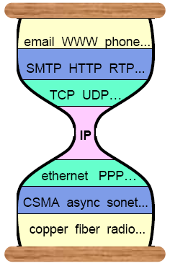
Problem Statement (2/4)
1. Basic Problems
1.4. Quality of Service
  Internet architecture is not enough to support quality of service from
  user or application perspective.
  It is still unclear how and where to integrate different levels of quality
  of service in the architecture.
1.5. Heterogeneous Physical Layers and Applications
  Recently, IP architecture is known as a “narrow waist or thin waist”.
  Physical Layers and Applications heterogeneity poses tremendous
  challenges for network architecture, resource allocation, reliable
  transport, context-awareness, re-configurability, and security.
1.6. Network Management
  The original Internet lacks in management plane.
Narrow Waist for
Internet Hourglass
(Common Layer = IP)
Source : Steve Deering,
IPv6 :addressing the future

Slide 18
Problem Statement (3/4)
1. Basic Problems
1.7. Congestive Collapse
  Current TCP is showing its limits in insufficient dynamic range to handle
  high-speed wide-area networks, poor performance over links with
  unpredictable characteristics, such as some forms of wireless link, poor
  latency characteristics for competing real-time flows, etc.
1.8 Opportunistic and Fast Long-Distance Networks
  Original Internet was designed to support always-on connectivity, short
  delay, symmetric data rate and low error rate communications, but
  many evolving and challenged networks do not confirm to this design
  philosophy.
  E.g., Intermittent connectivity, long or variable delay, asymmetric data
rates, high error rates, fast long-distance communications, etc.
1.9. Economy and Policy
  The current Internet lacks explicit economic primitives.
  There is a question of how network provider and ISP continue to make
  profit.

Slide 19
Problem Statement (4/4)
2. Problems with Original Design Principles
2.1. Packet Switching
  Packet switching is known to be inappropriate for the core of
  networks and high capacity switching techniques (e.g., Terabit).
2.2. Models of the End-to-End Principle
  The Models of the end-to-end principle have been progressively
  eroded, most notably by the use of NATs, which modify addresses,
  and firewalls and other middle boxes
  End hosts are often not able to connect even when security policies
  would otherwise allow such connections.
  2.3. Layering
  Layering was one of important characteristics of current IP
  technologies, but at this phase, it has inevitable inefficiencies.
  One of challenging issues is how to support fast mobility in
  heterogeneous layered architecture.

Slide 20
Routing Problems for FI
Scaling Problem
  IPv4 growth explosively
  PI desire from users: destroys topology based address aggregation
  Sub-prefix announcing for TE: more than one prefix announcements for one CN.
  Widespread of multihoming: destroys topology based address aggregation
Usage Pattern change: Host Oriented -> Data (content) oriented
  동광
Other Approaches
  User Empowerments
  박사학위

Slide 21
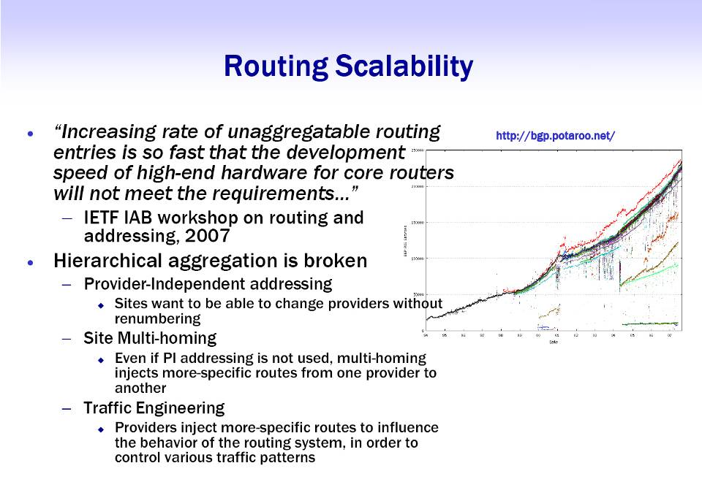

Slide 22
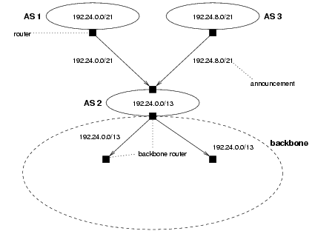
Prefix Aggregation

Slide 23
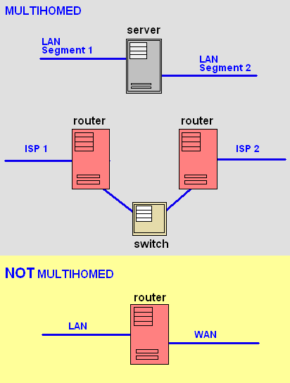
Multihoming

Slide 24
Proposed Solutions
Scaling Problem
  Separation address space: GRA for ISP and GDA for end networks
Usage Pattern Change

Slide 25
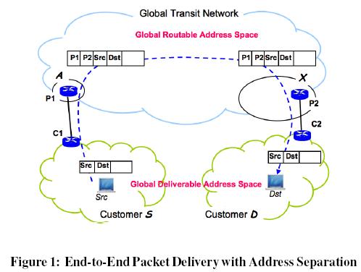
The Separation of two address classes
“Addressing can follow topology or topology can follow addressing.”
- Address prefixes in the routing system should be topologically
aggregatable, and aggregated when necessary to keep the
table size under control.
- this desire of prefix aggregation runs into direct conflict with
supporting end-site multihoming in the current routing system
architecture.
IP address space – globally routable addresses(GRA) and globally deliverable addresses(GDA)
Notes:
The global routing system runs on the GRA address space.
That is, the Internet service providers (ISPs) will all be assigned address blocks from the GRA address space, hence any ISP can reach the prefixes of any other ISPs
All the end-sites will be assigned addresses from globally deliverable addresses (GDA). These addresses are globally unique, so that each end-site can be uniquely identified by its GDA prefixes, and each end host can be reached by its GDA address(es).
Figure1 illustrates how packets between two end hosts are forwarded over the GRA space. When a packet from Src to Dst reaches the edge router P1 of the source ISP, the router P1 will consult the mapping function and find the GRA address corresponding to the destination ISP’s router P2 that is connected to the destination
end-site. P1 then encapsulates the packet, with its own address as the source and P2’s address as the destination in the tunnel header, and send the packet out. When the packet reaches P2, it is de-capsulated, forwarded to the end-site, and further forwarded to the destination host based on the GDA destination address of the packet.

Slide 26
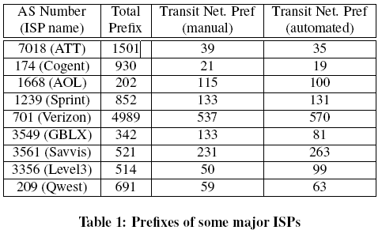
Benefits from the separation
Routing Scalability and Stability
Because of the separation of GDA from GRA, routing dynamics
occurring inside end-sites or at the border (between end-sites and
PNs) will no longer have an impact on the routing stability inside
GTN.
since the number of prefixes in the GTN is expected to
be much smaller than the number of the prefixes in the routing system
today, routing convergence would be substantially faster than
that of today’s BGP.
Notes:
Transit Network 이란 어떤 경로로 가는 중에 경유(통과)되는 네트워크를 말한다. 통상 공유된 매체를 통해 라우터가 2대 이상 연결되어 있는 형상을 갖는다.
A transit network is a network that bridges a connection between two other networks, as well as passes traffic for its own network.
These results show that, if the GRA-GDA separation is applied to today’s Internet, both the size of the routing table and the amount of routing churns can be reduced to one order of magnitude smaller than what we have today.
the difference between the manual match and automated match is very small in all but one cases. Thus, we applied the automated matching to all the transit networks and their prefixes. The results show that, out of 209,549 prefixes in the global routing table, only 22,733, about 11%, belong to transit networks (although more were originated by them). Next we count the number of updates for transit network prefixes and end-site prefixes respectively during the month of August 2006. Out of 367 million updates from all the RouteViews monitors, only 57 million updates (15%) are for
transit network prefixes.

Slide 27
Benefits from the separation
Site Multihoming and Traffic Engineering
Once we separate end-sites to a separate address space (GDA),
naturally the entire GDA address space becomes provider-independent.
customers may also want to fully utilize the parallel connectivities provided by multihoming.
Since the address space separation between GDA and GRA introduces the need for a mapping function, we can utilize this mapping function for effective traffic engineering support.
customers can inject into the mapping record additional policy information to facilitate the selection of provider address among multiple alternatives

Slide 28
Benefits from the separation
Security Enhancement
Because our design puts all end hosts in an address space separate
from that of backbone routers, all user data packets are encapsulated
when they cross the backbone.
Compromised hosts in the customer space no longer have direct access to the provider infrastructure.
The encapsulation of end-user packets also makes it easy to trace
attack packets back to the GTN ingress router even if they have
spoofed source addresses, since the encapsulation header records
the addresses of the GTN entry and exit routers.

Slide 29
Challenges
how to design scalable, secure and efficient mapping function, how to handle the failures between GRA and GDA, and how to conduct network measurement on the Internet backbone after the GRA and GDA separation.
The Mapping Function
given a destination customer address, it should return a destination provider address so that the packet can be encapsulated and forwarded across the Internet.
• Fast lookup: packets cannot be forwarded until the mapping is completed, so a fast lookup service is essential for good performance.
• Fast failure recovery: mapping entries should adapt quickly with changes.
• Resilience to abuses and attacks: mapping service can be a potential target for attacks. Updates to the mapping service or query replies from mapping service must be authenticated.

Slide 30
Challenges
Handling Border Link Failures
Our proposed solution separate GRA and GDA address space,
so that only topological changes in the GRA space, i.e. inside the
global backbone, are handled by the global routing protocols.
However, a link between an end-site D and its provider P is not part of
the GRA routing space.
Thus when this link, or D’s router at theother side of the link, fails, no routing update would be generated in the global routing system.
This can be viewed as an advantage as it provides the insulation of edge dynamics from the global routing system.
At the same time this also introduces a challenge in assuring packet delivery, if the mapping function only reflects which providers connects to, but not whether the connectivity is up on a real time basis.
Notes:
ICMP: 인터넷 게이트웨이 사이에서 메시지를 제어하고 에러를 알려주는 프로토콜
The Internet Control Message Protocol (ICMP) is one of the core protocols of the Internet Protocol Suite. It is chiefly used by networked computers' operating systems to send error messages—indicating, for instance, that a requested service is not available or that a host or router could not be reached.

Slide 31
Challenges
Network Diagnosis
the separation of GRA and GDA address space effectively presents end users a black box, which connects up all user networks but does not offer user networks any visibility or influence over the internal paths being used inside the transit backbone.
end users can still measure the external behavior of this
black box, detect any problems that affect their data delivery, and
move traffic between different access ISPs.
Open research question
whether the tunneling mechanism used to cross the transit
backbone should hide all the information about the backbone,
or should reveal limited information

Slide 32
Proposed Solutions
Scaling Problem
  Separation address space: GRA for ISP and GDA for end networks
Usage Pattern Change
  Host Centric to Data (Service, Content) Oriented

Slide 33
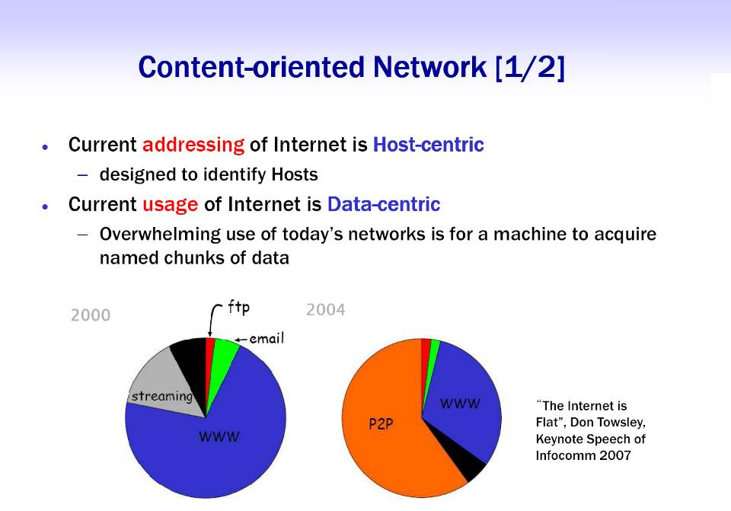

Slide 34
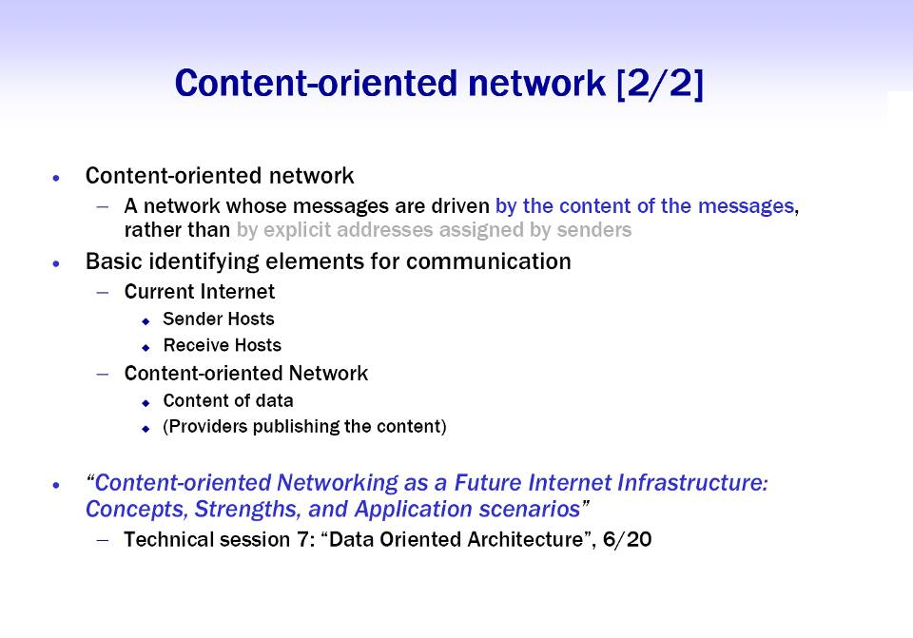

Slide 35
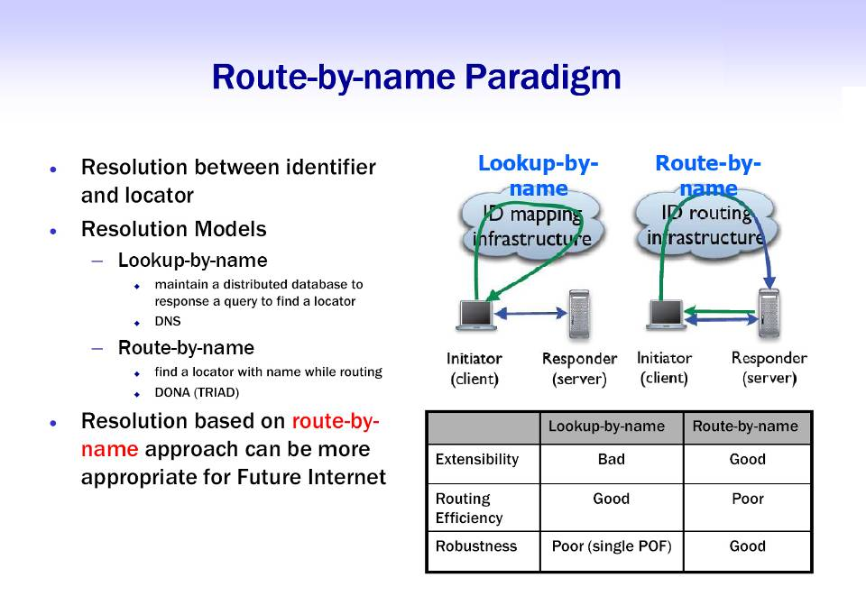

Slide 36
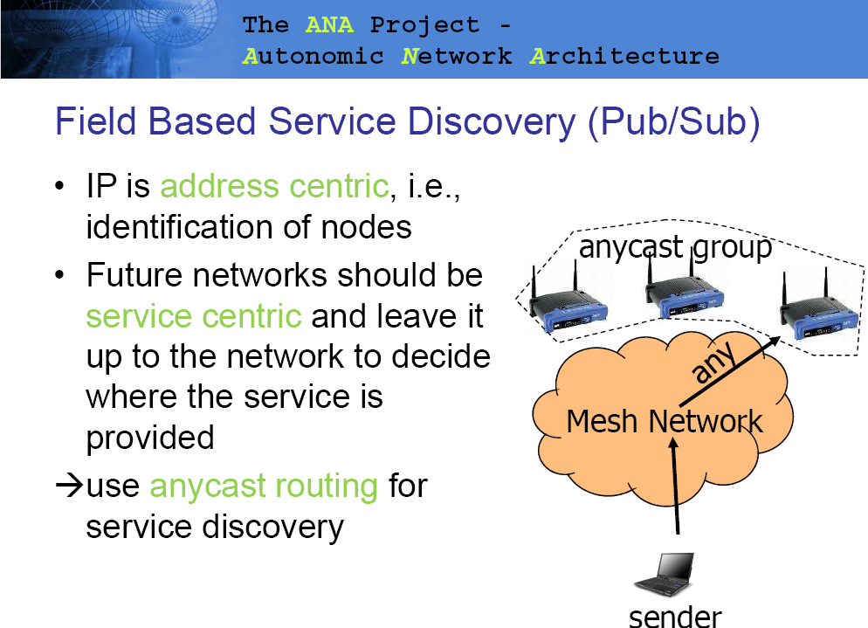

Slide 37
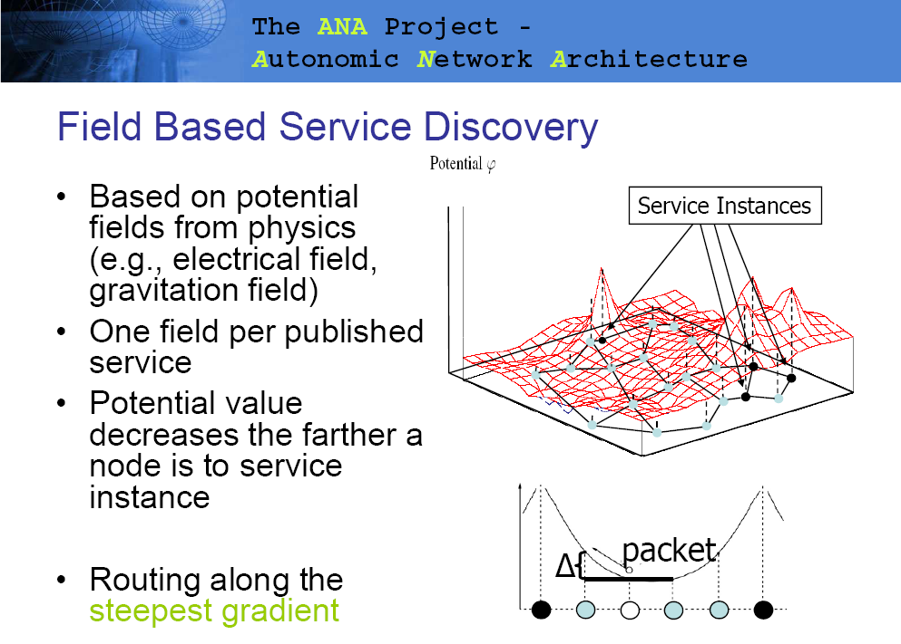

Slide 38
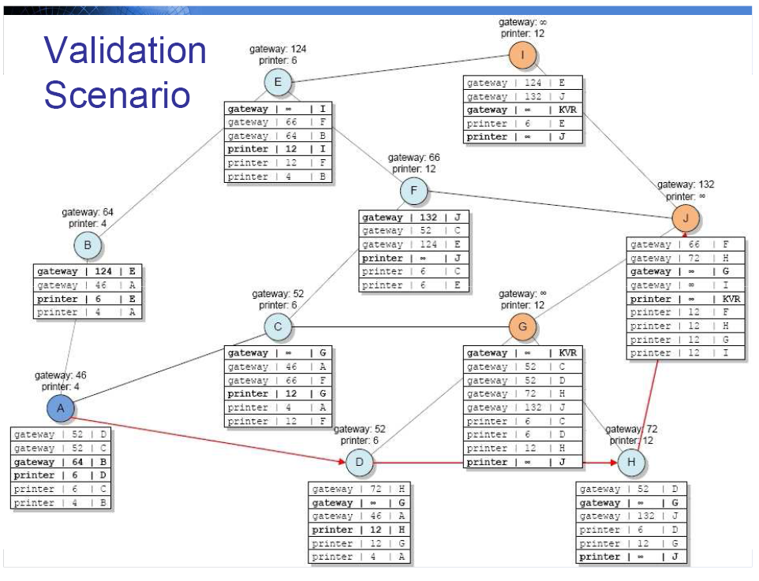

Slide 39
Proposed Solutions
Scaling Problem
  Separation address space: GRA for ISP and GDA for end networks
Usage Pattern Change
  Host Centric to Data (Service, Content) Oriented
Other Approaches
  User Empowerment
  Routing Management System

Slide 40
We Want to Let Users Choose Domain-Level Routes
AT&T
UUNET
Our hypothesis:
  User choice stimulates competition.
  Competition fosters innovation.
Validation requires market deployment.
NIRA: the technical foundation.
Local ISP

Slide 41
Central Ideas of NIRA
Built on earlier ideas of explicit routing, up/down routing.
Defines efficient representation of explicit route for common case.
  Assuming today's generally tree-shaped inter-domain topology, with providers and customers
  "Core" in the center.
Strict provider-rooted hierarchical addressing

Slide 42
System Components of NIRA
Addressing
Route discovery
  Topology Information Propagation Protocol (TIPP)
  A user learns his addresses and topology information (static) and perhaps route availability (dynamic)
Name-to-Route mapping
  Name-to-Route Lookup Service (NRLS) – an enhanced DNS service
  A user learns destination’s addresses and optional topology information.
  Combining information from TIPP and NRLS, a user is able to select an initial route.

Slide 43
Routing Mgmt System
Introduction
Why we need Manageability in RS?
  Manageability Challenges
  Key Tenets of Manageability
A Strawman Proposal for an Architectural Framework

Slide 44
Introduction
Current Internet successful “hourglass” design choice
Distributed routing decision making process

Slide 45
Introduction
Recently, the old structure has some problems:
  More advanced services are being deployed
  Best-effort service may not sufficient for real-time apps.
  Distributed decision making process → difficult to detect, pinpoint and fixing routing problems.
  …
More centralized solution are being advocated

Slide 46
Introduction
In this work, we will:
  Develop a generic framework for specifying details that should be present in design of any management solution for routing systems (RS).
  Center around a number of specific problems associated with both existing and new routing systems.
  Our proposed framework will be refined and validated using the GENI facilities.

Slide 47
Why we need Manageability in RS?
Manageability features:
  Configuration
  Benchmark and Trending
  Problem Detection
  Analysis and Diagnosis
Our goal: how manageability can be successfully incorporated into RSs
Most important features

Slide 48
Why we need Manageability in RS?
We focus on two critical dimensions:
  Horizontal: understanding how distributing the decision process that controls routing decisions affects its manageability.
  Vertical: keep in mind that RSs do not operate in isolation (but depends on multiple components or layers)

Slide 49
Key Tenets of Manageability
Visibility
  Ability to obtain information about routing state and knowledge of the routing decision making processes.
Reasonability
  Ability to analyze and reason about routing behaviors based on collected routing state information.
Actionability
  Ability to identify necessary changes in routing configuration, resources and operations.

Slide 50
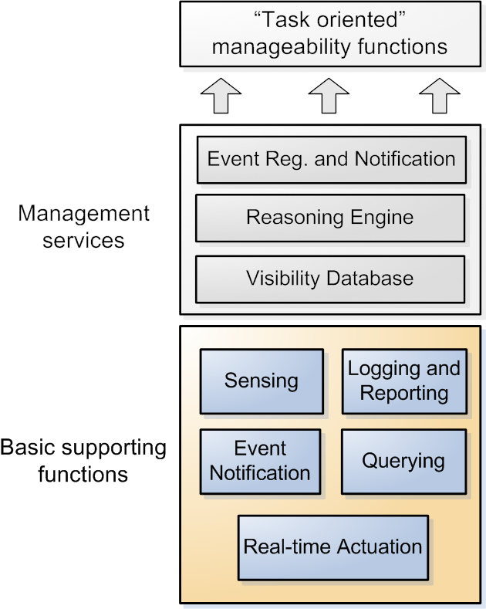
Proposal for an Architectural Framework
Sensing: Monitor & detect changes in the network state
Logging and Reporting: locally collect and record visibility information
Event Notification: receiving report/notification regarding certain changes in network state
Querying: Query a routing element for its information
Real-time Actuation: Allow other entities to ask a routing element to execute certain actions

Slide 51
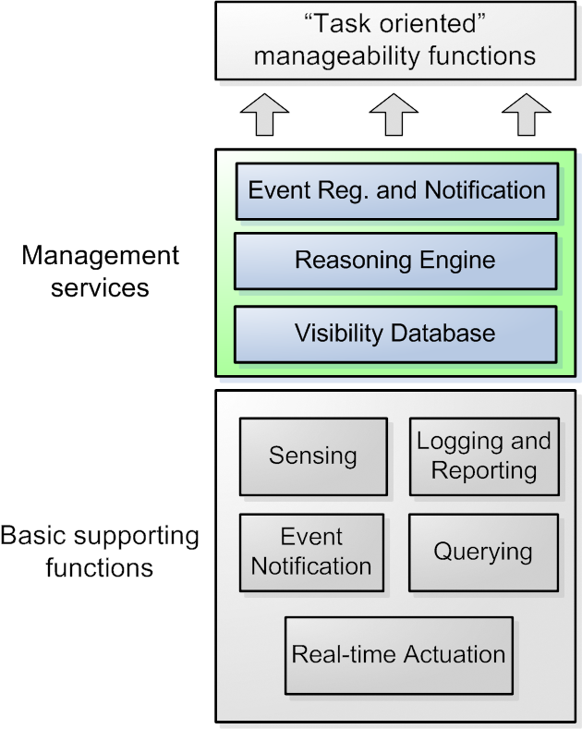
Proposal for an Architectural Framework
Visibility Database:
  Centralized repository for storing data collected from routing elements
Reasoning Engine:
  Consist of a set of tools and algorithms for analyzing network data and performing management functions
Event Registration and Notification:
  Provides network-wide service for entities and users to register and be notified of events of interest.

Slide 52
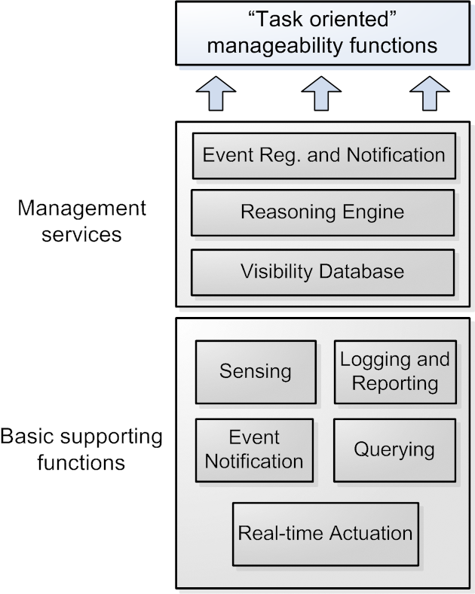
Proposal for an Architectural Framework
“Task oriented” network-wide manageability support functions (within single network domain or across network domains)

Slide 53
Research Problems and Approaches
Modeling Routing Systems as Rule Systems
Manageable Distributed Computation Based Routing Protocol
Building Domain-Wide Integrated Management Systems
Building Network-Wide Management Services

Slide 54
References
A Framework for manageability in Future Routing System.pdf by Lixin Gao of Univ. of Mass
Daniel Massey, A scalable routing system design for FI, IPv6’07, August 31, 2007, Kyoto, Japan.
Jaeyoung Choi, Addressing in Future Internet: Problems, Issues, and Approaches
Theus Hossmann, Implementing the Future Internet: A Case Study of Service Discovery using Pub/Sub in the ANA Framework
Routing in a FI Architecture by Bob Braden, USC/ISI
The Role of IP Address in the Internet Architecture by Lixia Zhang, UCLA at Asia Future Internet Summer School August 2008

