Slide 1
SNMP over IPv6
ID: 2008310105
Name: Sunmin Hwang

Slide 2
SNMP over IPv6
Net-snmp-5.0.3
Structure of MIB
traditional MIB | Combined MIB
tcpConnTable+ipv6.. | tcpConnTable
ipv4StateTable+ipv6.. | ipStateTable
ipv4UdpTable+ipv6.. | ipUdpTable
.. | ..

Slide 3
IPv6 over IEEE 802.15.4 (USN environment)
Storage limitation (ipv4 : 32bit, ipv6 : 128bit)
Small routing tables
Periodic sleep aware management
Compressed addresses (Low bandwidth < 300kbps)
Low network overhead
IP network interaction (Seamless IP routing, Compatible with SNMP, etc)

Slide 4
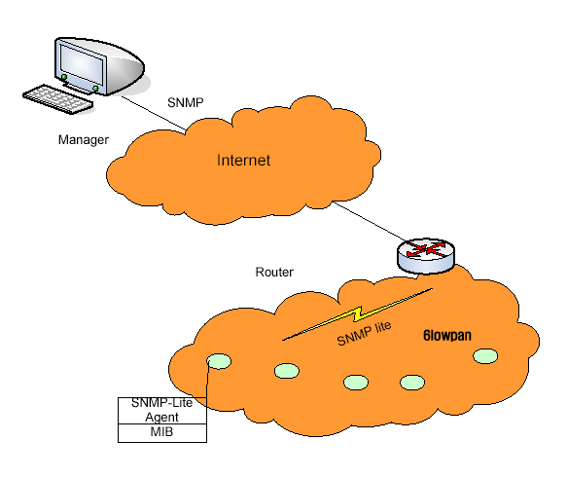
System Architecture

Slide 5
Future work
How to minimize MIB (management information base)
How to reduce the transaction of the network
Make the algorithm that effectively manage the sensor network

