Slide 1
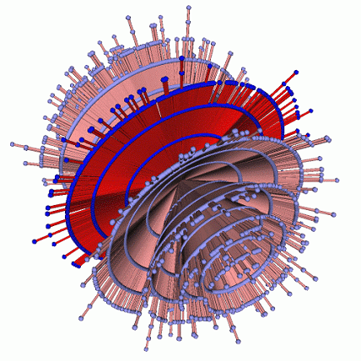
Future Internet
Problem of current Internet
Prof : Choong Seon Hong
ID: 2008310464
Han Seungmin(한승민)

Slide 2
Problem of Current Internet
QoS (how to improve QoS?)
Guarantee Service.
Communicate each devices.
Slow bandwidth
VOD
More user
More Bandwidth
Traffic control
Support Heteroginios Devices

Slide 3
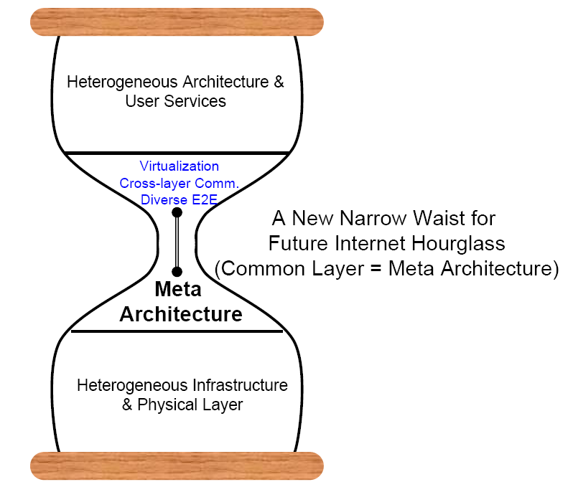
Proposal
Cloud Computing
Semantic Web Layer

Slide 4
Proposal
Internet Access Device
Service Terminal
Access and Authorization Control
Control Interface
Data Interface
Analysis Interface
Semantic validated code
User validated code
Legacy code
Acquisition
Data Management
Transparent DB and Flat File Access Protocols
Data
Data
Meta Data
Meta Data
Analysis interface

Slide 5
Proposal
Utilizing online Web communities as sources of internet resources
High Language -> A.I
Legacy Code
New Commercial Market restoration
Open data structure for outline of user participation
Enable more complex QoS processing

Slide 6
References
1. Guy, M. Jacovi, E. Shahar S. Farrell et al. Harvesting with SONAR- The Value of Aggregating Social Network Information. ACM CHI 2008, April 5-10, 2008, Florence, Italy
2. Zhang, M. S. Ackerman and L. Adamic. Expertise Networks in online Communities: Structure and Algorithms. WWW 2007, May 8-12, Banff, Alberta, Canada
3. Zhang and M. S. Ackerman. Searching For Expertise in Social Networks: A simulation of Potential Strategies. ACM GROUP’05, Nov, 2005, USA
4. Fu, R. Xiang, Y. Liu, M. Zhang and S. Ma. Finding Experts Using Social Network Analysis. IEEE/WIC/ACM Intl. Conf .on Web Intellligence, 2007
5. Scholze, G. Haya, J. Vigen, and P. Prazak. Project GRACE: a grid based search tool for the global digital library. In 7th international conference on electronic theses and dissertations. Lexington, KY, 2004
6. B. Cambazoglu, E. Karaca, T. Kucukyilmaz, A. Turk and C. Aykanat. Architecture of a Grid Enabled Web Search Engine. Journal of Information Processing and Management 43 (2007) 609-623, Elsevier

Slide 7
Q&A
Thank you

