Slide 1
Chapter 28 ICMPv6

Slide 2
28.1 Introduction
This new version, Internet Control Message Protocol version 6 ( ICMPv6 ), follows the same strategy and purposes of version 4
ICMPv6, however, is more complicated than ICMPv4
Some protocols that were independent in version 4 are now part of ICMPv6
Some new messages have been added to make it more useful

Slide 3
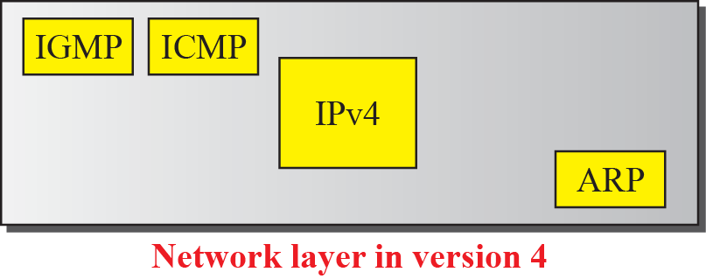
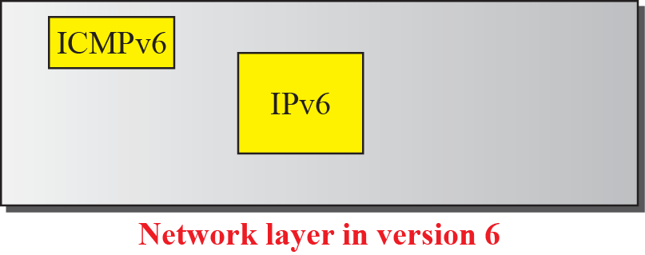
Introduction (cont’)
Comparison of network layers in version 4 and version 6
Taxonomy of ICMPv6 messages

Slide 4
28.2 Error Messages
One of the main responsibilities of ICMP is to report errors
Four types of errors are handled
Destination unreachable
Packet too big
Time exceeded
Parameter problems

Slide 5
Error Messages (cont’)
Destination unreachable message
Code 0 : No path to destination
Code 1 : Communication is prohibited
Code 2 : Beyond the scope of source address
Code 3 : Destination address is unreachable
Code 4 : Port unreachable
Code 5 : Source address failed (filtering policy)
Code 6 : Reject route to destination

Slide 6
Error Messages (cont’)
Packet-too-big message
If a router receives a datagram that is larger than the maximum transmission unit (MTU) size of the network through which the datagram should pass.
Discarding the datagram
Then, sending an ICMP error packet to the source
MTU field : informing the sender of the maximum size packet accepted by the network

Slide 7
Error Messages (cont’)
Time-exceeded message

Slide 8
Error Messages (cont’)
Parameter-problem message
Offset pointer : 4 bytes
Code fields
Code 0 : Erroneous header field
Code 1 : Unrecognized next header type
Code 2 : Unrecognized IPv6 option

Slide 9
28.3 Informational Messages
Two of the ICMPv6 messages can be categorized as informational messages
Echo request and echo reply messages
A host or router can send an echo request message to another host; the receiving computer or router can reply using the echo response message

Slide 10
Informational Messages (cont’)
Echo-request message
Echo-reply message

Slide 11
28.4 Neighbor-Discovery Message
Several messages in the ICMPv4 have been redefined in ICMPv6 to handle the issue of neighbor discovery
The most important issue is the definition of two new protocols that clearly define the functionality of these group messages
Neighbor-Discovery (ND) protocol
Inverse-Neighbor-Discovery (IND) protocol

Slide 12
Neighbor-Discovery Message (cont’)
Router Solicitation and Advertisement
An option is added to allow the host to announce its physical address to make it easier for the router to respond.
Router-solicitation message
Router-advertisement message

Slide 13
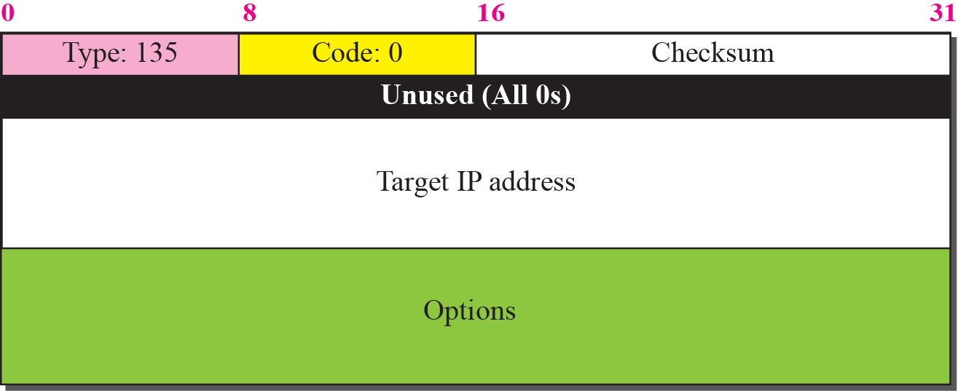
Neighbor-Discovery Message (cont’)
Neighbor-solicitation message

Slide 14
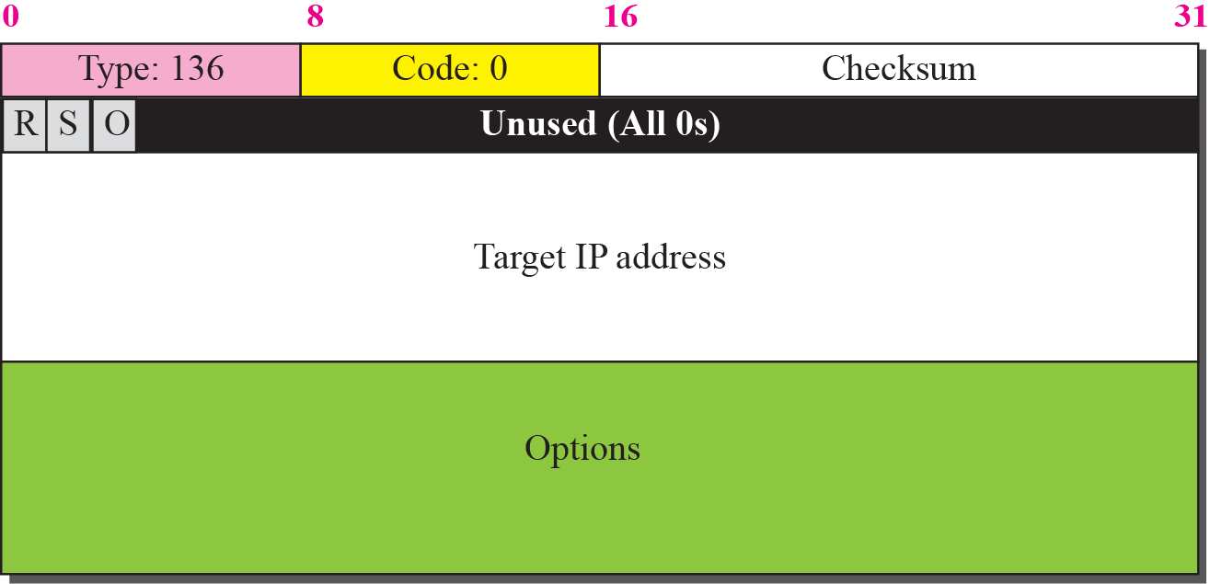
Neighbor-Discovery Message (cont’)
Neighbor advertisement message

Slide 15
Neighbor-Discovery Message (cont’)
Redirection message
An option is added to let the host know the physical address of the target router

Slide 16
Neighbor-Discovery Message (cont’)
Inverse-neighbor-solicitation message
Inverse-neighbor-advertisement message

Slide 17
28.5 Group Membership Message
The management of multicast delivery handling in IPv4 is given to the IGMPv3 protocol
In IPv6, this responsibility is given to the Multicast Listener Delivery protocol
MLDv1 is the counterpart to IGMPv2; MLDv2 is the counterpart to IGMPv3
The idea is the same as in IGMPv3, but the sizes and formats of the messages have been changed to fit the larger multicast address size in IPv6.

Slide 18
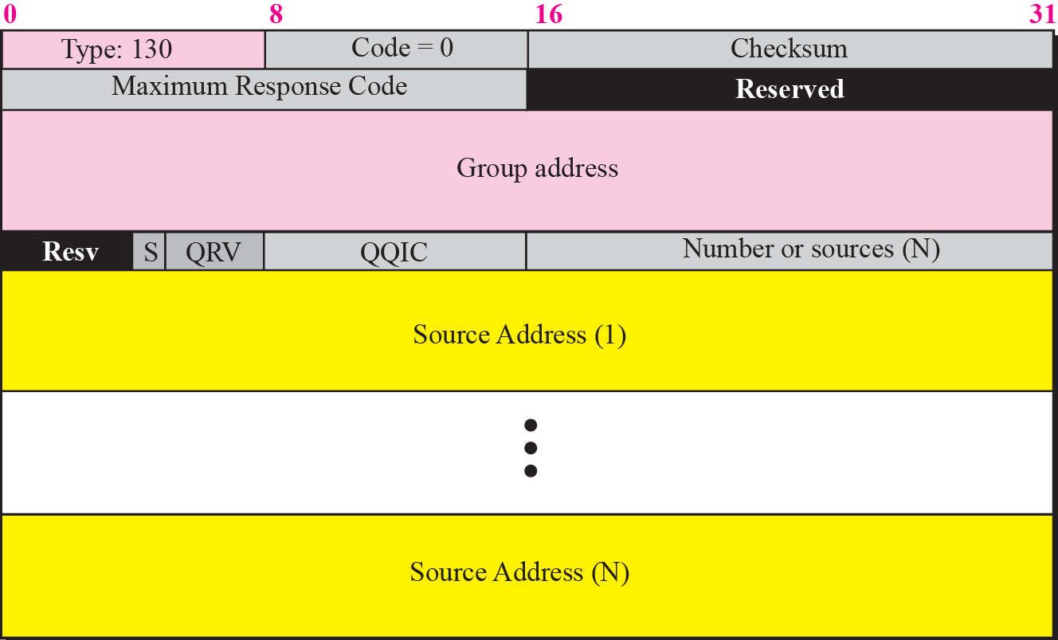
Group Membership Message (cont’)
Membership query message format

Slide 19
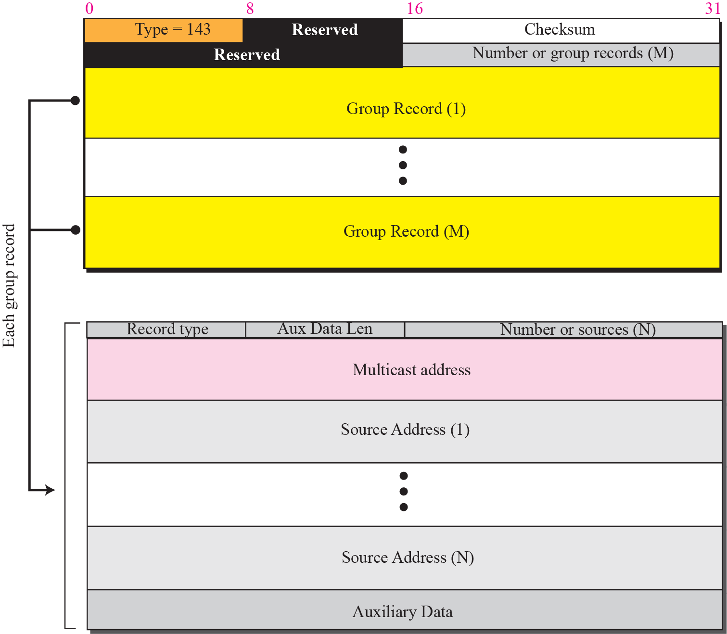
Group Membership Message (cont’)
Membership-report message format

Slide 20
Summary
ICMPv6, like ICMPv4, is message-oriented; it uses messages to report errors, to get information, probe a neighbor, or manage multicast communication. However, a few other protocol are added to ICMPv6 to define the functionality and interpretation of the message.
We have divided all messages in the ICMPv6 into four categories: error messages, informational messages, neighbor-discovery messages, and group-membership messages.
Four types of error messages have been discussed: destination-unreachable, packet-too-big, time-exceed, and parameter-problem.

Slide 21
Summary
Two type of informational messages have been discussed : echo-request and echo-response.
We discussed seven neighbor-discovery messages. The first five, router-solicitation, router-advertisement, neighbor-solicitation, neighbor-advertisement, and redirect are under the control of the ND protocol. The last two message, inverse-neighbor-solicitation and inverse-neighbor-advertisement are under the control of the IND protocol.
We discussed two group management messages : membership-query and membership-report. They are under the control of MDLv2 protocol

