Slide 1
NGN –Lecture 2:
Introduction to
Wireless Sensor Network

Slide 2
Service Trend
Digital / IT
Convergence
Ubiquitous
Computing
Ubiquitous
Intelligence
Functional Add-on
Adapt Human
to the Computer
Digitalization
of real world
Adapt the Computer
to Human
Goal-oriented
autonomic fusion
service
Adapt the Computer
to Human’s Intent

Slide 3
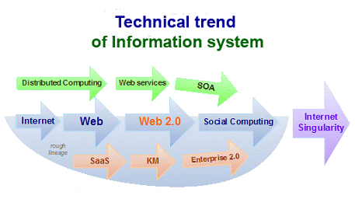
Technical Trend
Notes:
3

Slide 4
Design Consideration
Filtering, Cleaning,
Alerts
Monitoring,
Time-series
Data Mining
(recent history)
Archiving (provenance
and schema evolution)
local
Geographic Scope
global
Several Readers
Regional Centers
Central Office

Slide 5
Design Consideration
Filtering, Cleaning,
Alerts
Monitoring,
Time-series
Data Mining
(recent history)
Archiving (provenance
and schema evolution)
seconds
Time Scale
years
On-the-fly processing
Disk-based processing

Slide 6
Design Consideration
Filtering, Cleaning,
Alerts
Monitoring,
Time-series
Data Mining
(recent history)
Archiving (provenance
and schema evolution)
Degree of Detail
Aggregate Data Volume
Dup Eliminate
history: hrs
Interesting Events
history: days
Trends/Archive
history: years

Slide 7









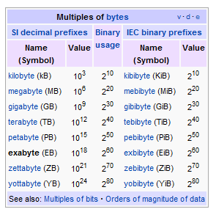
Business Consideration
Traditional
Business
Internet
e-Business
Real Time
Business
Weeks/days
Megabytes
Batch Process
Few People
Back Office
Hours/Minutes
Terabytes
Human Driven
Many People
Front Office
(Sub)seconds
Exabytes
Event Driven
Automated
Assets

Slide 8
Research challenges
Real-time analysis for rapid response.
Massive amount of data → Smart, efficient, innovative data management and analysis tools.
Poor signal-to-noise ratio due to traffic, construction, explosions, ….
Insufficient data for large earthquakes → Structure response must be extrapolated from small and moderate-size earthquakes, and force-vibration testing.
First steps
  Monitor building motion
  Develop algorithm for network to recognize significant seismic events using real-time monitoring.
  Develop theoretical model of building motion and soil structure by numerical simulation and inversion.
  Apply dense sensing of building and infrastructure (plumbing, ducts) with experimental nodes.

Slide 9

App: Contaminant Transport
Science
  Understand intermedia contaminant transport in real systems.
  Identify risky situations before they become exposures.
  Subterranean deployment.
Multiple modalities (e.g., pH, redox conditions, etc.)
Micro sizes for some applications (e.g., pesticide transport in plant roots).
Tracking contaminant “fronts”.
At-node interpretation of potential for risk (in field deployment).
Air Emissions
Water Well
Soil Zone
Spill
Path
Volatization
Dissolution
Groundwater

Slide 10



ENS Research Implications
Environmental Micro-Sensors
  Sensors capable of recognizing phases in air/water/soil mixtures.
  Sensors that withstand physically and chemically harsh conditions.
  Microsensors.
Signal Processing
  Nodes capable of real-time analysis of signals.
  Collaborative signal processing to expend energy only where there is risk.
Contaminant
plume

Slide 11
Enabling Technologies
Embed numerous distributed devices to monitor and interact with physical world
Network devices
to coordinate and perform higher-level tasks
Embedded
Networked
Control system w/
Small form factor
Untethered nodes
Exploit
collaborative
Sensing, action
Sensing
Tightly coupled to physical world
Exploit spatially and temporally dense sensing and actuation

Slide 12
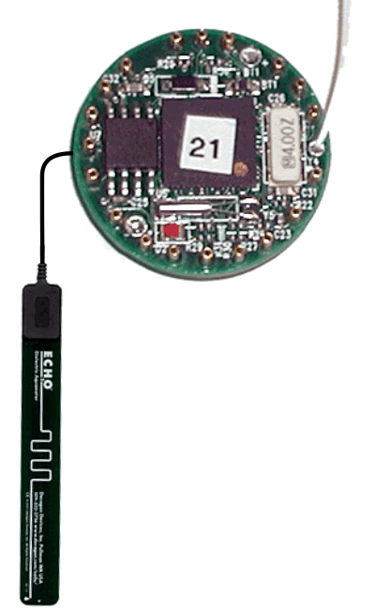
Sensor Network
Antenna
Server
Interface electronics, radio and microcontroller
Soil moisture probe
Sensor field
Mote
Communications barrier
Internet
Gateway

Slide 13
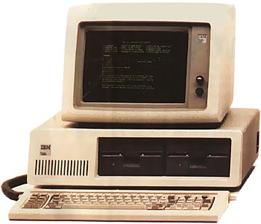
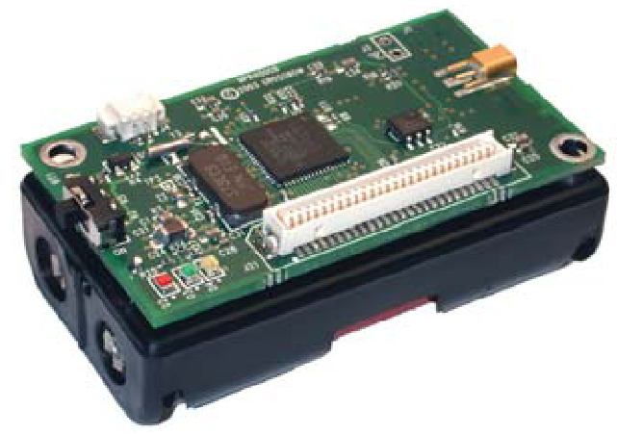
Computer Revolution
Original IBM PC (1981)
MICAZ Mote (2005)
4.77 MHz
4 MHz
16-256 KB RAM
128 KB RAM
160 KB Floppies
512 KB Flash
~ $6K (today)
~ $35
~ 64 W
~14 mW
25 lb, 19.5 x 5.5 x 16 inch
0.5 oz, 2.25 x 1.25 x 0.25 inch

Slide 14
How Did We Get Here?
Advances in wireless technology
  MEMS, VLSI
  Bandwidth explosion
Changes in regulation
Cultural changes
  Wireless devices are everywhere and people are receptive to new applications
  The concept of networks is ingrained in culture
  Open source
Computer Science
  Operating system theory, network theory
  Inexpensive compilers

Slide 15
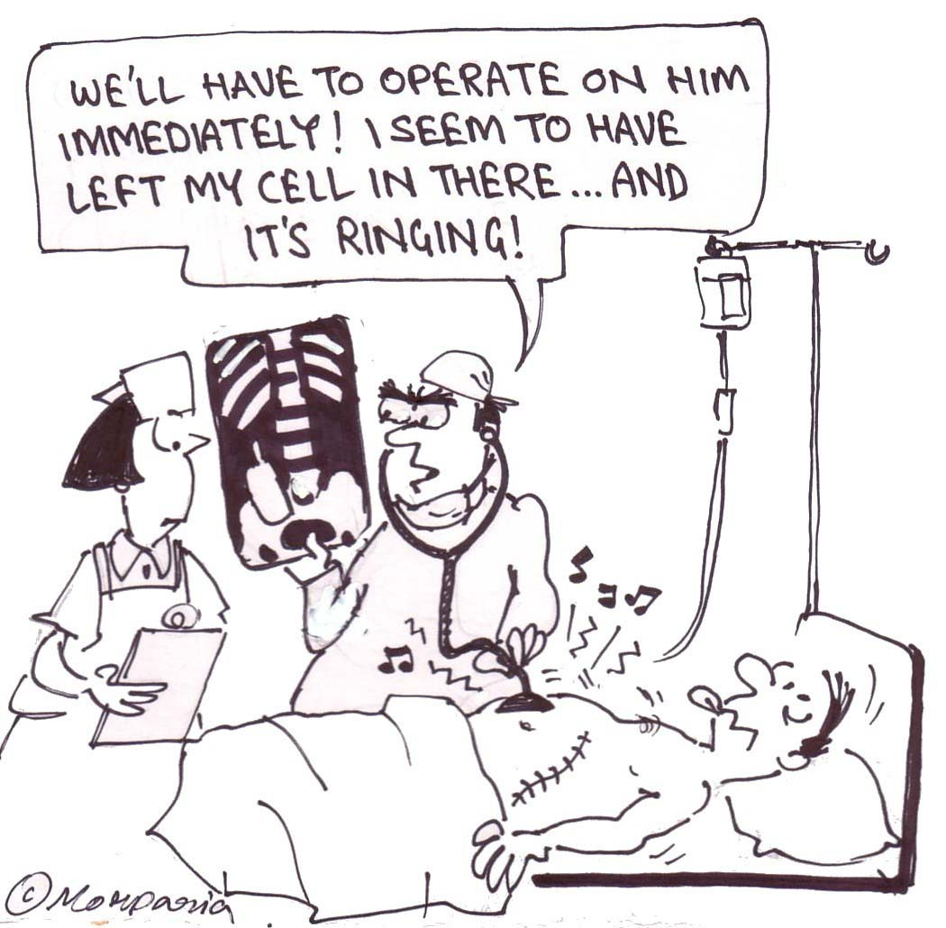
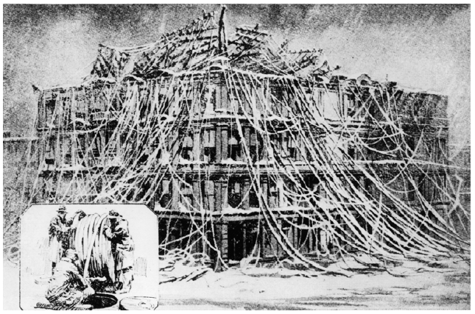
Wireless Revolution
Boston central telephone station at 40 Pearl Street after the blizzard of 1881

Slide 16
Sensors
Passive elements: seismic, acoustic, infrared, salinity(염도), humidity, temperature, etc.
Passive Arrays: imagers (visible, IR), biochemical
Active sensors: radar, sonar
  High energy, in contrast to passive elements
Technology trend: use of IC technology for increased robustness, lower cost, smaller size
  COTS adequate in many of these domains; work remains to be done in biochemical
COTS : Commercial off-the-shelf

Slide 17
Sensor Node Energy Roadmap
Source: ISI & DARPA PAC/C Program
10,000
1,000
100
10
1
.1
Deployed (5W)
Rehosting to Low Power COTS
PAC/C Baseline (.5W)
Average Power (mW)
(50 mW)
-System-On-Chip
-Adv Power Management
Algorithms
(1mW)
2000 2002 2004
Notes:
Sensor nodes combine signal processing, communications and sensors in one package, together with an energy supply. A combination of advances in IC technology, customization, and most importantly system optimization methods will lead to node energy consumption decreasing steadily over time.

Slide 18
Communication/Computation Technology Projection
Source: ISI & DARPA PAC/C Program
Assume: 10kbit/sec. Radio, 10 m range.
Large cost of communications relative to computation continues
Notes:
This fact together with scalability concerns provides strong incentive for processing data at source, rather than sending it to some central collection point.

Slide 19
New Design Themes
Long-lived systems that can be unattended
  Low-duty cycle operation with bounded latency
  Exploit redundancy and heterogeneous tiered systems
Leverage data processing inside the network
  Thousands or millions of operations per second can be done using energy of sending a bit over 10 or 100 meters
  Exploit computation near data to reduce communication
Self configuring systems that can be deployed ad hoc
  Un-modeled physical world dynamics makes systems appear ad hoc
  Measure and adapt to unpredictable environment
  Exploit spatial diversity and density of sensor/actuator nodes
Achieve desired global behavior with adaptive localized algorithms
  Cant afford to extract dynamic state information needed for centralized control

Slide 20
From Embedded Sensing to Embedded Control
Embedded in unattended “control systems”
  Different from traditional Internet, PDA, Mobility applications
  More than control of the sensor network itself
Critical applications extend beyond sensing to control and actuation
  Transportation, Precision Agriculture, Medical monitoring and drug delivery, Battlefield applications
  Concerns extend beyond traditional networked systems
    Usability, Reliability, Safety
Need systems architecture to manage interactions
  Current system development: one-off, incrementally tuned
  Serious repercussions for piecemeal uncoordinated design: insufficient longevity, interoperability, safety, robustness, scalability...

Slide 21
What are wireless sensor networks (WSNs)?
Networks of typically small, battery-powered, wireless devices.
  On-board processing,
  Communication, and
  Sensing capabilities.
Sensors
P
O
W
E
R
Storage
Processor
Radio
WSN device schematics

Slide 22
WSN node components
Low-power processor.
  Limited processing.
Memory.
  Limited storage.
Radio.
  Low-power.
  Low data rate.
  Limited range.
Sensors.
  Scalar sensors: temperature, light, etc.
  Cameras, microphones.
Power.
Sensors
P
O
W
E
R
Storage
Processor
Radio
WSN device schematics

Slide 23
Why Now?
Use of networked sensors dates back to the 1970s.
  Primarily wired and
  “Centralized”.
Today, enabling technological advances in VLSI, MEMS, and wireless communications.
  Ubiquitous computing and
  Ubiquitous communications.

Slide 24
Vision: Embed the World
Embed numerous
sensing nodes to
monitor and interact
with physical world
Network these devices
so that they can
execute more complex task.

Slide 25
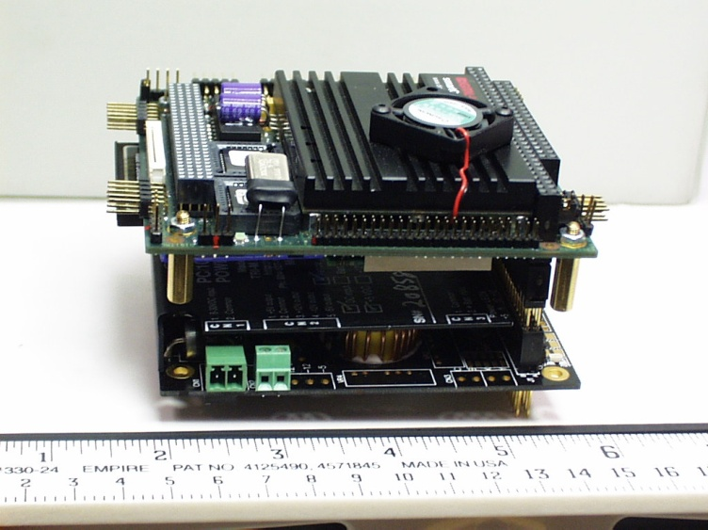
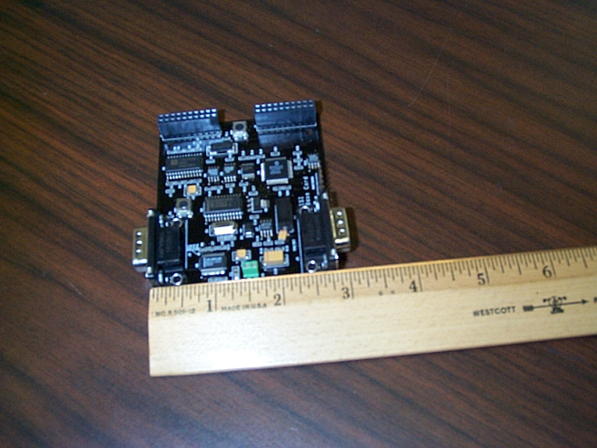
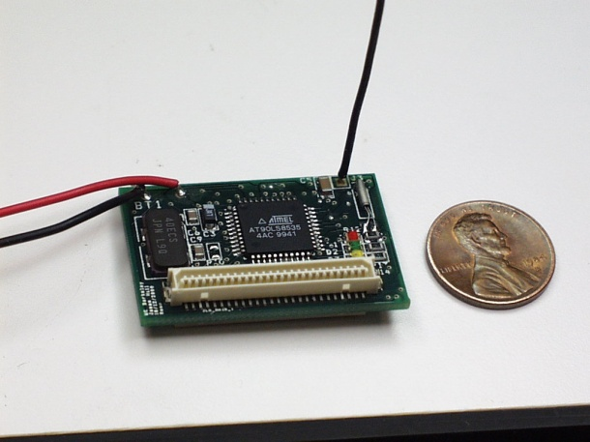
Examples of WSN Platforms
PC-104+
(off-the-shelf)
UCLA TAG
(Girod)
UCB Mote
(Pister/Culler)

Slide 26
Berkeley Mote
Commercially available.
TinyOS: embedded OS running on motes.

Slide 27
Design Challenges
Why are WSNs challenging/unique from a research point of view?
Typically, severely energy constrained.
  Limited energy sources (e.g., batteries).
  Trade-off between performance and lifetime.
Self-organizing and self-healing.
  Remote deployments.
Scalable.
  Arbitrarily large number of nodes.

Slide 28
Design Challenges (Cont’d)
Heterogeneity.
  Devices with varied capabilities.
  Different sensor modalities.
  Hierarchical deployments.
Adaptability.
  Adjust to operating conditions and changes in application requirements.
Security and privacy.
  Potentially sensitive information.
  Hostile environments.

Slide 29
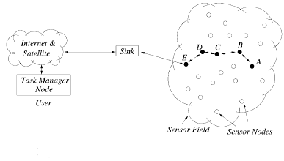
Definition : Wireless Sensor Network
A network that is formed when a set of small sensor devices that are deployed in an ad hoc fashion cooperate for sensing a physical phenomenon.
A Wireless Sensor Network (WSN) consists of base stations and a number of wireless sensors.
Typical Sensor Network

Slide 30
Requirements
Hardware: The main challenge is to produce low cost and tiny sensor nodes. With respect to these objectives, current sensor nodes are mainly prototypes. Miniaturization and low cost are understood to follow from recent and future progress in the fields of MEMS and NEMS. Some of the existing sensor nodes are given below. Some of the nodes are still in research stage.
  BTnode (ETH Zurich) (http://www.btnode.ethz.ch)
  Atlas (Pervasa/University of Florida) (http://www.pervasa.com/)
  Mica Mote (Crossbow) (http://www.xbow.com/Products/productsdetails.aspx?sid=62)
  XYZ node (http://www.eng.yale.edu/enalab/XYZ/)
  WINS (Rockwell) Wireless Integrated Network Sensors)
  WINS (UCLA)
  SensiNet Smart Sensors (Sensicast Systems) (http://www.sensicast.com)
  Smart Dust (Dust Networks) (http://www.dustnetworks.com/ spun out of UC Berkeley)
  COTS Dust (Dust Networks) (http://www.dustnetworks.com/ spun out of UC Berkeley)
  Sensor Webs (SensorWare Systems) (http://www.sensorwaresystems.com/ spun out of the NASA/JPL Sensor Webs Project)
  Hoarder Board (MIT Media Lab) (http://vadim.oversigma.com/Hoarder/Hoarder.htm)
  EYES Project (http://eyes.eu.org)
MEMS:Microelectromechanical Systems
NEMS: Nano-

Slide 31
Requirements (Cont’d)
Software
  Energy is the scarcest resource of WSN nodes, and it determines the lifetime of WSNs. WSNs are meant to be deployed in large numbers in various environments, including remote and hostile regions, with ad-hoc communications as key. For this reason, algorithms and protocols need to address the following issues:
  Lifetime maximization
  Robustness and fault tolerance
  Self-configuration
  Amongst the hot topics in WSN software, the following can also be pointed out:
    Security
    Mobility (when sensor nodes or base stations are moving)
    Middleware: the design of middle-level primitives between the software and the hardware

Slide 32
Requirements (Cont’d)
Operating systems
  Bertha (pushpin computing platform)
  BTnut Nut/OS
  Contiki
  CORMOS: A Communication Oriented Runtime System for Sensor Networks
  EYESOS
  MagnetOS
  MANTIS (MultimodAl NeTworks In-situ Sensors)
  SenOS
  SOS
  TinyOS

Slide 33
Requirements (Cont’d)
Middleware
  There is a need and considerable research efforts currently invested in the design of middleware for WSN's. There are various research efforts in developing middleware for wireless sensor networks. In general approaches can be classified into distributed database, mobile agents, and event-based.
  AutoSec
  COMiS
  COUGAR
  DSWare
  Enviro-Track
  Global Sensor Networks;GSN (Application Oriented Middleware for sensor networks).
  Impala
  MagnetOS
  MiLAN
  SensorWare
  SINA
  TinyDB
  TinyGALS

Slide 34
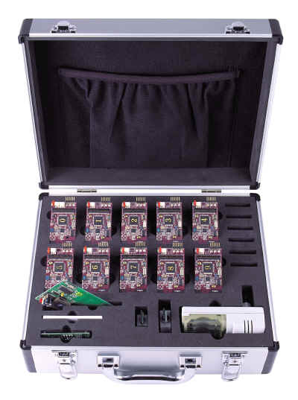
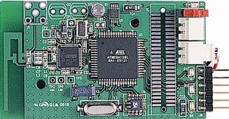
Hanback Zigbex
Computing
  Atmel 8-bit RISC microcontroller
  128KB Flash program memory
  4KB SRAM
Radio Transceiver
  Chipcon CC2420
  Radio range: (130m)
  Data rate: 240 Kbits/sec
  Frequency range: 2.4 GHz (ISM)
TinyOS, Nano-Qplus(ETRI OS)
RFID reader + RFID tag
Base sensor + Multi-modal Sensor Board

Slide 35
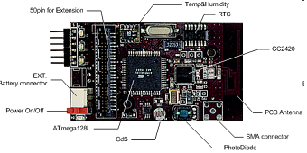
ZigbeX Mote
Mote node

Slide 36
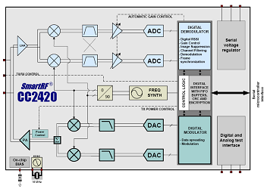
ZigbeX- CC2420

Slide 37
Why it is Different From Traditional Network
Nodes are energy constrained
Every node participating in the network can be
host and router
Topology is dynamic
No end-to-end reliability for data transmission
Limited memory and processing power
# of nodes in a sensor network can be several orders of magnitude higher than the nodes in an Ad Hoc network (100s to 1000s nodes)

Slide 38
Why it is Different From Traditional Network (cont’d)
Densely deployed (20 nodes/m³)
Prone to failures
Topology changes very frequently
Mainly use a broadcast communication, whereas most Ad Hoc networks are based on point-to-point
May not have global ID because of the large amount of overhead and large number of sensors

Slide 39
Ad hoc Network and Sensor Network
A sort of ad-hoc networks
A network of low cost,
densely and flexibly deployed,
sensor nodes
Application areas:
heath, military, and home
Placed in inaccessible terrains or disaster areas
  It may be impossible to recharge batteries
Different Node Characteristics from Traditional nodes
  Limited storage
  Processing capability
  Most importantly severe energy constraints
MANET
Wireless Sensor Network

Slide 40
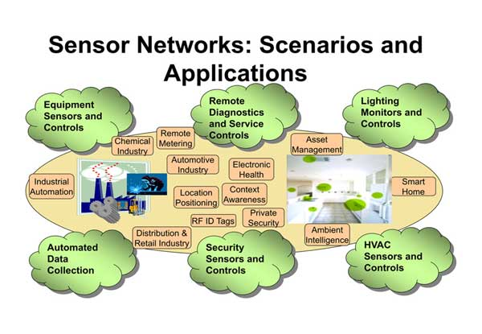
Applications

Slide 41
Applications (Cont’d)
General Engineering
  Automotive telematics: cars, having a network of dozens of sensors and actuators, are networked into a system to improve the safety and efficiency of traffic
  Sensing and maintenance in industrial plants
  Aircraft drag reduction
  Smart office spaces
  Tracking of goods in retail stores
  Tracking of containers and boxes
  Social Studies
  Commercial and residential security

Slide 42
Applications (Cont’d)
Agricultural and Environmental Monitoring
  Precision agriculture: Corp and livestock management and precise control fertilizer concentration are possible
  Planetary exploration: Exploration and surveillance in inhospitable environments such as remote geographic regions or toxic location can take place
  Geophysical monitoring: Seismic activity can be detected at a much finer scale using a network of sensors equipped with accelerometers
  Monitoring of freshwater quality
  Zabranet: Tracking the movement of zebras
  Habitant monitoring
  Disaster detection
  Contaminant transport: The assessment of exposure level requires high spatial and temporal sampling rates, which can be provided by WSNs

Slide 43
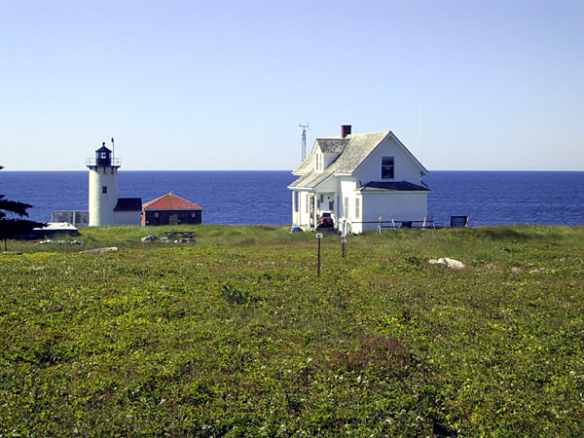
Great Duck Island Monitoring Project
http://www.greatduckisland.net/
Mission:
  monitor the microclimates in and around nesting burrows used by the Leach's Storm Petrel.
Goal:
  to develop a habitat monitoring kit that enables researchers worldwide to engage in the non-intrusive and non-disruptive monitoring of sensitive wildlife and habitats
Starting time: Spring 2002,
Participants:
  Intel Research Laboratory at Berkeley
  the College of the Atlantic in Bar Harbor
  University of California at Berkeley
Task:
  deploy wireless sensor networks on Great Duck Island, Maine.

Slide 44
Applications
Civil Engineering
  Monitoring of structures
  Urban planning
  Disaster discovery

Slide 45
Applications
Military Applications
  Assessment monitoring and management: Status and location of troops, weapons, supplies etc.
  Surveillance and battle-space monitoring
  Urban warfare
  Protecting highly sensitive systems
  Self-healing minefields
  Monitoring friendly forces, equipment and ammunition
  Targeting
  Battle damage assessment
  Nuclear, biological and chemical attack detection and reconnaissance.

Slide 46
Applications
Health Monitoring and Surgery
  Medical sensing: Physiological data such as body temperature, blood pressure, and pulse are sensed and automatically transmitted to a computer or physician
  Micro surgery: A swarm of MEMS-based robots may collaborate to perform microscopic and minimally invasive surgery
  Tracking and monitoring doctors and patients inside a hospital
  Drug administration in hospitals
  Elderly Assistance
Age-in-life

Slide 47
MIThril the next generation research platform for context aware wearable computing
MIThril is a next-generation wearables research platform developed by researchers at the MIT Media Lab.
The goal of the MIThril project is the development and prototyping of new techniques of human-computer interaction for body-worn applications.
Through the application of human factors, machine learning, hardware engineering, and software engineering, the MIThril team is constructing a new kind of computing environment and developing prototype applications for health, communications, and just-in-time information delivery.
The MIThril hardware platform combines body-worn computation, sensing, and networking in a clothing-integrated design.
The MIThril software platform is a combination of user interface elements and machine learning tools built on the Linux operating system
http://www.media.mit.edu/wearables/mithril/

Slide 48
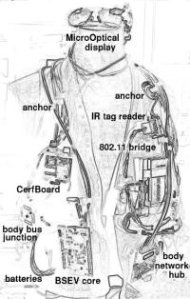
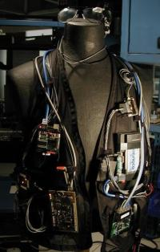
MIThril the next generation research platform for context aware wearable computing (Cont’d)

Slide 49
Home applications
Home automation
Smart environment
Other commercial applications
Environmental control in office buildings
Interactive museums
Detecting and monitoring car thefts
Managing inventory control
Vehicle tracking and detection

Slide 50

Thank you !
Q & A

