Slide 1
NGN –Lecture 3:
Introduction to Ubiquitous Computing

Slide 2
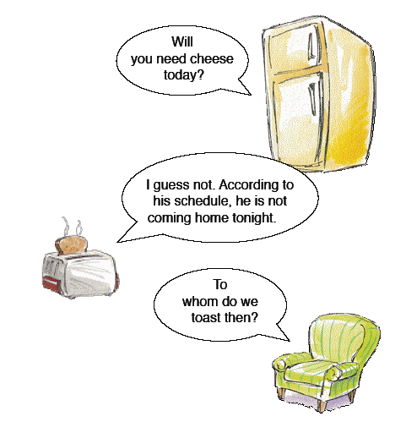
C O N T E N T S
1. Introduction
2. Ubiquitous Computing
3. Evolution
4. Generic Features
4. Technologies of Ubiquitous Computing
5. Project

Slide 3
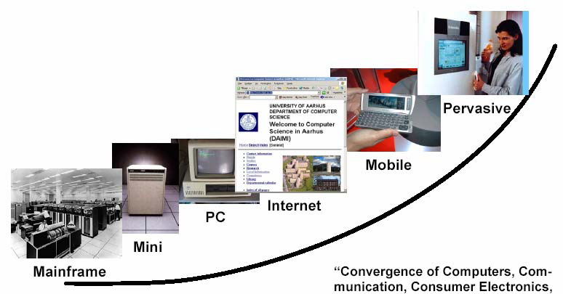
1. I n t r o d u c t i o n
The Trends …
Smart
Cloud
The computer for the 21st Century
(1991, Scientific American)

Slide 4
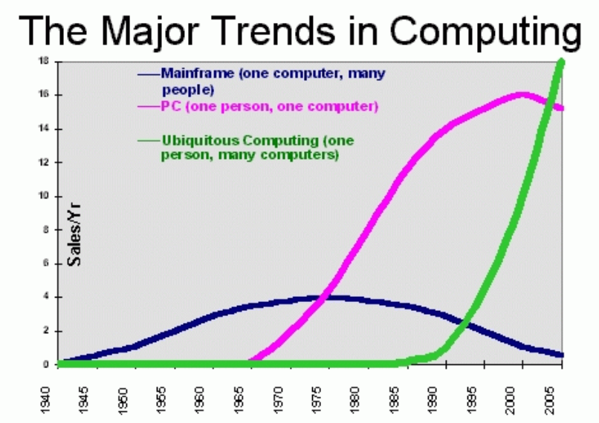
1. I n t r o d u c t i o n
Cloud Computing
2011
20
출처: Normadic Issues in U. Computing – Mark Weiser(1996) and modified by CS Hong (2011)

Slide 5
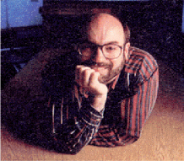
1. I n t r o d u c t i o n
Ubiquitous Computing has roots in many aspects of computing. In its current form, it was first articulated by Mark Weiser in 1988 at the Computer Science Lab at Xerox PARC. He describes it like this:
"Ubiquitous computing names the third wave in computing, just now beginning.
First were mainframes, each shared by lots of people.
Now we are in the personal computing era, person and machine staring uneasily at each other across the desktop.
Next comes ubiquitous computing, or the age of calm technology, when technology recedes into the background of our lives." --Mark Weiser
Mark Weiser

Slide 6
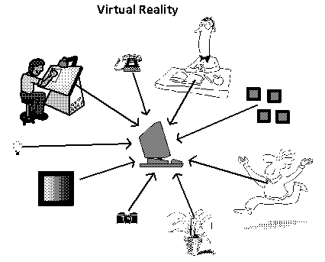
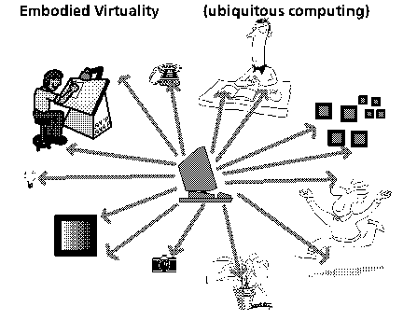
1. I n t r o d u c t i o n
Embedded Virtuality Embodied Virtuality
(Virtual Reality) (Ubiquitous Computing)

Slide 7
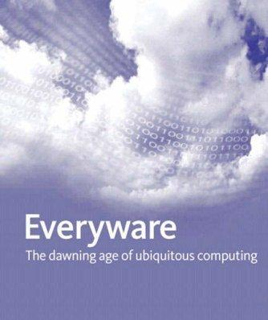
1. I n t r o d u c t i o n
Writing: The First IT
Capture symbolic information of spoken language for long-term storage
(Almost) No need to depend on human memory
This technology is now ubiquitous
  It is everywhere
  we don’t notice it
  don’t need to be an expert in ‘literacy technology’ to access it

Slide 8
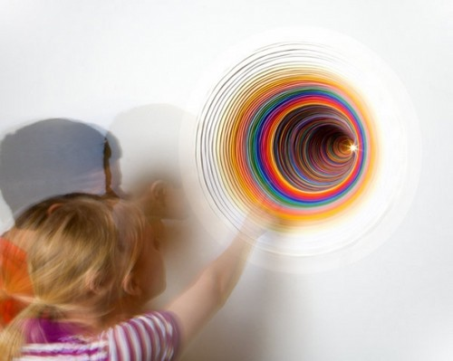
1. I n t r o d u c t i o n
Computers that Vanish
A new way to think about computers
  account for human environment
  think about how and where people live and work
When people learn something very well,
they cease to be aware of it

Slide 9
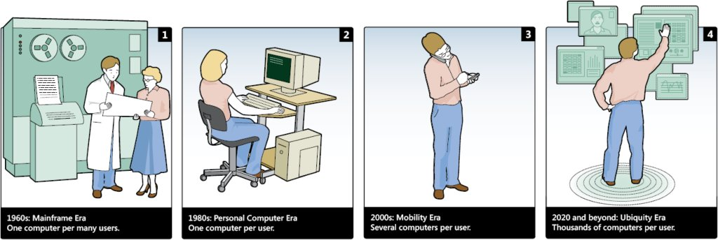
2. U b i q u i t o u s C o m p u t i n g
Integrate computers seamlessly into the world
– invisible, everywhere computing
– Often called pervasive/invisible computing
Augmented reality (Not virtual reality)
– Ability to query your environment
– Ability to ask for non-intrusive guidance
“Using a computer should be as refreshing as a walk in the woods”

Slide 10
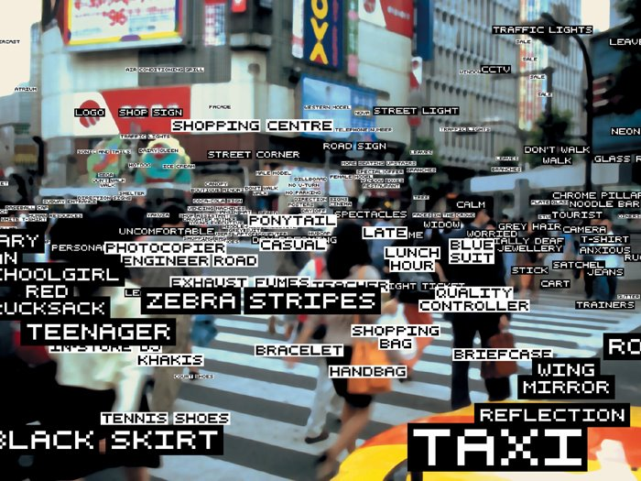
2. U b i q u i t o u s C o m p u t i n g
the result of calm tech is to put us at home, in a familiar place

Slide 11
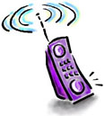

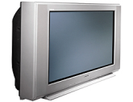

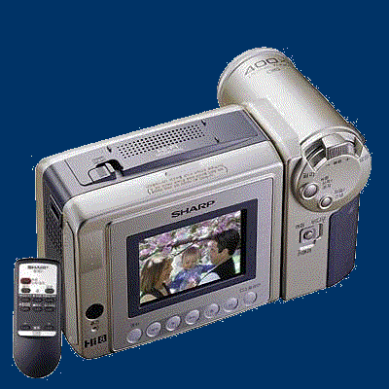

2. U b i q u i t o u s C o m p u t i n g
Ubiquitous Service
Ubiquitous Service Structure
Provider
Channel
Device & Home Network
End-user
On-line
Business
System
Wireless
Network
PC
An individual
PDA
Finance
Transportation
Product
VoIP
Phone
Family
Mobile
Network
Mobile
Phone
etc.
VR이미지보기
상세정보
판매가: 450,000원
OKPoint : 4000
A corporation
Digital
TV
상품번호 : 4989017000
Off-line
Shop
Off-Line
Networked Household Appliance

Slide 12
2. U b i q u i t o u s C o m p u t i n g
Example: A Responsive Environment
Office-light brightness will be adjusted automatically according to the daylight
Your active ID-badge indicates your identity (and your preferences)
System knows your current location
Light turns on as you enter a room
The seat is adjusted to your size

Slide 13
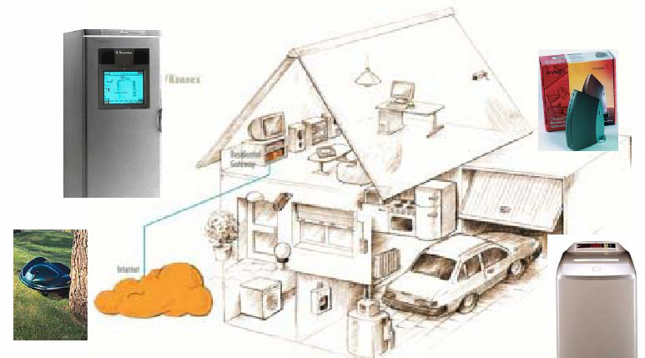
2. U b i q u i t o u s C o m p u t i n g
Ubiquitous Computing at Home

Slide 14
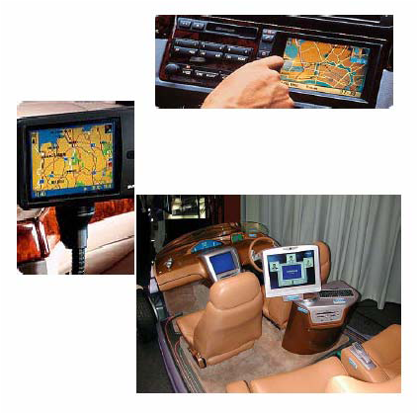
2. U b i q u i t o u s C o m p u t i n g
Ubiquitous Computing in the Car
On-board Computers
– GPS Navigation
– Infotainment
– Services
In-Vehicle Networks

Slide 15
3. E v o l u t i o n
Constraint:
– best way to serve the user community is not clear.
Approach:
– Prototype the solution
– Acquire feedback from users.
– Modify the application(with least possible downtime)

Slide 16
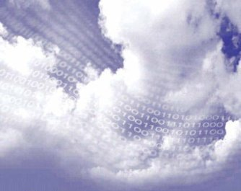
3. E v o l u t i o n
wearable
computing
disappearing
computer
context- aware
computing
pervasive
computing
Mobile/Nomadic
computing
Ubiquitous computing

Slide 17
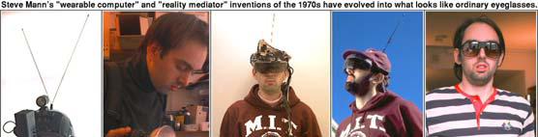
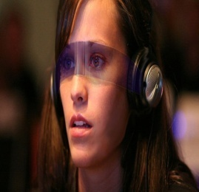
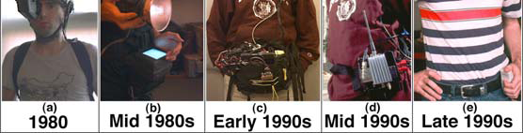
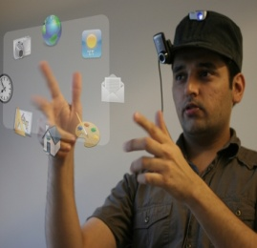
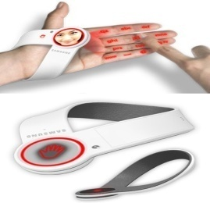
3. E v o l u t i o n
Wearable Computing
The inventor of wearable computing: Steve Mann.
See http://wearcam.org/mann.html

Slide 18
3. E v o l u t i o n
Context-Aware Computing
  Context
    Powerful, longstanding concept in human-computer interaction
  Act is explicit. But context is implicit
  Notion of context is much more widely appreciated
    It’s a key to enter computation into our lives
  One goal of context-aware computing
    To acquire and utilize information about the context of a device
    People, place, time, event, etc…
    Example : Cell phone and concert

Slide 19
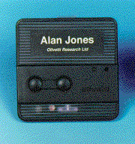
3. E v o l u t i o n
Context-Aware Computing
Example
  Active Badge & PARCTab
  Shopping assistant
  Cyberguide
  Perception system for recognizing user moods from their facial expressions
  House where position is sensed and temperature adjusted automatically

Slide 20
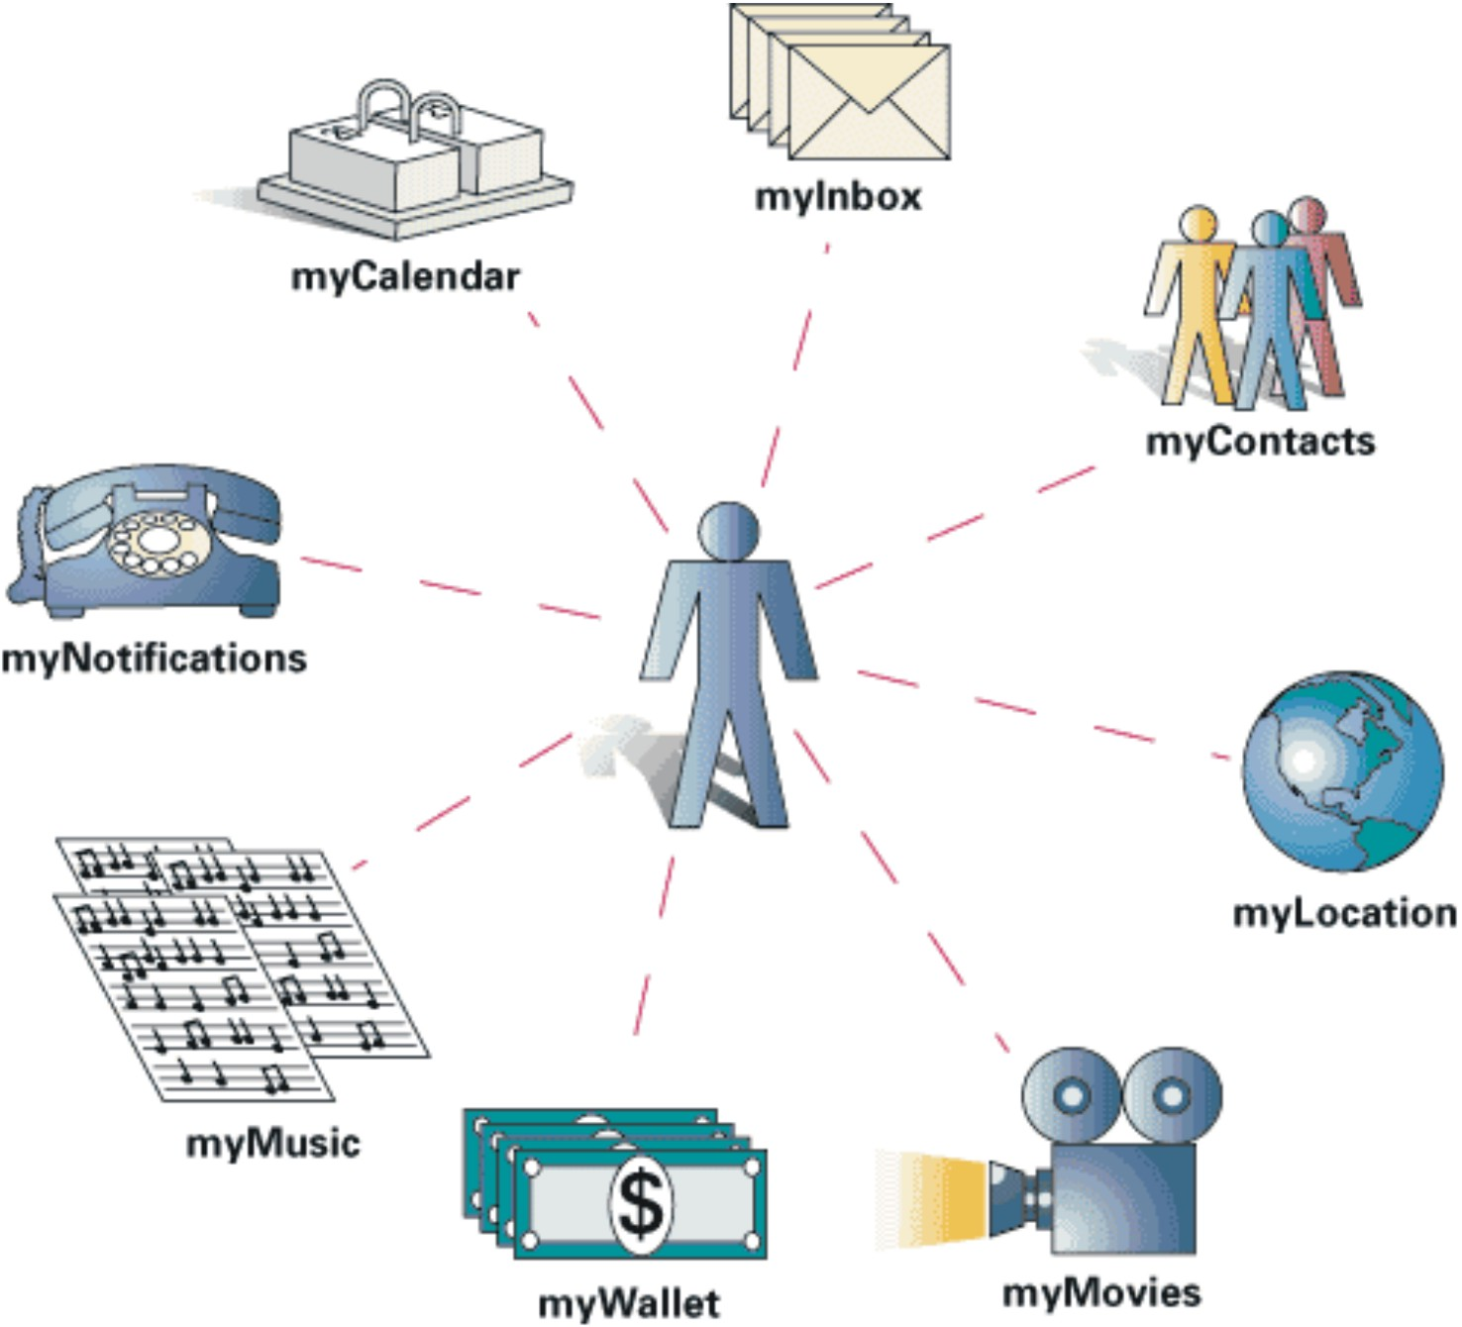
3. E v o l u t i o n
Pervasive Computing

Slide 21
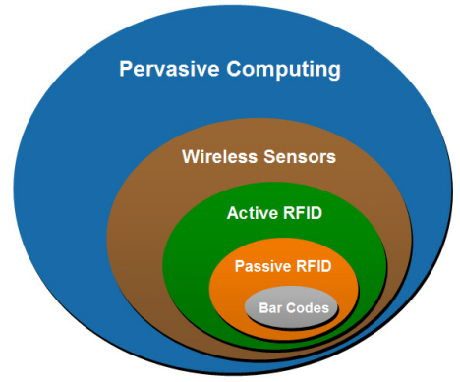
3. E v o l u t i o n
Pervasive Computing
Numerous, Accesible, Invisible computing devices
Mobile or embedded in environment
Connected to an increasingly ubiquitous network infrastructure composed of a wired core and wireless edges

Slide 22
3. E v o l u t i o n
Mobile / Nomadic Computing
Some implications for Normadicity
  - Each person uses many devices
  :Total nomadic devices >> number of people
  - Large number of fixed devices
  : Many computers imbeded in environment
  : Normadic devices must interact with fixed infrastructure
  - Many normadic devices are essentially “PC Peripherals”

Slide 23
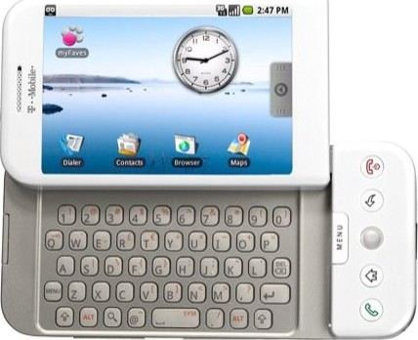
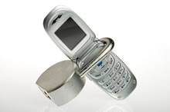
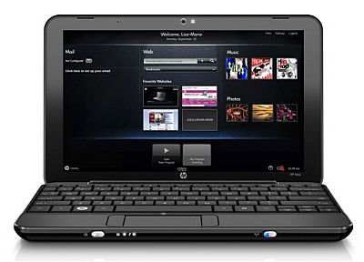
3. E v o l u t i o n
Mobile / Nomadic Computing
The Normadic PC Peripheral
  Soon everyone in a world will have a PC in their life
  New devices must integrate with our existing PCs
  The internet provides the raw glue tying together PCs and Normadics
Computing power

Slide 24
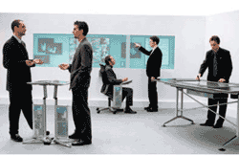
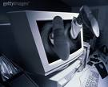
3. E v o l u t i o n
Disappearing Computer

Slide 25
4. G e n e r i c F e a t u r e s
Transparent
Interfaces
Awareness of Context(s)
Capture Experience

Slide 26
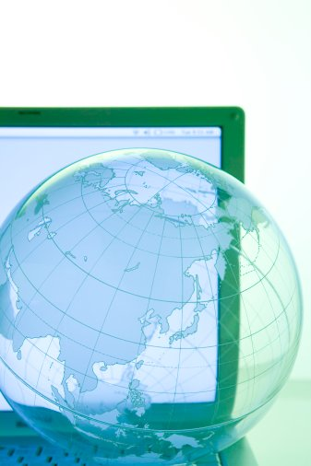
4. G e n e r i c F e a t u r e s
Transparent Interface
Hide their presence from user
Provide interaction between user and application
Examples: Gesture recognition, speech recognition, free form pen interaction etc.
Keyboard and mouse are still the most commonly used interfaces !!
Need:
  flexible interfaces
  Varied interfaces that can provide similar functionality

Slide 27
4. G e n e r i c F e a t u r e s
Context Awareness
Context – information about the environment with which the application is associated.
LOCATION and TIME are simple examples of context !
Context aware application:
- is one which can capture the context
- assign meaning to it
- change behavior accordingly
Need:
- Applications that are context aware and allow rapid personalization of their services.

Slide 28
4. G e n e r i c F e a t u r e s
Automated Capture
To capture our day-to-day experience and make it available for future use.
Constraints:
- Multiple streams of information
- Their time synchronization
- Their correlation and integration
Need:
- Automated tools that support capture, integration and future access of info.

Slide 29
5. Technologies of Ubiquitous Computing
Hardware technologies
  Processors, memories, …
  (Wireless) networking
  Sensors, actuators
  Power
  Packing and integration
  Potentially: entirely new
  technologies (optoelectronics, biomaterials)
Software technologies
  Operating environments
  Networking
  Middleware
  Platform technologies
  User interfaces

Slide 30
5. Technologies of Ubiquitous Computing
Moore’s Law and Its Best Friends
Moore's law: Capacity of microchips doubles in 18 months => capacity grows an order of magnitude (10x) in 5 years
But also:
  Fixed network transfer capacity grows an order of magnitude in 3 years (but delay will not be significantly improved)
  Wireless network transfer capacity grows much slower, perhaps an order of magnitude in 5-10 years
  Mass storage capacity grows an order of magnitude in 3 years – presently, one euro buys more than one gigabyte of mass storage (but seeking a piece of data is not improving nearly as rapidly)
  Significant progress in power is unlikely
These variable speeds may lead to qualitative changes:
  Mass storage is cheap and plentiful
  Wireless access remains a relative bottleneck, and it only gets worse
  Power remains an issue

Slide 31
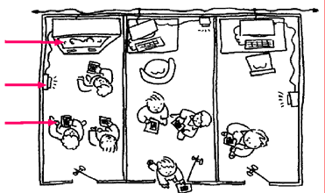
5. Technologies of Ubiquitous Computing
Ubiquitous Computing Phase I:
Tabs, Pads, and Boards
Hundreds of computers per person
Wireless networks
Location-based services
Shared meeting applications
board
transceiver
tab

Slide 32
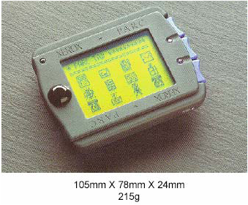
5. Technologies of Ubiquitous Computing
Ubiquitous Computing Phase I:
Tabs, Pads, and Boards
Tabs
– very small – smart badge with user info, calendar, diary, etc
– allow personalized settings to follow a user
– leave bio’s behind after meetings
– attached to virtually everything -- e.g., books, car keys, people

Slide 33
5. Technologies of Ubiquitous Computing
Ubiquitous Computing Phase I:
Tabs, Pads, and Boards
Tabs (cont.)
– one hundred per person per office
– processor had low-power mode but was weak
– wirelessly connected (infrared communications)
– small touch-sensitive display screen (128x64 pixels)
– scatter around the office like post-it notes

Slide 34
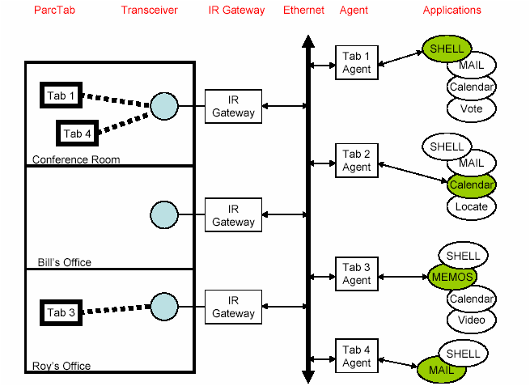
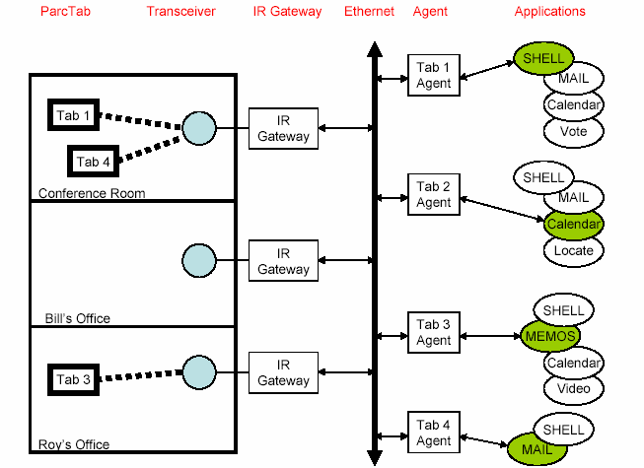
5. Technologies of Ubiquitous Computing
System Architecture:
Wireless Displays

Slide 35
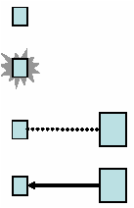
5. Technologies of Ubiquitous Computing
Tab Applications
Local (stand-alone mobile device)
– application shell, anything that fit
Aware local (mobile device + sensors)
– room information
External (part of some other application)
– locator
Remote terminal (map mouse, keyboard, display)
– weather, dictionary, thesaurus

Slide 36
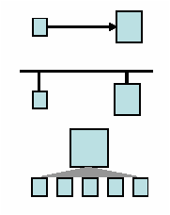
5. Technologies of Ubiquitous Computing
Tab Applications(cont.)
Remote control (input to some other device)
– projectors, media switch
Networked (version customized to device)
– email, pager
Cooperative (multiple devices, multiple people)
– voting, drawing, annotation

Slide 37
5. Technologies of Ubiquitous Computing
Ubiquitous Computing Phase I:
Tabs, Pads, and Boards(cont.)
Pads
– paper size
– portable computers but not laptop metaphor
– scrap computers - grab and use, no identity or importance
– ten per person per office
– near megabit wireless communication bandwidth
– antidote to windows (use a real desk)
– can project onto larger computers with a wave of your hand

Slide 38
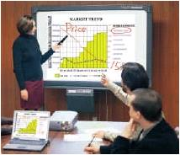
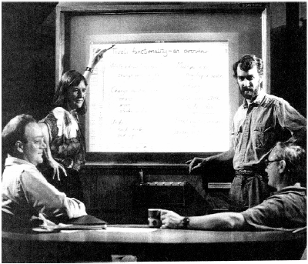
5. Technologies of Ubiquitous Computing
Tab Applications(cont.)
Boards
– larger display
–whiteboard size
– personalized electronic bulletin boards
– multiple pens
– multi-site
– informal meetings
– meeting capture
– Lots of bandwidth available because they’re plugged into the wall

Slide 39
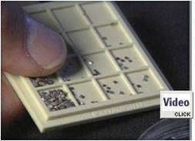
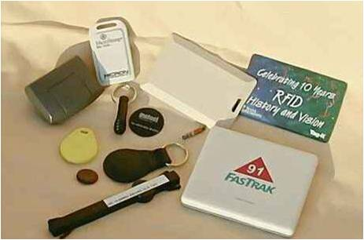
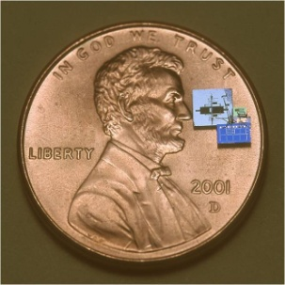
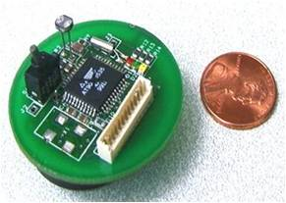
5. Technologies of Ubiquitous Computing
Sensor
Passive elements: seismic, acoustic, infrared, salinity, humidity, temperature, etc.
Passive Arrays: imagers (visible, IR), biochemical
Active sensors: radar, sonar
  - High energy, in contrast to passive elements
Technology trend: use of IC technology for increased robustness, lower cost, smaller size
  - COTS adequate in many of these domains; work remains to be done in biochemical

Slide 40
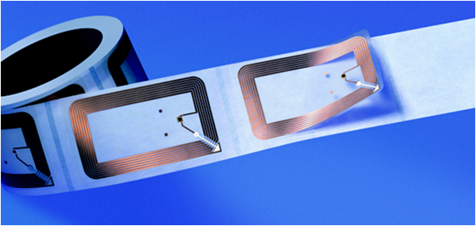
5. Technologies of Ubiquitous Computing
RFID
A remotely readable tag that replies an incoming RF signal with some data
RFID has been around for some 10 years, but high tag prices have limited its use
New manufacturing methods are now reducing the price to low cent region
This may lead to massive deployment

Slide 41
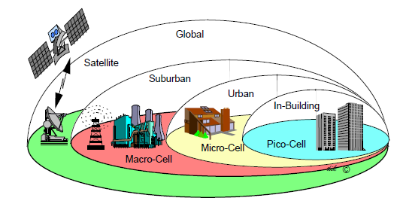
5. Technologies of Ubiquitous Computing
Wireless Networking
• WAN: Wide Area Network
• MAN: Metro Area Network
• LAN: Local Area Network
• PAN: Personal Area Network
• Satellite (WAN)
• Microwave (MAN)
• Laser (MAN)
• Cellular (WAN)
• Wireless LANs
• Bluetooth (Wireless PAN)
• IrDA (Wireless point-to-point PAN)

Slide 42
5. Technologies of Ubiquitous Computing
Satellite
• GEO (Geosynchronous/Geostationary)
– Remains "stationary" relative to equator
– Deployed @ 36,000 km—requires a big rocket!
– Need only 3 to cover earth
– High latency (1/4 sec or so round trip)
– Need high-power transmitter to reach satellite
• XM Satellite radio uses GEOs (only 2, though)

Slide 43
5. Technologies of Ubiquitous Computing
Satellite
LEO (Low Earth Orbit)
– Much lower orbits—less than 1000 km
– Must have handoff mechanism—don't appear stationary to earthbound base stations
– Lower power transmitter than GEO
– Lower latency, but handoff delay…
– Space junk!
• MEO (Middle Earth Orbit)
– ~10,000 km

Slide 44
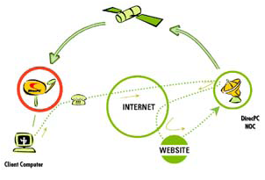
5. Technologies of Ubiquitous Computing
Satellite
• ~400Kb/sec downlink from GEO
• Modem uplink (but DirecWAY introduces 2-way)
• Dish must see the sky (typical of satellite)

Slide 45
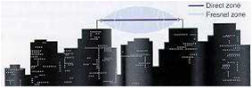
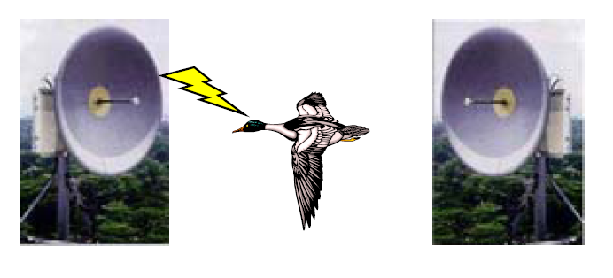
5. Technologies of Ubiquitous Computing
Microwave
• Range: 20 miles or more, typically less
• Line of sight only, point to point
• Rain causes problems, because rain absorbs microwave energy
• Ethernet speeds
• Ducks won't fry

Slide 46
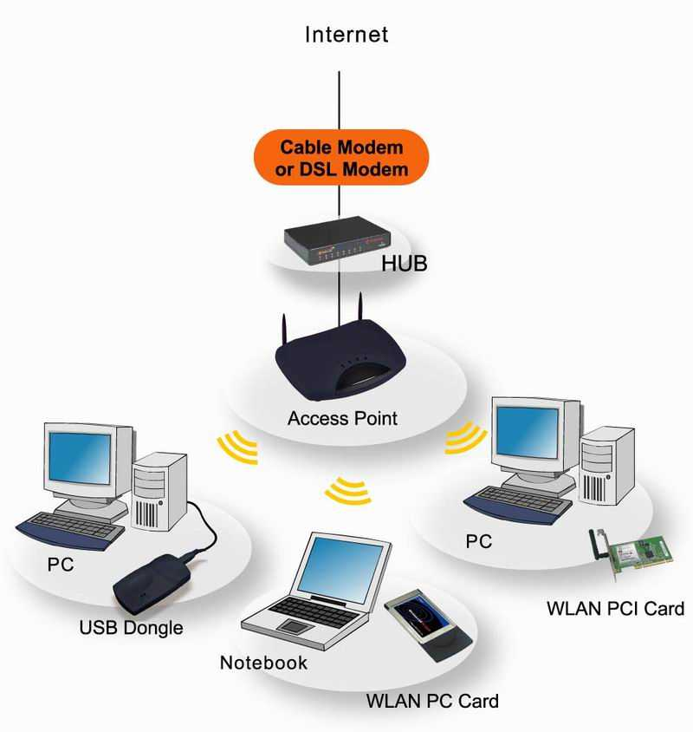
5. Technologies of Ubiquitous Computing
Wireless LANs
• One example: IEEE 802.11 standard
• CSMA/CA instead of CSMA/CD, as in Ethernet
– Ethernet: detect collision during transmission
– Wireless: impossible -- can only hear own signal
during transmission
• Current speeds 1Mb/sec – 54Mb/sec
– 802.11b: 2-11Mb/sec (we have this) in 2GHz
range
– 802.11a: 54Mb/sec in 5GHz range
– 802.11g: ~20Mb/sec, compatible with 802.11b

Slide 47
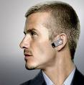

5. Technologies of Ubiquitous Computing
Bluetooth
Provide small, inexpensive
Power-conscious radio system
Personal (short-range) ad-hoc networks
– Not really intended
as a wireless LAN technology
Device communication and cooperation

Slide 48
5. Technologies of Ubiquitous Computing
Bluetooth
• Predicted long term cost: < $5/unit
• Low-cost radio operates in the 2.4GHz band
• Bluetooth ~1Mb/sec over several meters
• Range can be extended with an external power amplifier
• Up to 7 simultaneous links
• ~75 hours voice – 3 months standby w/ 600mAh batter

Slide 49
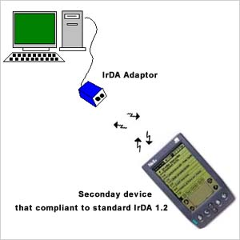
5. Technologies of Ubiquitous Computing
IrDA
Line of sight
– Connected IrDA devices must remain relatively stationary
Inconvenient for Internet bridge solutions
Higher bandwidth than Bluetooth
– 4-16Mb/sec
Current costs for deployment of IrDA are much cheaper
– < $2/unit

Slide 50


5. Technologies of Ubiquitous Computing
Wireless Networking
Mobile Ad Hoc Network vs Infrastructure Network
Mobile Ad Hoc Network Type

Slide 51

6. P r o j e c t s
Cyberguide
can replicate human tour guide using mobile and hand held technology
makes use of location information to track the user / suggest establishments
maintains history of places visited, for future use

Slide 52
6. P r o j e c t s
Cyberguide
Transparent Interaction
has prototypes with varied interfaces
Speech recognition capability (limited!)
Context awareness
‘location’ as the context
Automated capture
acquires knowledge from places visited
(to server future visitors)

Slide 53


6. P r o j e c t s
Smart Dust
Special class of sensor network
Fine sensing granularity
Applications :
  Forest fire warning
  Enemy troop monitoring
  Large scale Biology or Geology
  Smart office spaces
  Defense-related sensor networks
  Inventory Control

Slide 54



6. P r o j e c t s
Smart Dust
Key Features of these electronic particles
Power
  Survive for extended amount of time
Computation
  Process Sensor Data and Communicate
Sensors
  To Interface to the environment
Communication
  To glue the pieces of information

Slide 55

6. P r o j e c t s
Smart Dust
What is really behind the race?
Computer Science!
Ad hoc Networking
  Dynamic Reconfigurable network
  Scalability
Distributed Processing
  Network Oriented Operating Systems
  Data Aggregation
Data Fusion
  An efficient semantic to diffuse data in the network
  Interpretation of multimodal sensing

Slide 56

6. P r o j e c t s
Smart Dust
Power: Lithium Battery
  Big Problem
  Low capacity per unit of mass and volume
  Needs support by sleep mechanism and low power techniques
  Not really so much innovation after Volta!
    Solar
    Vibration
    Acoustic noise
    Thermal conversion
    Nuclear Reaction
    Fuel Cells

Slide 57
6. P r o j e c t s
Smart Dust
Sensors
  Motion Sensing
    Magnetometer
      Study 3 Element of Earth Magnetic field (Compass)
    Accelerometer
      To measure Local vertical (tilt switch) or measure motion vectors
  Environmental Sensing(Weather Monitoring)
    Pressure
      Barometer
    Temperature
    Light
    Humidity
Notes:
Magnetometer:To study the 3 elements of earth magnetic field (compass), The presences of disturbance field
Accelerometer:To measure the local vertical gravity vector(tilt switch), To measure motion acceleration vector(inertial navigation)
Pressure: Resistor Chip,can be used as a barometric altitude meter
Temperature: Digital Temperature
Light: photodiode
Humidity:An Integrated circuit chip

Slide 58


Slide 59

Thank you !
Q & A

