Slide 1
Towards WiFi Services using
TV White Space
March 26, 2013
CS Hong
Notes:
Thank you Chair, for your kind introduction for me.
It is a great honor to have a keynote speech. In this talk, I would like to discuss WiFi services using TV White Space.
As you know, governments around the world continue to search for new pieces of radio spectrum which can be used by the expanding wireless communications industry to provide more services in the usable spectrum. One of the usable candidates could be TV white space.
If we use the TV white space, we can expand available bandwidth for Internet services in high quality.

Slide 2
Contents
Data Explosion in Internet
What is TV white space
Research and Standardization activities on White Space in IEEE, IETF
Activities regarding TV white space in US, EU, etc
Experiments in Korea
Research topics on White Space
Notes:
It is my talk outline today. At first, I will show you the data explosion in the internet, and explain of what is the TV white space, then introduce you the research and standardization activities in the IEEE and IETF, and specially ativities in US, UK, JAPAN and Korea. And show you a trial in Korea. Finally discuss of research topics on TV White Space.

Slide 3
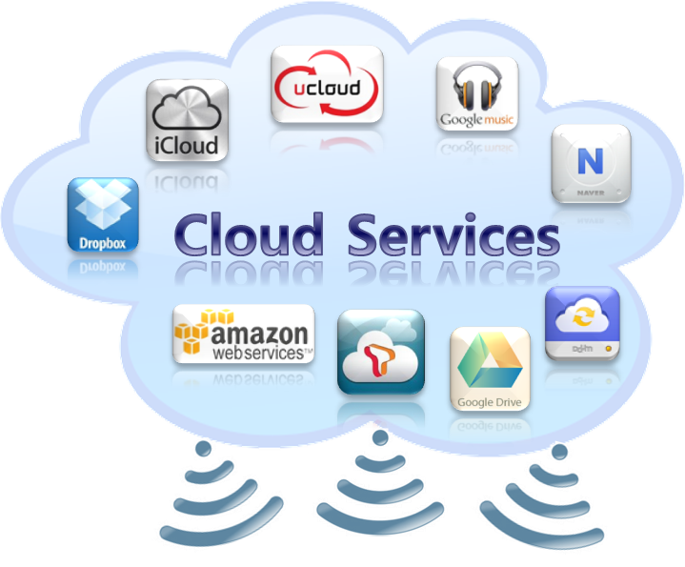

Data Explosion by wireless Internet
Cloud Services
Mobile Cloud Computing
Tasks and data kept on
the internet, providing
on-demand access
Not required to download
or install applications onto
the mobile devices
Notes:
In recent years, there are various cloud environments such as icloud, amazon cloud, etc for mobile services. These environments are making the mobile traffic increase rapidly.
Cloud stores your music, photos, apps, calendars, documents, and more. And Cloud wirelessly pushes those contents to all your devices. It’s the easiest way to manage your content. In the mobile cloud computing, tasks and data are kept on the internet, providing on-demand access. The mobile devices are not required to download or install applications onto the mobile devices

Slide 4
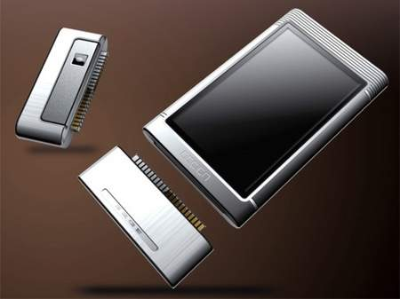

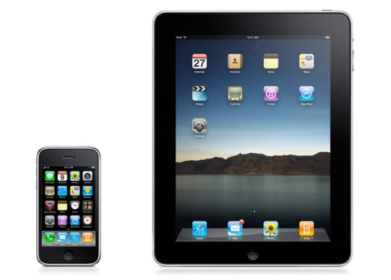
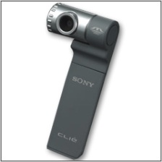
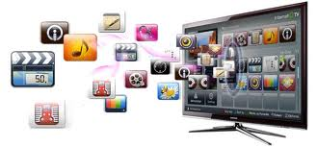
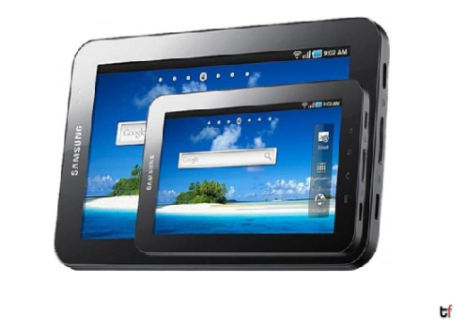

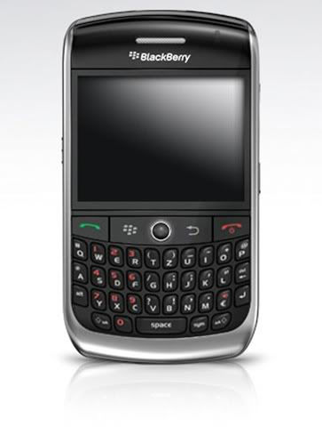
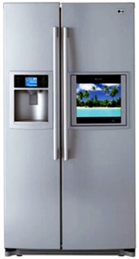
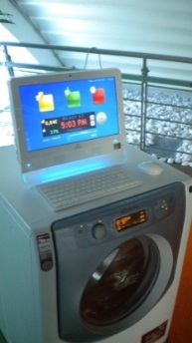
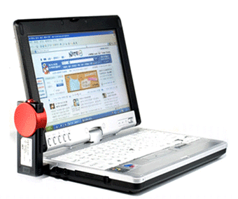
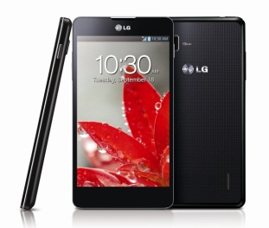
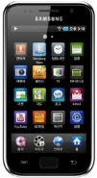
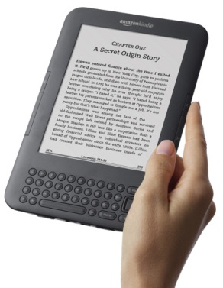
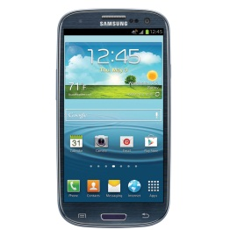
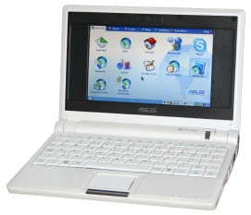
Smart Devices (1)
Evolution of Smart devices
PDA Phones: ~ ‘00
Smart phone and Pad:
~ ‘12
Smart Appliance: ~ ??
Modular PDA
Notebook
PC
BlackBerry,
E-Mail Device
Netbook
e-Book
Notes:
In Recent years, We have an evolution of smart devices. I believe that the evolution will be extended to smart appliances.

Slide 5
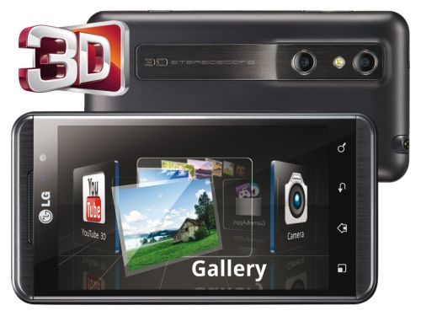
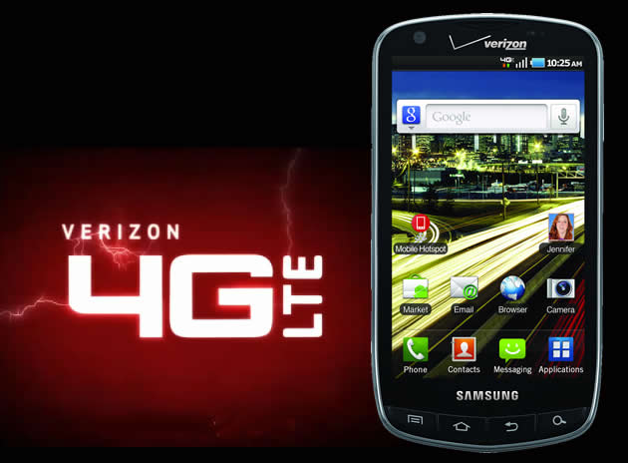
Smart Devices (2)
The Smart Phone, Video-oriented Device?
3D video recording
3D contents
(UCC, Indep. Films, CF)
Quad Core
4.5/5’’ display
Full HD quality
HTML full browser
Demand for video applications
will be continuously
increased with the high-end
smart phone and faster network
Notes:
The capability of smart devices will be increased.

Slide 6
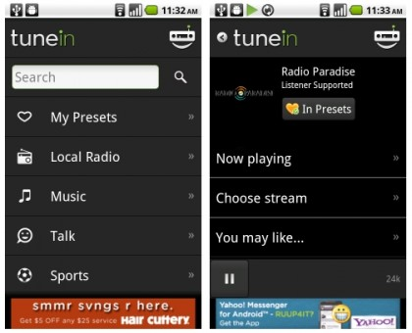


Unlimited Data Use
Data Explosion, Mixed Blessing for Mobile Telecoms
Unexpected rush, 3G/LTE network was not designed for mobile broadband….
  May be LTE-advanced
The smart phones make people to use the wireless network just as they
would use their fixed broadband line at home….
Around 10% heavy-user traffic takes up more than 93% of total 3G/LTE traffic.
How to solve …..
Notes:
We can say telecom executives see the data explosion as a serious threat `They`re all very concerned by unexpected rush of mobile traffic.
The smart phones make people to use the wireless network just as they would use their fixed broadband line at home
If they don`t manage this moment carefully, some mobile operators will run into major problems that threaten their very profitability and viability. Some may not survive. But especially service providers in Korea are just starting to compete for obtaining subscribers by selling unlimited data rate, even in LTE.

Slide 7
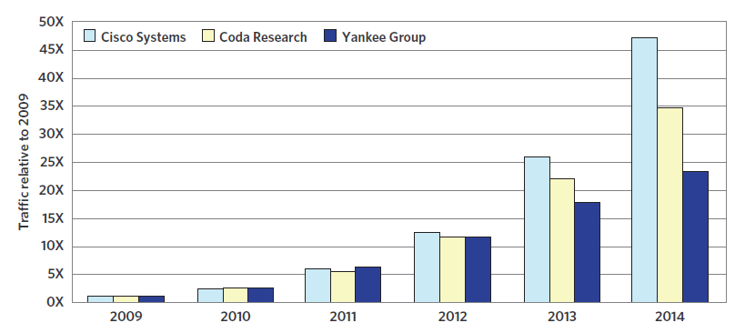
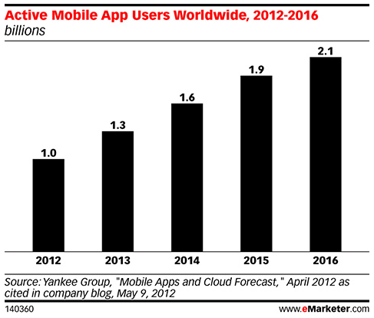
Data Explosion (1)
Data Big Bang in Mobile Universe
- Forecasted mobile data traffic in North America
Approximately x 50 increase
in mobile data traffic over 5 years
since inception of smart phones
to the market in US
- Active Mobile App Users Worldwide
Notes:
This slide shows Forecasted mobile data traffic in North America. Approximately 50 times are increased
in mobile data traffic over 5 years since inception of smart phones to the market in US.
Up to 2016 Active Mobile App Users Worldwide is expected 2.1 billions.

Slide 8
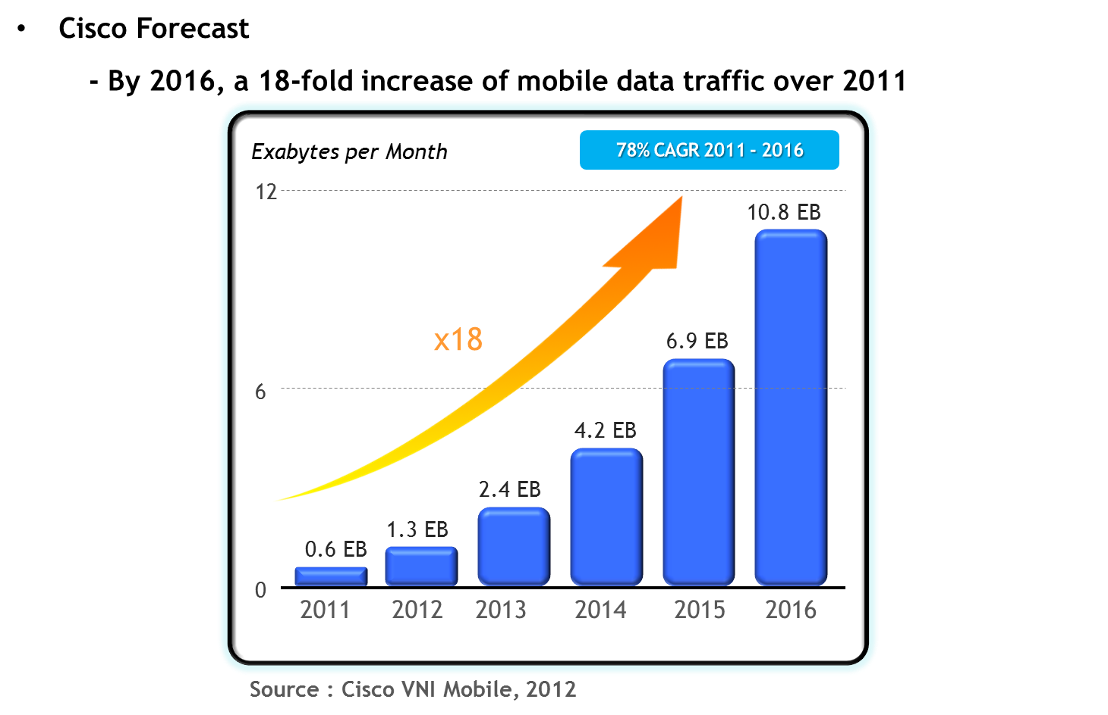
Data Explosion (3)
Notes:
Also by 2016, the Cisco forcast a 18-fold increase of mobile data traffic over 2011 as 10.8 Exa-byte.

Slide 9
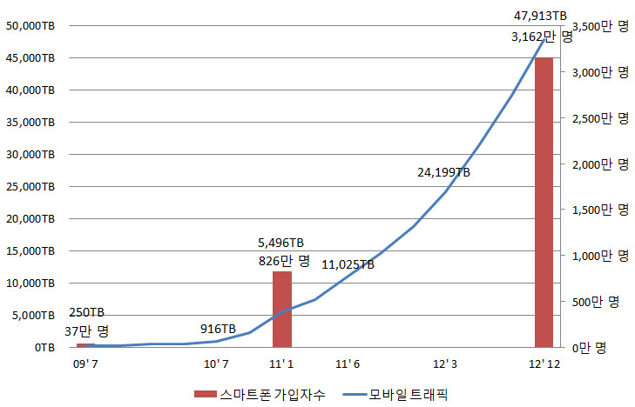
Data Explosion (2)
Data Traffic Demand in Korea
- Traffic demand vs. smart phone penetration: past & future
트래픽(TB)
66% penetration
Subscribers (10 thousands)
Traffic(TB)
3,162
3,500(10 thousands)
Bandwidth in use: 137.5MHz
Available bandwidth: 210MHz
3,000(10 thousands)
2,500(10 thousands)
X 8.7
traffic
increase
2,000(10 thousands)
1,500(10 thousands)
5,496 TB
8.26 millions
1,000(10 thousands)
500(10 thousands)
.37 million subscribers
0
0 TB
Smart Phone Subscribers
Mobile Traffic
Forecast on smart phone penetration implies more bandwidth
must be allocated.
Notes:
How is the data traffic demand in Korea. This graph shows that the mobile traffic of 5,496 TB and
8.26 millions smart phone subscribers the end of 2011 was. What about now around 9 times in mobile traffic is increased.
And we have more than 30 millions smartphone subscribers.
Forecast on smart phone penetration implies that more bandwidth must be allocated.

Slide 10
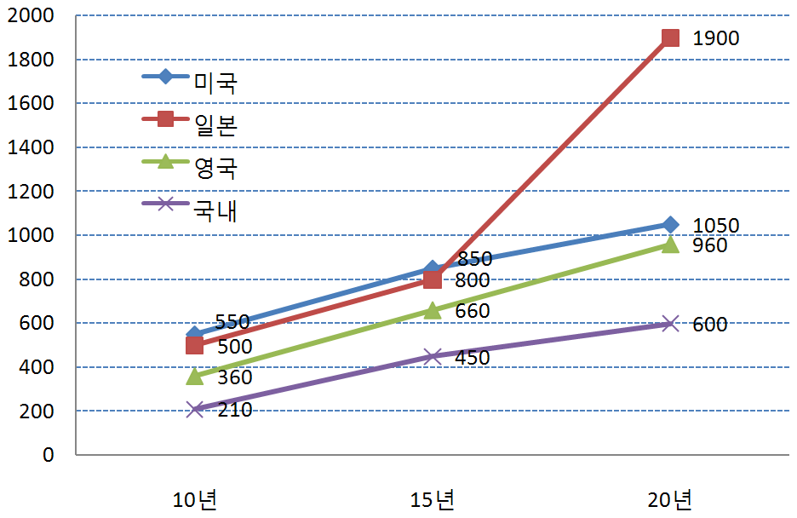
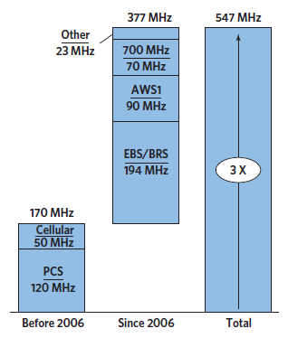
Requests on Frequency Spectrum Bands
- Demand by country
- Current band allocation in US
USA
Japan
UK
Korea
2010
2015
2020
More than 200MHz additional bandwidth
is required up to 2015 in Korea!
US already has taken a step
to cope with smart phone traffic!
Notes:
There are Requests on Frequency Spectrum Bands in each countries. In US, it needs to have 850 Mhz, 800Mhz in Japan, 450 Mhz in Korea.
More than 200MHz additional bandwidth is required up to 2015 in Korea!
As you see the graph, US already has taken a step to cope with smart phone traffic!
I think the one of the solutions to ensure mobile spectrum is to use the TV white space.

Slide 11
What is TV White Space ?
White spaces," which are empty fragments of the spectrum scattered between used frequencies“
TV stations have traditionally broadcast over lower frequencies that carry information longer distances. However, with the transition from analog to digital broadcasts, more unused frequencies are opening up than ever.
  512 megahertz and 698 megahertz (channels 21 ~ 51)
  698 megahertz and 806 megahertz (channels 52 ~ 69)
Notes:
White spaces are empty fragments of the spectrum scattered between used frequencies
As you know, TV stations have traditionally broadcast over lower frequencies that carry information longer distances.
However, with the ongoing transition from analog to digital broadcasts, more unused frequencies are opening up.

Slide 12
What is TV White Space ?
White space (WS): In a spectrum band that is licensed to primary users,
the part of spectrum that is unused by the primary user at specific locations
and sometimes at specific time.
  Example: Television Channels – not every channel is used in every town
White space allows secondary users to use the portions of spectrum not actually used by the primary user on an unlicensed basis.
The unlicensed user must not cause interference.
The unlicensed user cannot expect protection from interference
Received Signal Strength
Occupied TV Channels
(at given location)
White space
5
10
15
20
25
30
35
40
45
TV Channel (54Mhz – 698Mhz)

Slide 13
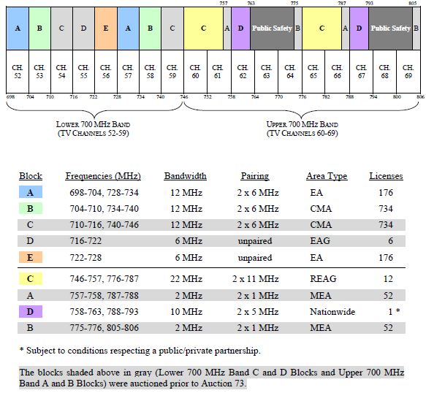
A TV White Space in US
FCC Band Plan for 700MHz Digital Dividend
- Auction 73 (2008):
Net bids $18,957,582,150
- 70MHz bandwidth
allocated for terrestrial
mobile services

Slide 14
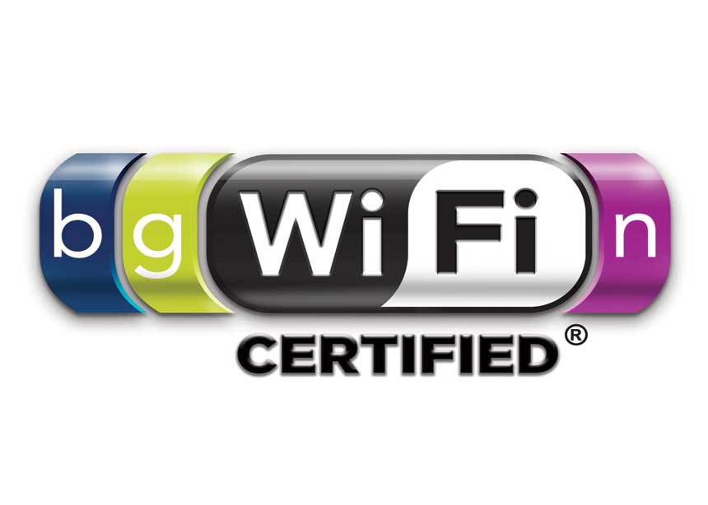
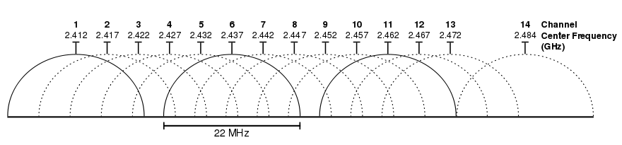




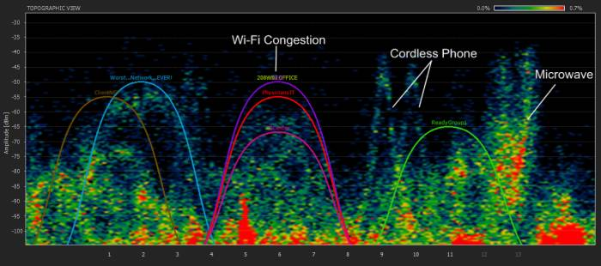
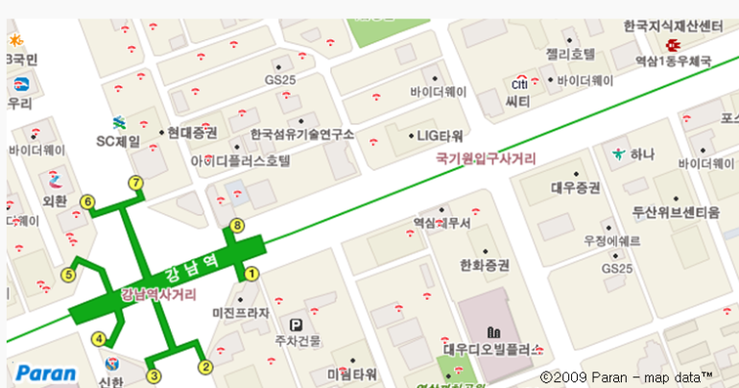
Capacity Boosting : Off-Loading
Off-Loading Data with WiFi: Dark Sides of Reality
- IEEE 802.11n: 600Mbps peak rate with 40MHz channel
- A plenty of channels?
72MHz @ 2.4GHz
150MHz @ 5GHz ➔ To play with 4 channels only …
- Congestion in 2.4GHz ISM band
- Limited coverage
By Olleh WiFi Zone Finder

Slide 15
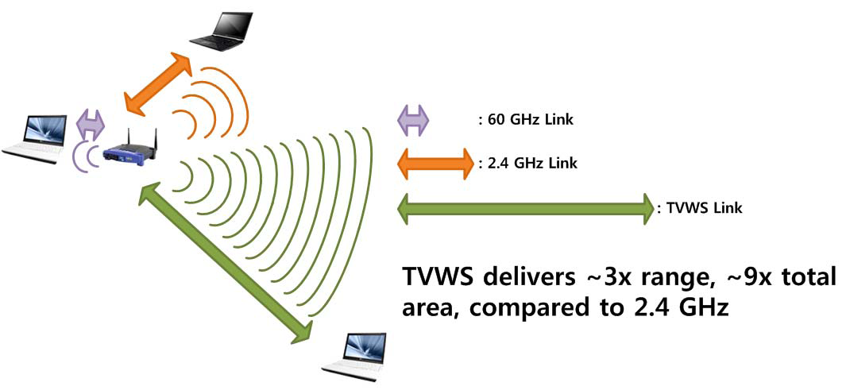
Why WiFi Service Using White Space?
Mostly meaning TV White Space
Offering a longer range than conventional Wi-Fi, which operates at 2.4 gigahertz
Be easier to provide broadband Internet access in rural areas and fill in gaps in city Wi-Fi networks
White Space Coalitions
  Microsoft, Google, Dell, HP, Intel, Philips, Earthlink, and Samsung Electro-Mechanics, etc.
To solve mobile divide
Notes:
In particular, IEEE 802.22 systems offer around 10 times the coverage of Wi-Fi and enable to provide reliable backup broadband communications in emergency.

Slide 16
How to Use White Space
The FCC ruled that companies could build devices that transmit over white spaces but also gave strict requirements that this should not interfere with existing broadcasts, both from TV stations and from other wireless devices that operate within the same spectrum
Until now, in wireless networks, we were given a spectrum, and we would share it with everyone else. Everyone was an equal stakeholder
Now, we have this spectrum where there are certain people who are primary users

Slide 17
Works in IEEE and IETF
IEEE 802.22 :
  Enabling Rural Broadband Wireless Access Using Cognitive Radio Technology in TV Whitespaces
IEEE 802.11af : Wireless LAN in the TV White Space
IEEE 802.19 : Wireless Co-existence Working Group
  standard, which enable effective use of TV white space by IEEE 802 algorithms via coexistence methods
  Coexistence between 802.11af and 802.22

Slide 18
Works in IEEE and IETF
IETF : PAWS WG (started July 2011)
  Protocol to Access White Space (PAWS) Database
  Overall goal of PAWS WG
  Standardize a mechanism for discovering a white space database
  Standardize a method for communicating with a white space
  database
  Standardize the data formats to be carried over the defined
  database communication method
  Ensure that the discovery mechanism, database access method,
  and query/response formats have appropriate security levels in place
Ex., LDAP

Slide 19
Strategies of TV white space in US, EU, etc
US
  November 4, 2008, the FCC voted 5-0 to approve the unlicensed use of white space
    FCC announced TV white space a publically accessible database
  September 23, 2010 : the FCC released a Memorandum Opinion and Order that determined the final rules for the use of white space for unlicensed wireless devices
  FCC has already approved Spectrum Bridge and Ericson as TV white space database administrators
EU
  ETSI : Cognitive System for White Space
  TC RRS: Technical Committee Reconfigurable Radio Systems
  ECMA : 2009.12 : PHY/MAC for White Space (ECMA-392)
  Ofcom :
  - 2011.09 : announced plans to run an ‘enhanced Wi-Fi’ service using
  the white space within the existing TV spectrum
    Enhanced Wi-Fi would typically operate at between 470 and 790MHz
  - 2012.11 : announced the service starting plan using TV White Space in 2013

Slide 20
Strategies of TV white space in US, EU, etc
Japan
  Examination Team For New Radio usage Vision, ”Communication News”, Vol.20, no.20, January 2010
  WiFi Prototype for TV White Space in Oct. 2012
  World's First TV White Space Prototype Based on IEEE 802.22 for Wireless Regional Area Network by NICT : Jan. 2013
Korea
  Testing the spectrum distribution
  Field trial using Wibro module with frequency modification : Oct. 2012

Slide 21
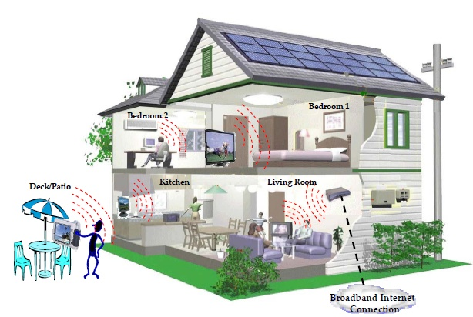
Use Case of WiFi Services using TVWS
Potential Uses (for Home)
  Device-to-Device (Machine-to-Machine)
  WLAN Access
  Backhaul
  Cellular offload

Slide 22
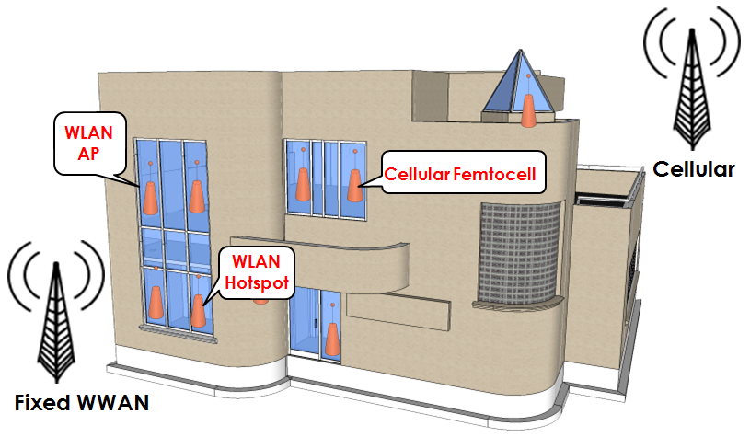
Use Case of WiFi Services using TVWS
Similar usage to the home use case, but very different environment (for business)

Slide 23
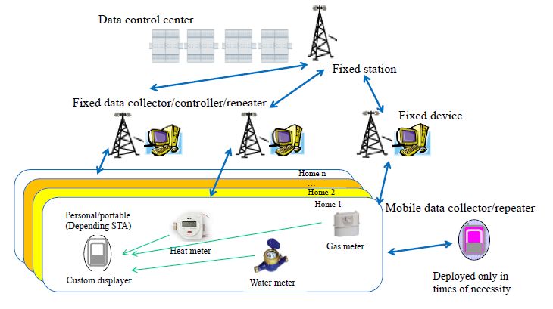
Use Case of WiFi Services using TVWS
Potential uses (for Utility Grid)
  Collection of metered data
  Reporting of aggregated data over the backhaul
  SCADA support

Slide 24
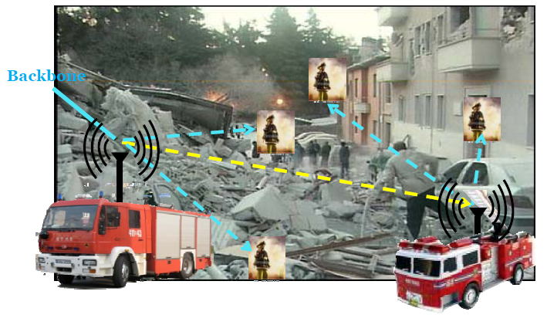
Use Case of WiFi Services using TVWS
Potential Usage (for public safety)
  Rapid deployment of emergency personnel networks
  Inter-personnel communication
  Network backhaul
  Communication to the main office

Slide 25

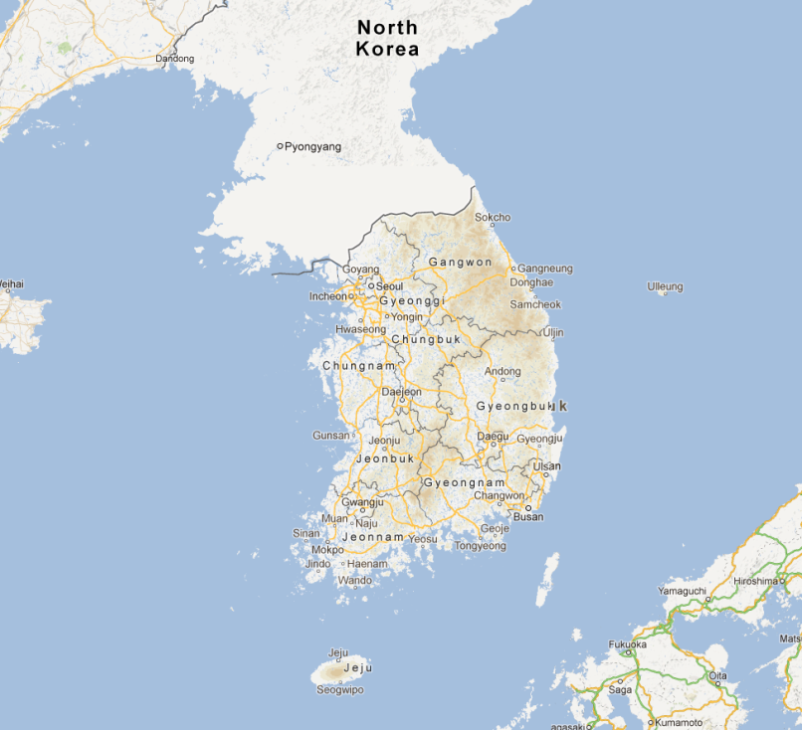
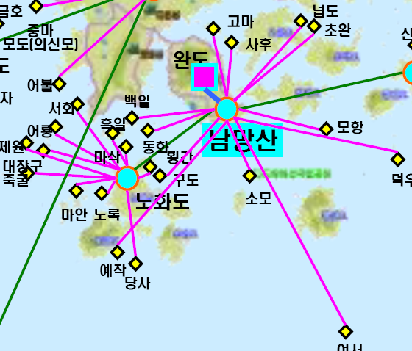
An Experiment in Korea
Backhauling using TV whitespace by KT (Oct. 2012)
Land
TV whitespace Communication
using Wibro
Island
Optical Line
Optical
Line
45th Channel among
4 Channels 24MHz
43
44
45
46
47
48
25
Guard Channels
Wando area,
Chonnam Province
656~662MHz
Experimental Channels
Experimental Region (Nammang Mt- Sahudo)

Slide 26
Research topics on White Space
Efficient Coexistence mechanism between IEEE 802.22 and IEEE 802.11af
Mobility in IEEE 802.22
  WiFi service mobility in white space
Efficient channel bonding and aggregation Technologies
Optimal resource management for MVNO services

Slide 27
Conclusions
Expansion of Backbone networks complying with data explosion
  ROI Issue
  Network Neutrality Issue : Solution?
    CCN
Expansion of unlicensed Spectrum
  For the universal services
  And creating new Internet business
Need to solve the conflictions with TV broadcasting group

Slide 28

Thank you !

