Slide 1
Introduction to Software Defined Network (SDN)
April 9, 2013
CS Hong

Slide 2

The Internet: A Remarkable Story
Tremendous success
  From research experiment
  to global infrastructure
Brilliance of under-specifying
  Network: best-effort packet delivery
  Hosts: arbitrary applications
Enables innovation in applications
  Web, P2P, VoIP, social networks, virtual worlds
But, change is easy only at the edge… ☹

Slide 3
Inside the ‘Net: A Different Story…
Closed equipment
  Software bundled with hardware
  Vendor-specific interfaces
Over specified
  Slow protocol standardization
Few people can innovate
  Equipment vendors write the code
  Long delays to introduce new features
Impacts performance, security, reliability, cost…

Slide 4



Networks are Hard to Manage
Operating a network is expensive (OPEX)
  More than half the cost of a network
  Yet, operator error causes most outages
Buggy software in the equipment
  Routers with 20+ million lines of code
  Cascading failures, vulnerabilities, etc.
The network is “in the way”
  Especially a problem in data centers
  … and home networks

Slide 5
Rethinking the Networking

Slide 6
Traditional Computer Networks
Data plane:
Packet streaming
  Forward, filter, buffer, mark,
  rate-limit, and measure packets
Notes:
Maybe this is a better picture… though need some details of what happens in each plane… like in next slides… or, have both?

Slide 7
Traditional Computer Networks
Control plane:
Distributed algorithms
  Track topology changes, compute routes, install forwarding rules
Notes:
Maybe this is a better picture… though need some details of what happens in each plane… like in next slides… or, have both?

Slide 8
Traditional Computer Networks
Management plane:
Human time scale
  Collect measurements and configure the equipment
Notes:
Maybe this is a better picture… though need some details of what happens in each plane… like in next slides… or, have both?

Slide 9
Death to the Control Plane!
Simpler management
  No need to “invert” control-plane operations
Faster pace of innovation
  Less dependence on vendors and standards
Easier interoperability
  Compatibility only in “wire” protocols!!
Simpler, cheaper equipment
  Minimal software

Slide 10
Open Networking Foundation on SDN
… In the SDN architecture, the control and data planes are decoupled, network intelligence and state are logically centralized and the underlying network infrastructure is abstracted from the applications …

Slide 11
Software Defined Networking (SDN)
Logically-centralized control
Smart,
slow
API to the data plane
(e.g., OpenFlow)
Dumb,
fast
Switches

Slide 12
OpenFlow Networks

Slide 13

Data-Plane: Simple Packet Handling
Simple packet-handling rules
  Pattern: match packet header bits
  Actions: drop, forward, modify, send to controller
  Priority: disambiguate overlapping patterns
  Counters: #bytes and #packets
src=1.2.*.*, dest=3.4.5.* → drop
src = *.*.*.*, dest=3.4.*.* → forward(2)
3. src=10.1.2.3, dest=*.*.*.* → send to controller

Slide 14
Unifies Different Kinds of Boxes
Router
  Match: longest destination IP prefix
  Action: forward out a link
Switch
  Match: destination MAC address
  Action: forward or flood
Firewall
  Match: IP addresses and TCP/UDP port numbers
  Action: permit or deny
NAT
  Match: IP address and port
  Action: rewrite address and port

Slide 15
Controller: Programmability
Controller Application
Network OS
Events from switches
Topology changes,
Traffic statistics,
Arriving packets
Commands to switches
(Un)install rules,
Query statistics,
Send packets

Slide 16
Example OpenFlow Applications
Dynamic access control
Seamless mobility/migration
Server load balancing
Network virtualization
Using multiple wireless access points
Energy-efficient networking
Adaptive traffic monitoring
Denial-of-Service attack detection
See http://www.openflow.org/videos/

Slide 17


E.g.: Dynamic Access Control
Inspect first packet of a connection
Consult the access control policy
Install rules to block or route traffic

Slide 18
E.g.: Seamless Mobility/Migration
See host and send traffic at new location
Modify rules to reroute the traffic

Slide 19
E.g.: Server Load Balancing
Pre-install load-balancing policy
Split traffic based on source IP
src=0*
src=1*

Slide 20
E.g.: Network Virtualization
Controller #1
Controller #2
Controller #3
Partition the space of packet headers

Slide 21
OpenFlow in the Wild
Open Networking Foundation
  Google, Facebook, Microsoft, Yahoo, Verizon, Deutsche Telekom, and many other companies
Commercial OpenFlow switches
  HP, NEC, Quanta, Dell, IBM, Juniper, …
Network operating systems
  NOX, Beacon, Floodlight, Nettle, ONIX, POX, Frenetic
Network deployments
  Eight campuses, and two research backbone networks
  Commercial deployments (e.g., Google backbone)

Slide 22
A Helpful Analogy
From Nick McKeowns talk“Making SDN Work” at the Open Networking Summit, April 2012

Slide 23
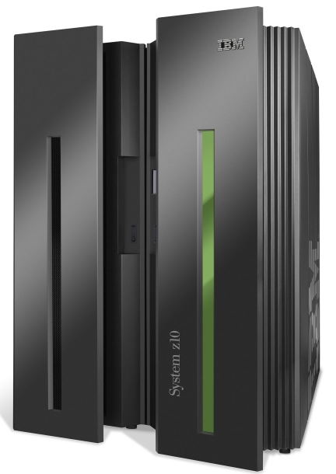
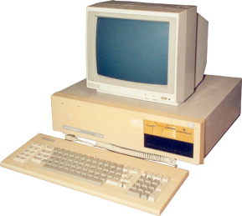
Mainframes
App
App
App
App
App
App
App
App
App
App
App
Specialized
Applications
Open Interface
Windows
(OS)
Linux
Mac
OS
Specialized
Operating
System
or
or
Open Interface
Specialized
Hardware
Microprocessor
Vertically integrated
Closed, proprietary
Slow innovation
Small industry
Horizontal
Open interfaces
Rapid innovation
Huge industry

Slide 24
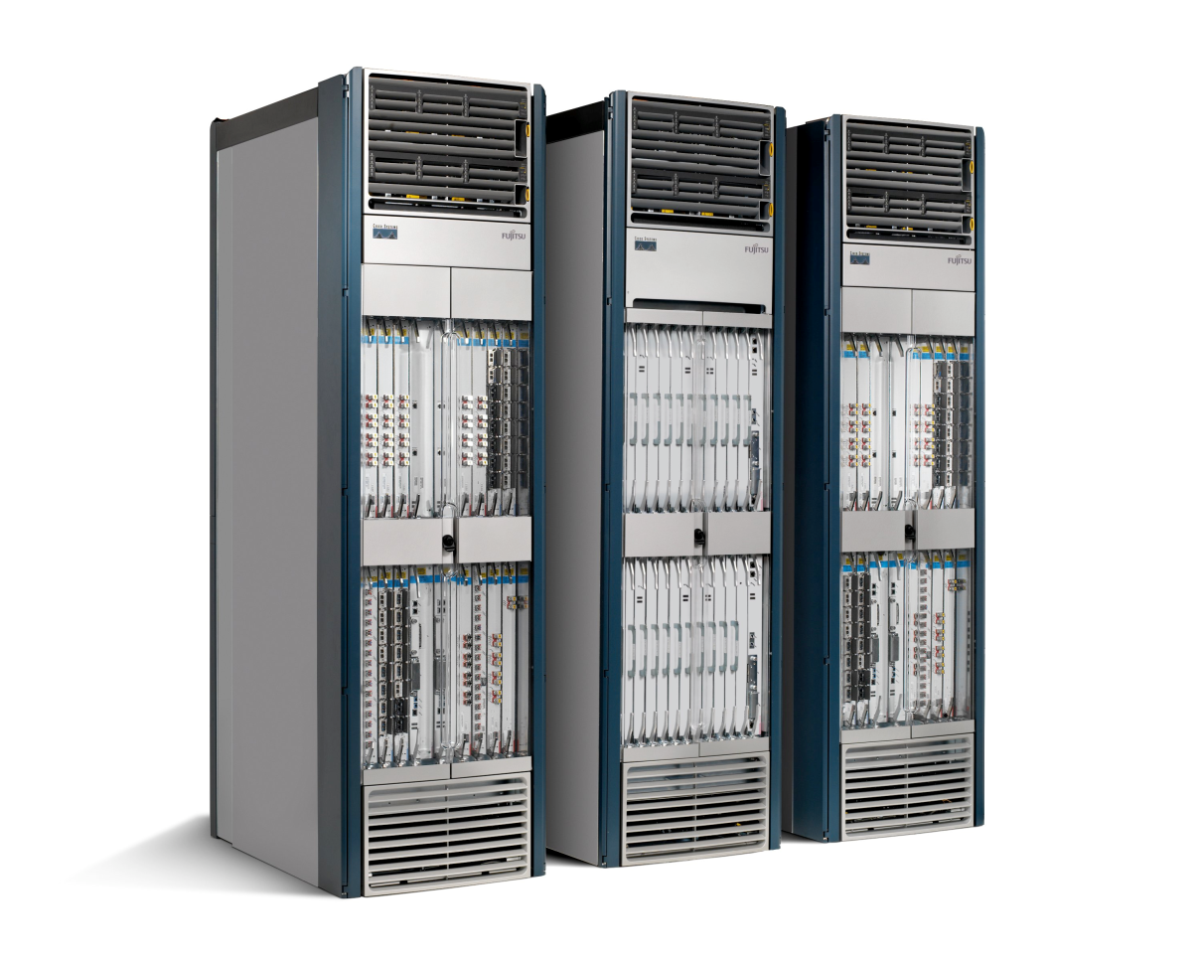
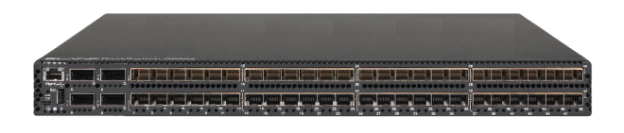
Routers/Switches
App
App
App
App
App
App
App
App
App
App
App
Specialized
Features
Open Interface
Control
Plane
Control
Plane
Control
Plane
or
or
Specialized
Control
Plane
Open Interface
Specialized
Hardware
Merchant
Switching Chips
Vertically integrated
Closed, proprietary
Slow innovation
Horizontal
Open interfaces
Rapid innovation

Slide 25
Challenges

Slide 26
Heterogeneous Switches
Number of packet-handling rules
Range of matches and actions
Multi-stage pipeline of packet processing
Offload some control-plane functionality (?)
access
control
MAC
look-up
IP
look-up

Slide 27
Controller Delay and Overhead
Controller is much slower than the the switch
Processing packets leads to delay and overhead
Need to keep most packets in the “fast path”
packets

Slide 28
Distributed Controller
For scalability and reliability
Controller Application
Controller Application
Partition and replicate state
Network OS
Network OS

Slide 29
Testing and Debugging
OpenFlow makes programming possible
  Network-wide view at controller
  Direct control over data plane
Plenty of room for bugs
  Still a complex, distributed system
Need for testing techniques
  Controller applications
  Controller and switches
  Rules installed in the switches

Slide 30
Programming Abstractions
Controller APIs are low-level
  Thin veneer on the underlying hardware
Need better languages
  Composition of modules
  Managing concurrency
  Querying network state
  Network-wide abstractions
Ongoing at Princeton
  http://www.frenetic-lang.org/
Controller
Switches

Slide 31
Standardization Issues
ONF (Open Networking Foundation)
  Responsible for developing specifications of OpenFlow
  Even though SDO, it is also doing commercial oriented activities
  OF 1.3.1, OF-Config 1.1, OF-Test 1.0. OF-Hybrid 1.0 …
  With Google + Stanford related companies
IETF (Internet Engineering Task Force)
  I2RS WG
  Proposed SDN RG
  Cisco + IETF
ITU-T
  Carrier – SDN
  New Question (NV+SDN), Y.FNsdn
ETSI NFV ISG

Slide 32
Standardization in ONF
Approval of OpenFlow Specification 1.3.1 approval (HP)
  Extensibility WG (Extensibility 1.3.1)
Approval of OF-CONFIG 1.1 (MS/NEC)
  Config & Mgmt WG
Testing & Interop 1.0 (Draft) (Ixia)
    Testing&Interop WG
Hybrid Programmable Forwarding Plane 1.0 (Huawei/Cisco)
  Hybrid WG (closed)
Arch WG (Big Switch)
  Top-Down Approach + (NB APIs)
Forwarding Abstraction WG (Brocade/Cisco)
  ASICs, NPUs, NP element Abstraction

Slide 33
Standardization of IETF
SDN (Software-Driven Networking) BoF @IETF82
Technical Plenary@IETF84
  Technical Session: "Software Defined Networking"
Proposed SDN RG@IETF84, IETF85
IRS BoF@IETF85, now WG
More discussions @IETF86

Slide 34
I2RS(IRS) @ IETF
Interface to the Routing System (i2rs)
Facilitating real-time or event driven interaction with the routing system through a collection of protocol-based control or management interfaces
Allowing information, policies, and operational parameters to be injected into and retrieved (as read or by notification) from the routing system
Users of the I2RS interfaces will be management
applications, network controllers, and user applications that make specific demands on the network

Slide 35
Standardization in ITU-T
Q.21 of SG13 (Future networks)
  Studying networks of 2015-20 ‘future networks’
  Has identified network virtualization as important components of 2015-20 telecom networks
  Hopes to be the pivot of SDN discussion in ITU-T
Draft Recommendations in Q.21
  Y.FNsdn, Framework of Telecom SDN Q4 2013)
  Y.FNsdn-fm, Requirements of formal specification and verification methods for software-defined networking (Q4 2013)
New Question for NV and SDN

Slide 36
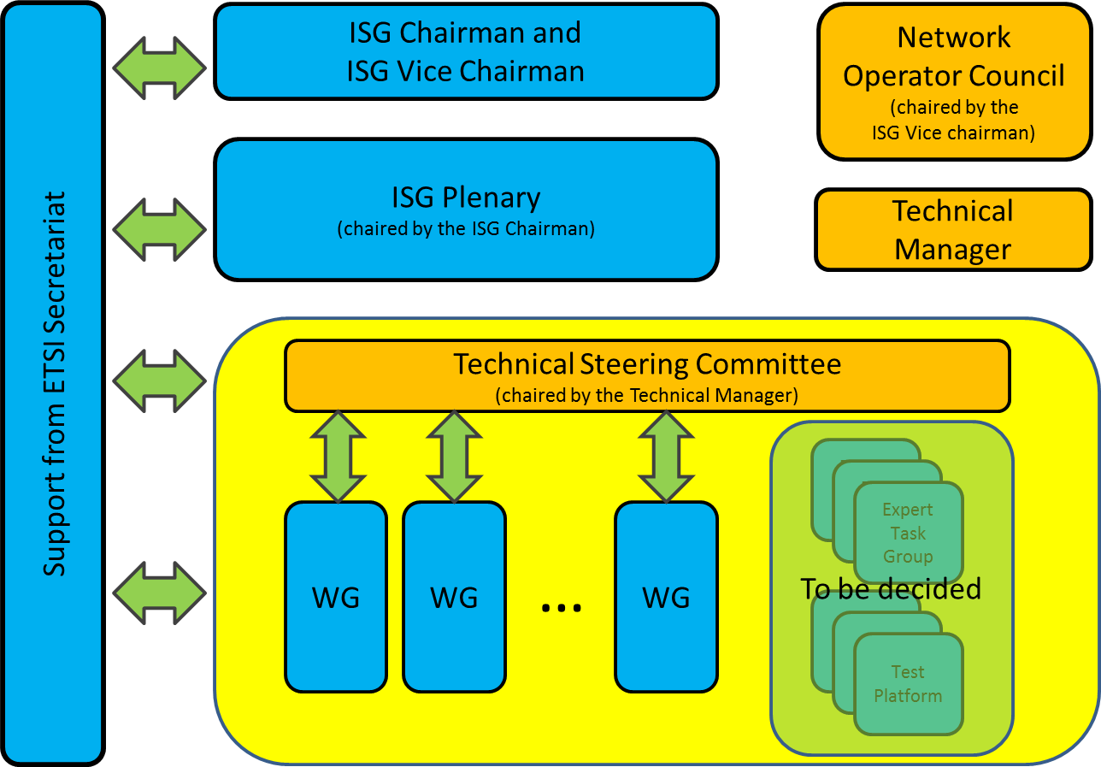
ETSI NFV ISG
1st Meeting
  15 to17January 2013 in Sophia Antipolis
Initial Discussions
  Architecture of the Virtualization Infrastructure (BT)
  Software Architecture for Network Functions (DT)
  Performance and Portability (Telefonica S.A.)
  Reliability & Availability (Verizon)
  Management & Orchestration (Telefonica S.A.)

Slide 37
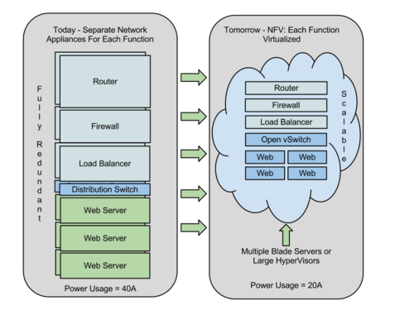
What is Network Function Virtualization

Slide 38

Virtualization,Cloud and SDN
Cloud Computing and SDN expands to Home Network, Data Center, LTE and etc.
Integration of various virtualization and management SW started under the framework of OpenStack
SDN & Cloud Computing
2012~
Rackspace offered Infrastructure-As-A –Service. Previously it was mostly Software-As-A-Service platform
Nicira Buy-out 2012
OpenStack
Management
2010
Openflow
2008
IaaS Cloud
2008
VMware buys Nicira and announced the network is the crucial for cloud computing.
VMWare
IPO 2007
Extended Mobility
(GTP, MME etc.)
Extended AAA
More Access Networks
Integration
Support for specific
applications
Commercially
Meaningful CPU
Virtualization

Slide 39
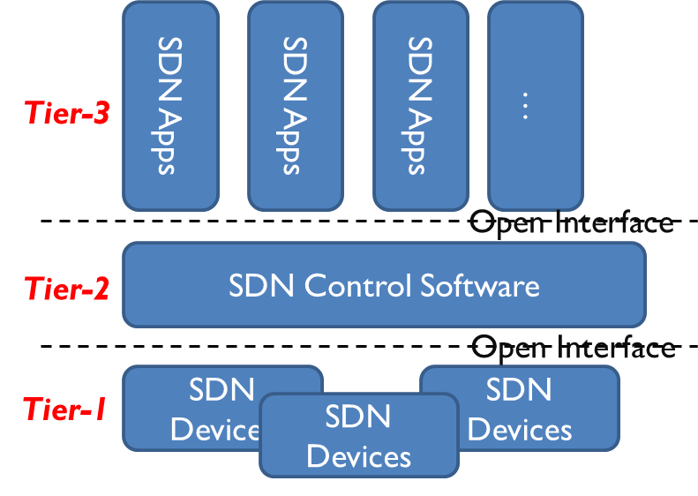
Tiers in SDN
Three-Tier Architecture of SDN
  Tier-1 : Forwarding entities and any software/hardware components comprising of them
  Tier-2 : Control and management entities for the Tier-1
    Control Layer
    Control functions Layer
  Tier-3 : Applications and services that take advantage of the infrastructures based on Tier-1 and Tier-2.

Slide 40
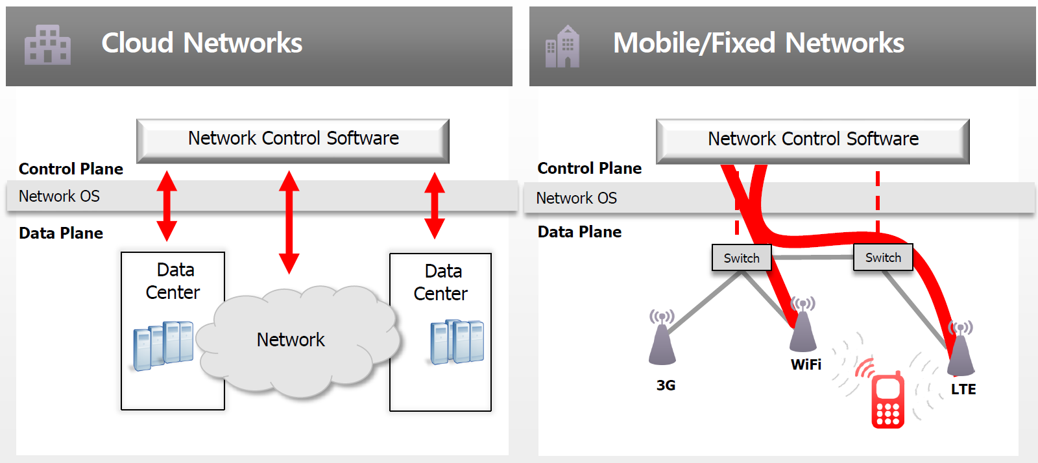
SDN Use Cases
NTT Data: Intra Data Center
Google: Inter Data Center
Verizon: Optimized Routing
DT: Access (RAN, Fixed)

Slide 41
HP Delivers SDN to Achieve Agility
Ability to Apply Business Logic to Network Behavior in Dynamic Fashion
Application
Layer
Deliver open programmable interfaces to automate orchestration of network services
Control
Layer
Separate control and data plane; abstract control plane of many devices to one
SDN Architecture
Infrastructure Layer
Open standard-based programmatic access to infrastructure

Slide 42
HP Delivers SDN to Achieve Agility
Ability to Apply Business Logic to Network Behavior in Dynamic Fashion
Application
Layer
Business Applications
Business Applications
Business Applications
Deliver open programmable interfaces to automate orchestration of network services
Deliver open programmable interfaces to automate orchestration of network services
Deliver open programmable interfaces to automate orchestration of network services
(e.g., OpenStack, CloudStack)
Network Applications
Cloud Orchestration
Network Applications
SDN Applications
Control
Layer
Programmable Open APIs
Separate control and data plane; abstract control plane of many devices to one
Separate control and data plane; abstract control plane of many devices to one
SDN Architecture
SDN Controller
Infrastructure Layer
Control & Data Plane Programmable
Interface (e.g., OpenFlow)
Open standard-based programmatic access to infrastructure
Open standard-based programmatic access to infrastructure
Network Device
Network Device
Network Device

Slide 43
References
Lecture Note by Jennifer Rexford http://www.cs.princeton.edu/courses/archive/spr12/cos461
Nick McKeown’s talk “Making SDN Work” at the Open Networking Summit, April 2012
MK Shin, HSN 2013 Presentation material of SDN
EK Paek, HSN 2013 Presentation material of SDN

Slide 44
Open Source SDN Projects
Floodlight : an open source controller in Java
  Getting rapid acceptance in the OpenFlow community
Open vSwitch (OvS) : a multi-layer virtual switch released under the open source Apache 2.0 license
  Some of the originators of OpenFlow created OvS
OFTest : a framework and set of tests implemented in Python
  Giving people a way to validate the functionality of their OpenFlow switches by developed at Stanford
Indigo : Providing an implementation of OpenFlow on hardware switches by started at Stanford
FlowScale : an OpenFlow load-balancer
FlowVisor : a special purpose OpenFlow controller that acts as a transparent proxy between OpenFlow switches and multiple OpenFlow controllers
http://yuba.stanford.edu/~casado/of-sw.html

Slide 45
Video on SDN
Mind the Gap
http://www.youtube.com/watch?v=Ho239zpKMwQ

Slide 46

Thank you !

