Slide 1
Future Internet Service/Applications
Deokjai Choi
2015. March

Slide 2
Contents
What is Service?
Driving Forces for Services
Emerging Trends
  Ubiquitous
  IoT
  Various, Unexpected Requirements Coming
2 Apporach examples
  Clean slate, evolutionary approach

Slide 3
What is Service?
Provider vs Consumer
IT Service: executing software component (a piece of application logic) which can be accessed, interactive, descriptive, …
Telecom service: what the user pays for
Future Internet Service: a service will be provided through Future Internet or in future required services? Need first? Environment first? Or Interaction?

Slide 4
Provider vs Consumer
Application is a user.
Network including transport is a provider.
Traditional Class of Applications (from network provider viewpoint): requires certain services from network.
  Elastic
  Realtime

Slide 5
Network Service
CO vs CL vs VC
Multimedia traffic
  Realtime(?)
  Now? Why?

Slide 6
Can we change from network to Users?
Service Provided by Network
Service Request from User
  How can we find new services without considering current network limitations?
  Is it possible?

Slide 7
Driving Forces for Services
Mainframe Period (1945 ~ 1980)
  Military
  A small number of users
  For static tasks
Minicomputer with early Networking (1980 ~1990)
  Scientists or some experts
PCs:
  Word Processing, Spread sheet (business)

Slide 8
Driving Forces
Networking period: information search and transfer (Frame: Devices are connected to the fixed network.)
How can we name the coming future computing world?
  Ubiquitous Computing Period?
  IoT
  SNS

Slide 9
Evolution of Computer Networks
Phase 1. Invention of Network
1950
Early networks was developed for military used
1960
The commercial airline reservation SABRE went online with two connected mainframes.
1964
Invention of Dartmouth Time Sharing System for distributed users of large computer systems.
Through the 1960s
network systems that used packets to transfer information between computers over a network.
1962
ARPA was launched for public

Slide 10
Phase 2. Network for Public
1965
First wide area network (WAN) was created
1972
TCP/IP Network was introduced based on X.25
1996
The 56K modem was invented
1991
Home Broadband created

Slide 11
Phase 3. Broadband Network
2000
Cisco achieved a stock market capitalization.
2001
Home broadband enters mainstream
2010
100 Gigabit Ethernet standard fully completed
2009
10 Gigabit Ethernet (GE) was introduced
2020
ultimate goal of enabling 100 Terabit Ethernet by 2020

Slide 12
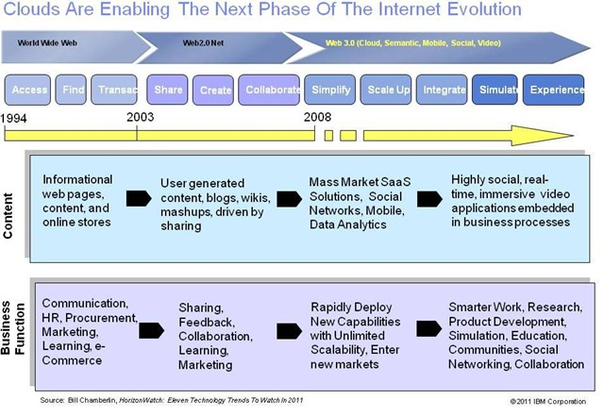
Evolution of World Wide Web

Slide 13
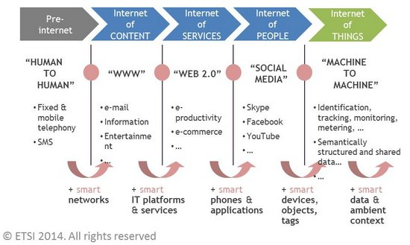
Evolution of Internet Services

Slide 14
Ubiquitous

Slide 15
What are the characteristics for ubiquitous computing?
Anytime, anywhere,…based on ubiquitous neworking (one of the characteristics of future Internet)
Trends
  Embedded processors
  Various emerging networking technologies
    BAN, PAN, VANet, AdHoc, P2P, Sensor Network, WiFi, Wibro, Fixed wireless, …
  Powerful user devices
  Software Tech: components, compositions, discovery, agent, reasoning, recognition, knowledge processing,..

Slide 16
Requirements for Future User
I-Centric
Context Aware
user preference
Proactive
Seamless Service
Knowledge
Contents
Personal
Information
User
Behavior
Personal
Communication
Sphere

Slide 17

I-Centric
Proactive Service Provisioning/ Recommendation
Learned Usage Pattern
Knowledge
Personalized Applications
User in Control
Context from BAN
User Behavior
temperature, heart beat,
Blood pressure, emotion, …
Context from PAN
User Profile
IO devices, Characteristics
Context from WAN
User Rule
Types of network, Network status
Personal Communication Sphere

Slide 18
Context
Human user
  location, identity,…
Device
  IP address, location,…
Network
  identity, resources (bandwidth), QoS, security level, access type, coverage,…
Flow
  congestion level, latency, jitter, loss, error rate, …

Slide 19
Knowledge
Reasoning
Learning
Prediction
Recommendation
wisdom
Knowledge
Information
Data

Slide 20
Network Intelligence
Recommendation
Prediction
Reasoning
Learning
Knowledge Base
User
Rule
User
Profile
User
Preference
Context
User
Behavior
History
Inferred
Knowledge
Service
Profile
General
Context
Communication related
Context
Multi-domain
Network-wide
Context

Slide 21


Service Scenario
Service Enablers
Situation
Personalized Service
Terminal
Value-added service layer
Knowledge layer
Component service layer
Privacy and
Trust
Group
Awareness
Policy
Service Creation and
Lifecycle Management
응급상황 발생
※ 앰뷸런스 5분내 도착
※ 견인차 10분 내 도착
※ 경찰 10분내 도착
※ 스케줄 자동 조정
※ 보험회사와 통화 하시겠습니까? (무응답의 경우 10분 후 담당자 출발)
Attentive Service
Knowledge
Knowledge
Interpretation
Personal
Information
Knowledge Discovery
and Exchange
.
.
.
User
Profile
Distributed Communication
Sphere Management
Information and Content
Delivery and Management
Service Usage Behaviors

Slide 22
Major Components
Service Interaction
Service Discovery
Service Composition

Slide 23
Interactions/Publish-Subscribe
Interaction protocols
  Request/Reply vs. Publish/Subscribe
Why Publish/Subscribe in Context-aware computing?
  Event producers and consumers should be decoupled to adapt to contextual changes.
Issues of publish/subscribe
  Subscription schemes
    Topic-based, content-based, and type-based
  Architecture
    Centralized server, distributed servers, and no server
  Event dissemination
    Communication mechanism: Unicast or multicast
    Event filtering

Slide 24
Standards & Specifications
OMG Data Distribution Service (DDS)
Java Message Service (J2EE JMS)
OASIS WS Notification
XMPP (Extensible Messaging and Presence Protocol of IETF) Publish-Subscribe (XEP-0060)
CORBA Event/Notification Service
OGSI (Open Grid Services Infrastructure) Notification
OGC SWE SAS
  Open Geospatial Consortium Sensor Web Enablement Sensor Alert Service

Slide 25
Issues
Interaction
protocol
dynamic binding of communication
peers (e.g. pub/sub)
adapt to underlying
networks
Context
awareness
Heterogeneous
networks
context-aware reconfiguration of network (e.g. SDR)
needs to incorporate network characteristics as context

Slide 26
Challenges
Context awareness vs. Heterogeneous networks
  Aspects of currently associated network constitute current context. (e.g. attached location, network performance metrics, PAN-id)
  Requires network characteristics to be exposed to context management
  Or, requires network to be context-aware
Heterogeneous networks vs. Interaction protocol
  Communication performance is often a limiting characteristic of interaction model.
  Requires an interaction protocol to adapt to underlying networks

Slide 27
Large Scale Semantic Service Discovery in the Future Internet
April 2007
ICU, Younghee, Lee

Slide 28
Contents
Introduction
Well known protocols
Service discovery in ad-hoc networks
Semantic service discovery
Large scale semantic service discovery
Context aware service discovery

Slide 29
Why service discovery?
Human will be surrounded by a various computing devices.
  Tiny sensors, PDA, PC, CP, notebook, server…
Extreme complexity to manage those devices
  Zero-administration, Zero-configuration
  Need to facilitate interaction between the computer
=> Goal of Service discovery
Originally, to lower the burden of system configuration
  “Plug and play” or “zero configuration”
In more dynamic or ad-hoc environments, service discovery is a necessity.

Slide 30
Service Discovery
What is service discovery?
  A protocol which enables users to discover the most appropriate services to the given context by automatically detecting the services available in the network.
Components and issues
  Directory repository
    Directory structurization
  Service description and matching
    Semantic representation and matching
  Query and service announcement
    Semantic routing
_{Resolver}
_{2. Service Request}
_{1. Service Registration}
_{3. Service Location}
_{4. Service Use}
_{User}
_{Server}

Slide 31
Why service discovery?
Scenario [1]
  Mr. Sue visits ICU
  He searches the Web and finds an on-line Map using his PDA.
    But it’s too small to view on his PDA
  PDA locates the printers
  Mr. Sue (or system) picks up a closest printer among the public printers that are allowed to be used by the guests
  PDA requests printing service (without having a driver for the printer) without Mr. Sue’s intervention
We need to find appropriate services:
  Printing service, Wireless connection service and Location information service.
  Service discovery system will do that with your minimum intervention

Slide 32
Pervasive Service Discovery vs
Web service discovery
Web Service Discovery
  No physical location limitation
  Focuses only on interoperation among applications
  Interoperability through standards such as WSDL and XML
  Universal Description, Discovery, and Integration(UDDI)
    The discovery and configuration process: analysts, programmers, administrators
  Registry and data structure: mainly for EC.: too specific for Pervasive computing service
Pervasive Service Discovery
  Ambient Services Discovery: Local
  Focuses also on both among applications and people
  Integration with people and their ambient environments.

Slide 33
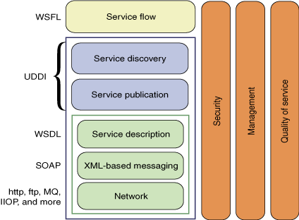
Web Service Stack for UDDI

Slide 34
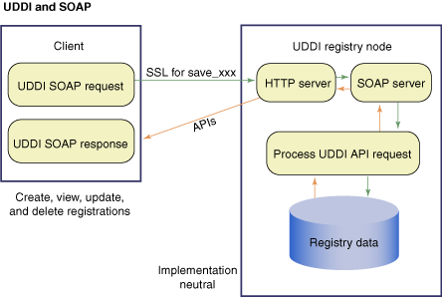
Message flow between Client and Registry

Slide 35
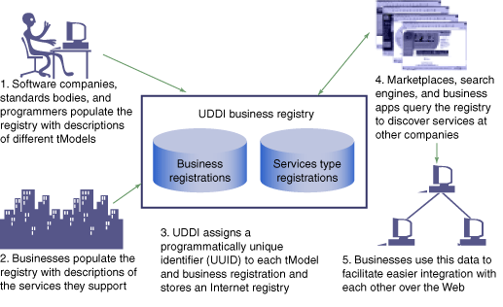
UDDI Working Sequence

Slide 36
Pervasive Service Discovery
Integration with People
  Integration of computing devices with people
  How do we protect personal privacy?
    Personal information : person’s presence, even health status from wearable medical device, user’s intention…..
  How much prior knowledge a user or service provider must have for service discovery?
    Ambiguity: “print” service, “printing” service, standard service name?
Integration with Environments
  How can we precisely define the ambient environment ?
    Location, current user tasks,
    Visitor’s view differs from host’s view
  Heterogeneity
    H/W, S/W platform, network protocols : common platform?
  Dynamic conditions
    Time based approaches: soft state and leased based approaches

Slide 37
Service Discovery
Research Trend
Context-aware Discovery
- Context-based Ranking
Pervasiveness
Semantic Discovery
-Semantic representation & Matching
Discovery in Ad-hoc Networks
- Mobility, Minimizing Cost
Discovery in Large-scale Networks
- Structured architecture (e.g. DHT)
Discovery in LAN
-Jini, UPnP, SLP, Salutation
Static Directory Service
-X.500, LDAP
Time

Slide 38
Well-known protocols
Jini
UPnP
SLP
Bluetooth SDP
Salutation

Slide 39
Service discovery in ad hoc networks
Service description
  What is described?
    service name, type, attribute, keywords, properties and functions
    Service hierarchy - tree like structure (Konark, GSD)
    Interface format, e.g., function prototype.
  How is it described and stored?
    WSDL file (Konark)
    Data structures similar to ASN.1 (DEAPSpace)
      Encoder/decoder
    Ontology: OWL, DAML+OIL (GSD)
Access to the service
  RPC
    SOAP/HTTP (Konark)
    Specific Interface, e.g., function prototype
      Encoder/decoder (DEAPSpace)
  Query formation
    Path based or syntax based
  Request routing
    Policy based (Allia)
    Group based (GSD)

Slide 40
Semantic service discovery
Difficulties of Service Discovery
  Different Resources
    Computing Devices, Software Services, Information Sources
    Representations, Capabilities, Usage
  Distinct Environmental Characteristics
    Preference, Permission, Context
Research Issues
  Abstract Representations
  Semantic Matching
  Context-awareness
Use of semantic ontology
  Inexact/exact querying
  More powerful reasoning engines and AI tools
  Enhancing current service location protocols
Find me the best Pizza service…

Slide 41
Context vs. Semantics
Context
  Any information that can be used to characterize the situation of entities (i.e. whether a person, place or object)
    Identity, Location, Status (or Activity), Time
Semantics
  Abstract notions which can be implicitly derived to identify the differences and correlations between objects/concepts
    What is the semantics of “Alarm”?
      Definition in dictionary
        Sudden fear produced by awareness of danger
        A noise warning of danger
        A bell and etc. which sounds to warn of danger or to wake a person from sleep

Slide 42
Location-aware service discovery
Where is the closest Italian restaurant to me?
Location sensing
Nomadic users
Handy devices

Slide 43
The Future Internet: Service Web 3.0

Slide 44
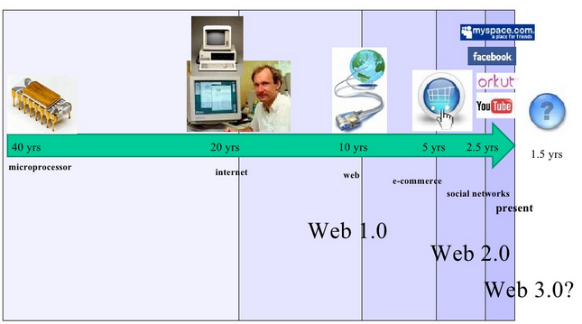
Evolution of the Internet

Slide 45
What is Web 1.0
Web 1.0 refers to the first version of the web, sometimes also known as the informational web.
Web 1.0 was essentially a source of information created by a small number of authors for a very large number of users.
It consisted largely of static webpages with little room for real interactivity. Thus, it functioned much like a large reference book, or indeed a whole library of reference books.

Slide 46
Characteristics of Web 1.0
Web 1.0 site are static
Web 1.0 site are not interactive
Web 1.0 applications are proprietary

Slide 47
What is Web 2.0
Web 2.0 is the term given to describe a second generation of the World Wide Web that is focused on the ability for people to collaborate and share information online.
Most people use it to refer to things like social networks such as Facebook, and other site such as Youtube, where people can post stuff and others can comment.

Slide 48
Characteristics of Web 2.0
  Folksonomy- free classification of information; allows users to collectively classify and find information (e.g. Tagging)
  Rich User Experience- dynamic content; responsive to user input
  User Participation - Information flows two ways between site owner and site user by means of evaluation, review, and commenting.

Slide 49
What is Web 3.0
The web 3.0 is the next paradigm shift of the internet taking the best of web 2.0, including rich internet applications and social media, and bringing them to mobile devices, netbooks, and digital signage. Information is searched for filtered, personalized, and delivered to end users based on preferences, biofeedback and location

Slide 50
Technology Trends
Web 3.0 might be defined as a third-generation of the Web enabled by the convergence of several key emerging technology trends.
Ubiquitous Connectivity
  Broadband adoption
  Mobile Internet access
  Mobile devices
  Network Computing
  Software-as-a-service business models
  Web services interoperability
  Distributed computing (P2P, grid computing, hosted “cloud computing” server farms such as Amazon S3)

Slide 51
Technology Trends (Cont’d)
Open Technologies
  Open APIs and protocols
  Open data formats
  Open-source software platforms
  Open data (Creative Commons, Open Data License, etc.)
Open Identity
  Open identity (OpenID)
  Open reputation
  Portable identity and personal data (for example, the ability to port your user account and search history from one service to another)

Slide 52
Technology Trends (Cont’d)
The Intelligent Web
  Semantic Web technologies : an exciting new evolution of WWW providing machine-readable and machine comprehensible information far beyond current capabilities (RDF, OWL, SWRL, SPARQL, Semantic application platforms, and statement-based data stores such as triple stores, tuple stores and associative databases)
  Distributed databases — or what I call “The World Wide Database” (wide-area distributed database interoperability enabled by Semantic Web technologies)
  Intelligent applications (natural language processing, machine learning, machine reasoning, autonomous agents)

Slide 53
Application of Future Internet Services
City Service with IoT

Slide 54
Smart Cities : Needs of Cooperation Frameworks for Open Innovation
H. Schaffers, N. Komninos, M. Pallot, B. Trousse, M. Nilsson and A. Oliveira, "The Future Internet 2011," 2011. [Online]. Available: http://www.springerlink.com/content/978-3-642-20897-3/.

Slide 55
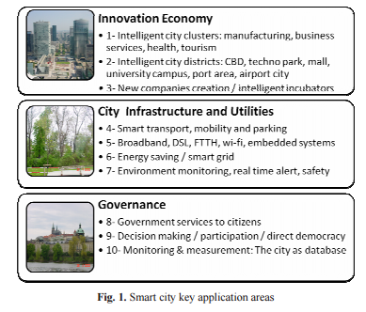
Smart City Key Application Areas

Slide 56
Toward Services to Smart Cities
Smart cities exploit synergies between the ubiquitous sensing technology and their social components to enhance the quality of life of citizens and to improve the efficiency of the city services
However, sometimes this technological environment leads us to disregard the fact that the ultimate aim of the Smart City concept must be the citizens
Following Internet of Things (IoT), enables the creation of a ubiquitous sensing infrastructure within the scope of a Smart City aiming at improving city service efficiency

Slide 57
Future Services
Augmented Reality Services
Participatory Sensing Services

Slide 58
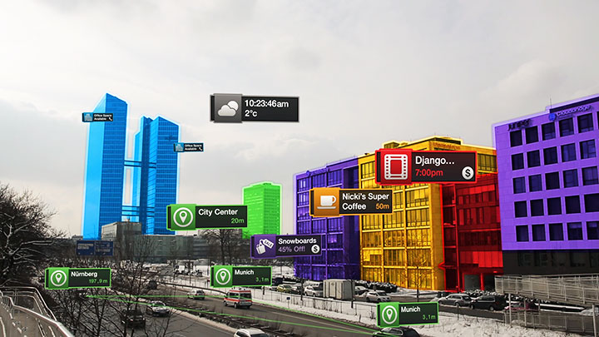
Augmented Reality Services
Augmented Reality (AR) systems have recently emerged as a powerful visualization tool, which augments real world elements with digital information
Powerful smartphones has accelerated the adoption of AR in mobile environments
A particularly important aspect of the AR is its ability to make the user feel naturally surrounded by the technology, thus providing a perfect eco-system for the user to engage with the Smart City concept

Slide 59
Participatory Sensing Services
Social media affect a big part in our lives, from individual to corporate user.
This increase in use of social media makes the topic very important for research and development of new services
Participatory sensing services aims at exploiting the use of citizens smartphones to make people become active in observations and data contributions
Using common platform, citizen can share, report, or notified any events happening in city
By using this platform, city authorities can get real-time feed about important event in the city

Slide 60
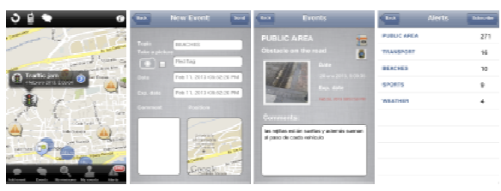
Participatory Sensing Services
Each citizen can subscribe to each specific type of event, for example : accident, traffic jam, flood, etc.
Each subscriber will get notification for each new event posted by other person
The application will also gather GPS location, humidity, acceleration, temperature, etc. which can contribute to further development of new services.

Slide 61
Architecture Model for Service Oriented Future Internet
D. S. Antonio Marcos Alberti, "Developing a NovaGenesis Architecture Model for Service Oriented Future Internet and IoT: An Advanced Transportation System Scenario," in IEEE World Forum on Internet of Things, 2014.

Slide 62
Architecture Model for Service Oriented Future Internet
NovaGenesis : An Advanced Transportation System Scenario
  A new internet architecture starting from scratch, this revolutionary internet will be so different from the current one that it can be seen as a new digital beginning.
Why?
  The technology available today makes it possible to develop a much better internet, one which will be able to cope with the challenges of the next decades
  Internet access is facing big issue of mobility support for scalable network
  How to support global connectivity over trillions of device
  How to secure huge amount of private, sensible information from the army of devices
  How to manage all of it?

Slide 63
IoT Background scenario
Using Advanced Rural Transportation System(ARTS)
  An Intelligent Transportation System that controls and provides relevant information about remote roads and other transportation system in rural area
A comprehensive ART can cover many systems, including for surveillance, monitoring, policing, security, etc.

Slide 64
IoT Scenario : ARTS Service
IoT is progressively committing with all kinds of applications, services and platform
The vision is each pervasive scenarios can be accessed to Internet
This means we deal with ad-hoc networks and smart sensors to monitor ARTS service

Slide 65
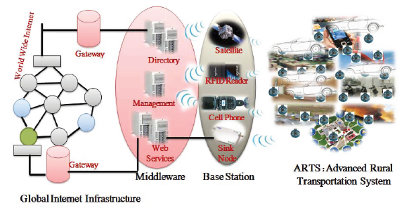
IoT Scenario : ARTS Service

Slide 66
Security, Privacy, and Trust
Ideally ARTS architecture needs built in security
Another useful technique is to change from the “receiver accepts all” model to the “publish/subscribe” model
Entities create trust networks among peers, evaluating the reputation of another entities before dynamic service contact established
Entities also can collaborate to detect illicit behaviors that can characterize potential attack

Slide 67
NovaGenesis Architecture Model
NovaGenesis is a set of distributed systems where any information processing is seen as a service
Services organize themselves based on names and contracts

Slide 68
Open Connectivity Services for the Future Internet
Zhao, Liang; Zaki, Y.; Udugama, Asanga; Toseef, Umar; Gorg, C.; Timm-Giel, A., "Open Connectivity Services for future networks," Emerging Technologies for a Smarter World (CEWIT), 2011 8th International Conference & Expo on , vol., no., pp.1,4, 2-3 Nov. 2011
doi: 10.1109/CEWIT.2011.6135865

Slide 69
Problems and Solution Approaches
Problems for Current Internet Technology:
  Internet today has to support completely different applications and requirements that it was originally designed for.
  Hard to adapt to the changes in traffic pattern in a timely manner.
  Current networking solutions lack efficient orchestration of several connectivity services spanning multiple protocols, layers and interfaces.
Two Approaches for this problem:
  Clean Slate approaches, design a completely new Internet.
  Evolution approaches, evolving the current internet technology to make it more flexible, and thus to cope with the challenges of the future networks.

Slide 70
OConS
One of Evolution Approaches that proposed in this paper is Open Connectivity Services (OConS)
The goals of OConS (Open Connectivity Service) is to provide enhanced and new connectivity mechanisms that are beneficial for the end-users and their applications, as well as for the network operators.
The proposed OConS complies with the following principles:
  Build on the existing Internet foundations.
  Provide a unified and abstract access to the OConS services.
  Provide an orchestration for the OConS mechanisms.
  Concerning security and privacy, the approach is to rely on existing security technology, applying cryptographic solutions that were proven to be useful and showed viability so far.

Slide 71
OConS Approach
Open Connectivity Services which will be offered by OConS are:
  Link Connectivity Services: typically implemented in the PHY or data-link layers.
  Network Connectivity Services: These are node specific services that are related to routing and transport mechanisms, and are independent of the application.
  Flow Connectivity Services: These are flow and session specific, either end-to-end or edge-to-edge, that are related to routing and transport mechanisms, and dependent of the application.

Slide 72
OConS Approach
OConS emphasized the functionality of orchestration for its architecture.
The orchestration applies at several levels, each of them having specific functionalities as follow:
  Orchestration Register: registering all entities so orchestration become aware of their existence and localization.
  Orchestration Monitoring: to monitors network state, implicitly communicating the need of triggering appropriated mechanism to answer specific adverse situations.
  Entities, Resources and Mechanisms Orchestration: responsible for the orchestration among OConS entities as well as the allocation and management of OConS entities resources.
  Link, Network, and Flow Connectivity Services Orchestration: in charge of the instantiation, composition, and launching of OConS mechanisms.

Slide 73
OConS Approach
The illustration of OConS orchestration:

Slide 74
The fluid internet: service-centric management of a virtualized future network
Latre, S.; Famaey, J.; De Turck, F.; Demeester, P., "The fluid internet: service-centric management of a virtualized future internet," Communications Magazine, IEEE , vol.52, no.1, pp.140,148, January 2014
doi: 10.1109/MCOM.2014.6710076

Slide 75
The Fluid Internet
Another paradigm for Evolution Approach is Fluid Internet.
The challenges:
  It must be possible to dynamically manage and provision services end-to-end, effectively breaking the boundaries between different management domains.
  Current static management approaches, over dimensioning of resources, and classification of traffic in only a few traffic classes (e.g., Diffserv’s best effort vs. assured forwarding) contrast greatly with the service centric nature of today’s Internet.
  As devices are becoming smaller and more portable, future Internet management should place larger emphasis on mobility support.

Slide 76
The Fluid Internet
Fluid Internet is paradigm which envisions the dynamic and seamless provisioning of virtualized infrastructure capabilities in order to continuously satisfy the ever-changing requirements of services and users in the face of environmental dynamics.
Fluid Internet introduce two main differentiating points:
  services are treated as first class citizens.
  facilitates the elastic provisioning of virtualized end-to-end service delivery infrastructures.
A unification of concepts from several networking and management principles: cloud computing, network virtualization, and service-centric networking (SCN).

Slide 77
Architecture of Fluid Internet
Fluid internet involves many stakeholders to build the architecture. The figure shows the illustration of fluid architecture that divided into four layer that each which have stakeholders with specific function regarding their layer position. This architecture introduces Infrastructure Provider (IP), Virtual Service Infrastructure Provider (VSIP), and Service Provider (SP).

Slide 78
Setting up a Virtual Service Delivery Network in Fluid Internet
An SP may request end-to-end Virtual Service Infrastructure (VSI) for delivering its service under specific guarantees. Based on this request, the VSIP subsequently performs two or more actions. First, it translates the received end-to-end service requirements into a VSI configuration. Second, it executes a virtual network embedding step.

Slide 79
Dynamic Management in the Fluid Internet
Dynamic management concept in the Fluid Internet goes beyond traditional internet elastic management in both scale and capabilities. In Fluid Internet, Service Provider (SP) continuously evaluates the deployed services requirements in order to assess if its VSIs still satisfy the requirement resource for the service. Illustration of this management concept is shows in the figure.

Slide 80
Future Internet Trend

Slide 81
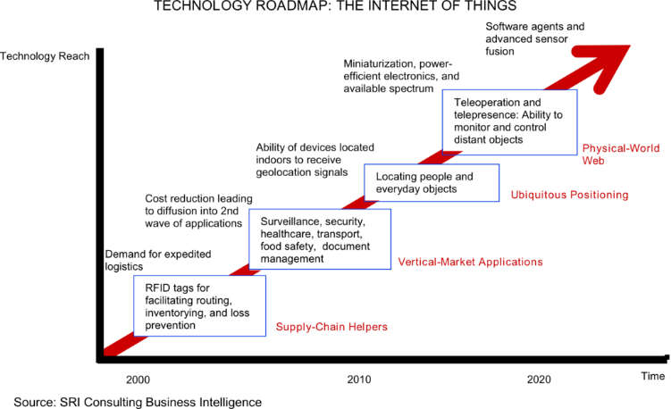
Technology Roadmap

Slide 82
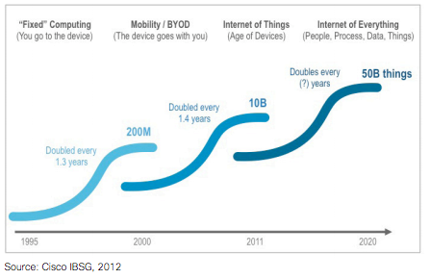
Computing Concept

Slide 83
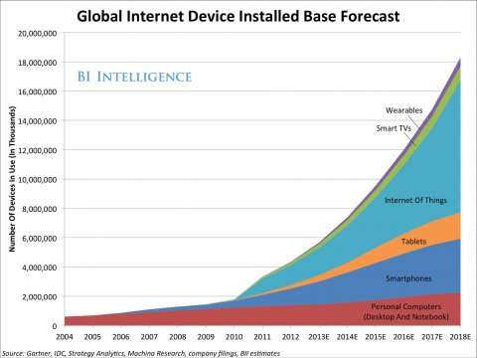
Emergence of Smart Devices

Slide 84
Future?
Human does not know future, even tomorrow what may take place, we do not know?
  How can we imagine after 20 years later application or services?
Bible says: ‘And he causeth all, both small and great, rich and poor, free and bond, to receive a mark in their right hand, or in their foreheads:
And that no man might buy or sell, save he that had the mark, or the name of the beast, or the number of his name.’ Rev 13:16-17

