Slide 1
IoT in Future Internet
2015. 4
Deokjai Choi

Slide 2
Table of Contents
What is IoT?
Why do we care for it?
Networking Issues
Service Issues
Security Issues

Slide 3
What is IoT?
Things equipped with computing(sensing and actuator) and networking capability
  Smart objects
Phase
  1st:Things are connected to the Internet
    Accessible
    Controllable
  2nd: collaboration among things to provide customized context aware service to the users.

Slide 4
Similar or Related Terms
Internet of Things
Machine-to-Machine communication(M2M)
Ubiquitous computing
Embedded computing
Pervasive computing
Smart services
Industrial Internet
→ Naming this phenomenon is difficult.

Slide 5
Examples of IoT systems
Remote monitoring of industrial machinery through sensors helps avoid downtime.
  Many kinds of vending machine (coffee, juice, icecream etc)
  Plants for watering or fertilizer
  Weight mgmt/pregnant women monitoring
  Mobile Personal Emergency Response Service
  Smart Electric meter for consumer and provider
  Air pressure level for car’s tire/ usage based car insurance policy development
  To find lost things such as small children/pet, or objects

Slide 6
Examples of IoT systems
Korea Government Initiated Projects

Slide 7
Global Smart City 실증단지 조성
미래창조과학부 (Ministry of Science, ICT and Future Planning, Korea) 공모 사업 (invitation for public participation)

Slide 8
Testbed Plans in Korea (2015/4)
Busan with SK Telecom
  Theme: Global Smart City
  Project period: 2015 ~ 2019 (5years)
  Area: 해운대 센텀지역
  Participants: 에스넷시스템, 핸디소프트
  Partners: Smart City Ecosystem Construction (Lotte 20B, 창조경제혁신센터), Busan University (IoT Research Center, Big Data Platform Research Center), KAIST IoT research center, ETRI 융합기술연구소 (Fusing technology)
  Budget: 5.47Billion won (Gov 3.2 B)
  Target Service: Smart Parking, Smart Energy Management for big market, Smart Safety Management, Smart Street Lamp (약 25개 서비스)
  Goal: HRD 1,500명, 창조기업 150개, 글로벌중소기업 15개 육성, 글로벌 공동서비스 15개

Slide 9
Testbed Plans in Korea (2015/4)
Daegu with Daegu Technopark
  Theme: Healthcare
  Participants: KT, Samsung Electronics
  Budget: 8.145B (Gov 5.2B)
  Target Service: Health management, Stress Control, Chronic Disease Mgmt, Obesity Mgmt for young people, airforce pilot fighting power mgmt.

Slide 10
Why do we care?
Any device that is connected is smart.
Opportunity to talk to the analog world around us in a digital way
  Speed of light, easy multiplication, easy integration with other digital systems.
To eliminate a lot of guesswork from everyday decisions.
Transform surrounding data in bto the valuable information

Slide 11
Key Trends behind this
Miniaturization by Moore’s Law
Affordability of devices (more than 50 billion devices will be connected by 2020)
  Arduino, Raspberry PI
Wireless connection
Data Mining
→ It will be continuing.
Once open connectivity interfaces are in place, service innovation will follow.

Slide 12
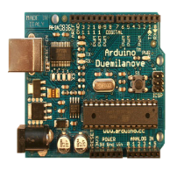
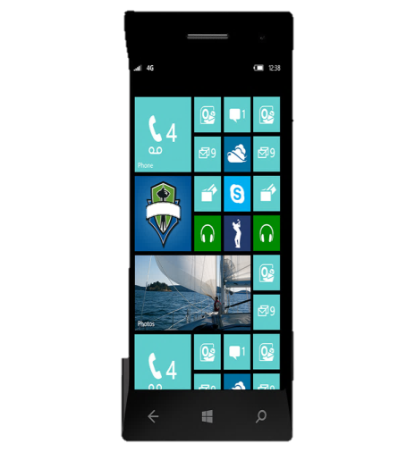
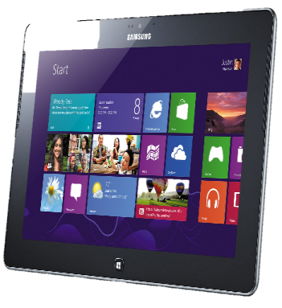

Service
Sensor
Sensor
Sensor
Sensor
Sensor
Sensor
Sensor
Digital Hub
Digital Hub

Slide 13






Device
IoT Component Costs
USD
Other key enablers for IoT Hardware
Cost effective component manufacturing
Energy Source
Open source hardware components
Camera
Accelerometer
Microphone
Wi-Fi Radio
Temp Sensor
GPS
Crowdfunding and easier financing
8-bit microcontroller
Bluetooth Radio
Notes:
Component costs are projected to reduce drastically by 2016
Controller and connectivity costs are projected to drop by ~50% of the 2010 costs
Sensor costs are projected to reduce between 20% - 50%
More sensors are being integrated on a single chip to reduce power, cost and physical size
Low-cost connectivity chips for WiFi, Zigbee, 6LoWPAN and Bluetooth Low Energy are widely available
TI’s WiFi chip module is priced at $10 for a quantity of 1000 chips
http://www.dragoninnovation.com/projects

Slide 14
Arduino

Slide 15
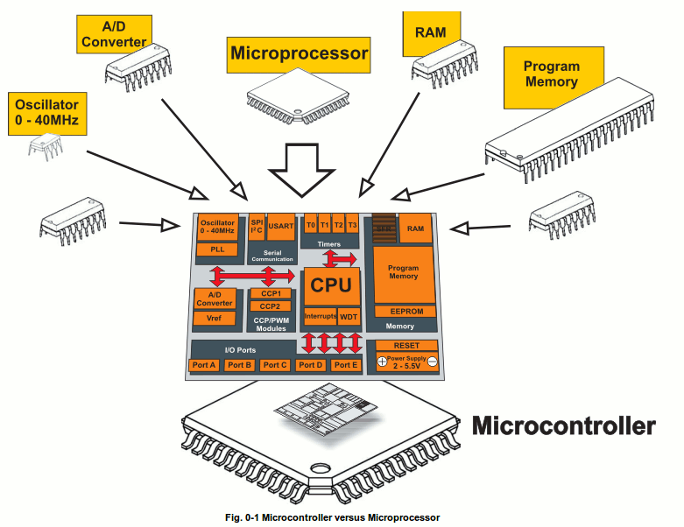
Microcontroller
하나의 칩으로 구성된 작은 컴퓨터
  processor, memory, input/output
주로 Embedded 영역에서도
최저 성능/비용
Arduino, Raspberry Pi…………

Slide 16
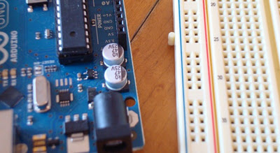
Open Hardware
Typical components include:
  power circuit
  programming interface
  basic input; usually buttons and LEDs
  I/O pins

Slide 17
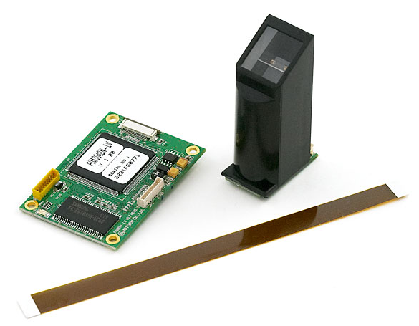
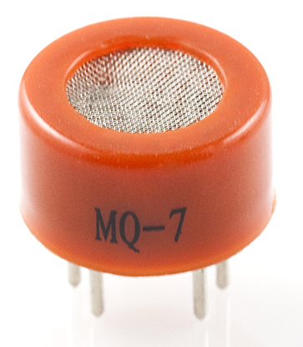
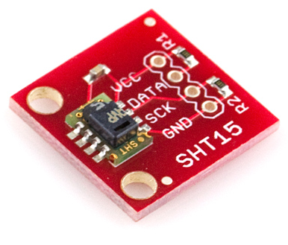
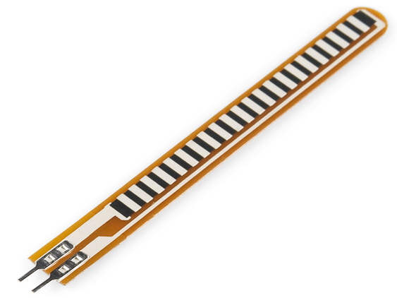
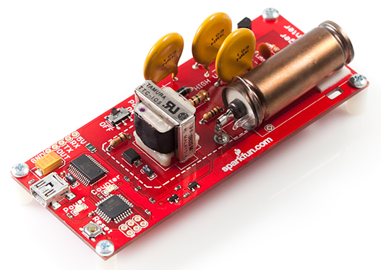
Sensors
Fingerprint Scanner
Gas Sensor
Temp & Humidity
Flex Sensor
Geiger Counter
Notes:
Shields aren't the only way to extend an Arduino board - you can hook sensors to it! These are some of the hundreds (if not thousands) available. Many of these are not made specifically for Arduino - some sensors, such as thermistors, you can get from Radio Shack and wire them in!
Sensors can run as low as $0.95 (for a thermistor or light sensor) to $150 (Geiger counter sensor)

Slide 18
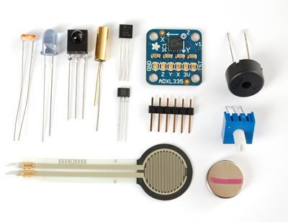
Sensors
Photo/thermistor, infared, force sensitive resistor, Hall effect, Piezo, tilt sensor..

Slide 19
Networking Issues
How to connect things with Internet?
Traffic characteristics
  Real time
  Elastic
  Big or small bandwidth requirements
  Stream like delivery vs not stream but disconnected allowed (because of mobility)
  → Probably nothing new from networking viewpoint.

Slide 20
Topology
Edge + Access + Core Network
Who are the members of Edge network?
  Individual smart object such as desktop, notebook, pad, smart phones, wearable things etc
  Each individual sensor?
  A group of nodes
    PAN with wearable devices
    Home network with home appliances
    Sensor network including mobile sensor networks
    Car or airplane network

Slide 21
What are technical challenges to FI for IoT?
Heterogeneity of resource capability
  Computing power
  Communication capability
  Energy consumption requirements
Too many things for naming and addressing
Can anyone design a certain architecture and enforce that design to the world?
Or Should researchers try to accommodate naturally coming things evolutionarily?

Slide 22
Lessons from current IP
To overcome underlying heterogeneous hardware networks.
In IoT world, there would be more networks than current which are heterogeneous too.
So, we need to have still virtual technology to hide this heterogeneity.
Considering too many things in future, IPv6 may not be avoidable.

Slide 23
Naming & Addressing Issues
Option 1: Every node has its own IP address.
Option 2: IP address is given up to a gateway node. Internal nodes to the gateway are allowed to use its own addressing scheme.
  Hierarchical address with address translation

Slide 24
Glowbal IP: An adaptive and transparent IPv6 integration in the Internet of Things
Mobile Information Systems 8 (2012) 177–197
Antonio J. Jara∗, Miguel A. Zamora and Antonio Skarmeta
Department of Information and Communication Engineering, University of Murcia, Murcia, Spain

Slide 25
Motivation and Objectives
Future Internet and the IoT represent unprecedented growth in the number of devices and users connected to the Internet.
Nowadays, users and clients discover and use homogenous IP-based resources which already deployed.
The problem is other technologies such as IEEE 802.15.4 (LR-WPAN) and Bluetooth Low Energy are not based on IP networks
Main motivations :
  The overload resulting from 6LoWPAN for global communications
  Make IP connectivity feasible for non-IP enabled technologies and new IoT technologies such as Bluetooth Low Energy

Slide 26
Motivation and Objectives
Based on those motivations, Glowbal IP’s objective is to provide connectivity to the Future Internet Core Network based on IPv6 for devices which have no support for 6LoWPAN in their stacks
Glowbal IP technologically provides current sensors from deployed environments with an adaptation mechanism to make end-to-end connectivity feasible.

Slide 27
AAID : Access Address Identifier
AAID is 32-bit address that is generated at the time the connection is set up.
The access address identifies a connection between a node and a client
The sensors can configure/negotiate the AAID with the gateways/Border Routers for a communication process.
AAID simplifies the parameters from the IPv6 communication (source address, destination address, source port, and destination port) in a single 32 bit communication identifiers.
In order to make the process more compatible and extendible, AAID included as part of the current application layer (payload) not as an additional network layer
The AAID is generated using a simple hash process based
on CRC-32 bits

Slide 28
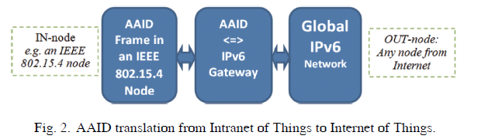
AAID : Access Address Identifier
Translation is carried out by the gateways, as shown in Fig. 2.
Global connectivity is reached through the AAID to IPv6 gateway, which is called an AAID gateway (similar to Border Routers from 6LoWPAN)

Slide 29
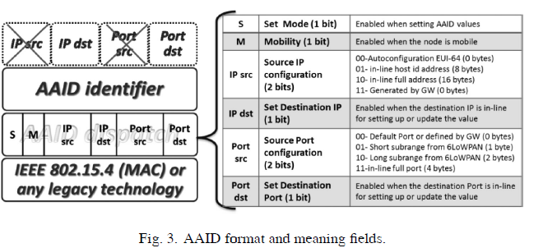
Glowbal IP Header Format
Glowbal IP is not actually presenting a network header since it is considered part of the payload.
Therefore, it can be considered as a session layer over the application layer
AAID requires information regarding the IP network layer, mainly for the destination node.
The IPv6 header format consists of these main parts :
  AAID dispatch
  AAID identifier

Slide 30
Glowbal IP Header Format
AAID dispatch: Indicates the control information for AAID management, as well as information from the original IP/UDP header in-line. Specifically, the fields provided are:
  Set bit (S): This bit indicates the definition of a new session from the AAID gateway to the AAID node, or vice versa
  Mobility/Multi-homing bit (M): This tells the AAID gateway to check with the other AAID gateways, through the back end or the overlay, that this node does not have pending sessions from another location.
  IP source format (IP S): These bits indicate the IP source address format
  IP destination set (IP D): This bit shows its configuration. This function is usually enabled in conjunction with the S bit.
  Port source format (Port S): This is based on the same format as the one for 6LoWPAN in RFC4944, where specific sub-ranges of ports are defined in order to reduce the number of bytes that are required to specify the source port.
  Port destination set (Port D): This bit shows its configuration. This function is usually enabled in conjunction with S bit
AAID identifier: This defines the 32 bits of the AAID identifier

Slide 31
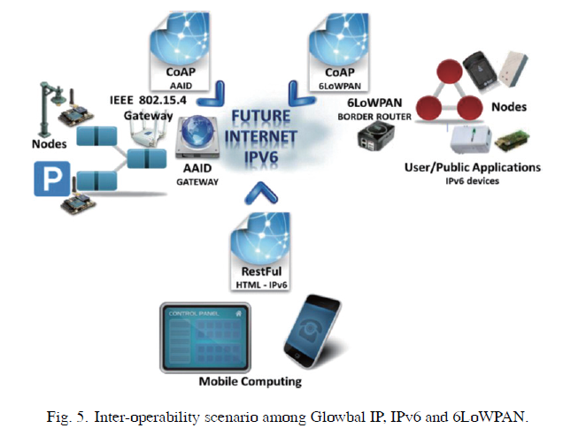
Interoperability Scenario
Figure 5 shows an interoperability scenario,where there are sensors supporting 6LoWPAN and RestFul through Contiki OS, such as Telos B motes, as well as sensors with native IPv6 support, such as SunSpots
It is connected with applications from the user or public management as well, and accessed through the Future Internet network in a transparent and homogeneous way

Slide 32
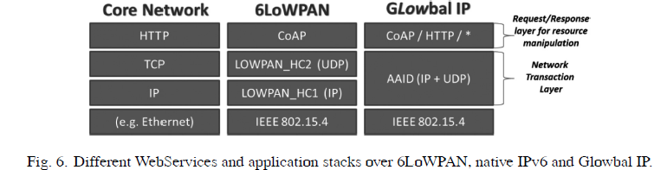
WebServices support with Glowbal IP
Homogenous access to information and management WebServices such as is highly interesting and desirable in order to define solutions that are based on the so-called Web of Things
WebServices protocols, such as RESTful and other application packets, are encapsulated after AAID, which only identifies the session to which the packet belongs
It also opens an opportunity for the Web of Things and remote Web Services with end-node

Slide 33
Discovery support with Glowbal IP
Glowbal IP presents the advantage of continuing to use the already extended discovery systems for the Internet of Things
The chosen solution for discovery is DNS-SD (service discovery) and mDNS, which is an evolution of DNS
It is mainly focused on the naming aspects for resources, although it also offers the description of the resource and services through the use of its records
DNS-SD defines DNS pointer (PTR) records to indicate the type of service using the form_type._protocol.domain for a specific IP locator

Slide 34
Discovery support with Glowbal IP
These DNS-SD pointers are originally defined by the reverse DNS protocol, which through these, the user is able to find all resources in a specific domain, e.g.: “example.com,” by issuing a query for http. tcp.example.com
DNS-SD is extended with mDNS in order to carry out the queries, and use the “.local.” domain to operate over link-local multicast

Slide 35
Efficient and scalable IoT service discovery on Cloud
Fei Li, Michae Vogler,..
Vienna University of Technology
2013

Slide 36
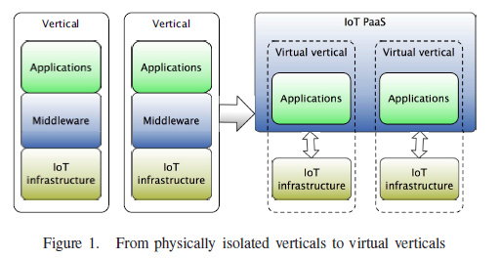
Introduction
Current Internet of Things solutions are typically provided in single domains, problem specific which is not efficient and have very limited scalability
The efficiency and scalability of such service delivery model are intrinsically limited, posing significant challenges to IoT solution providers
This work aims at leveraging cloud service delivery models to enable efficient and scalable IoT service delivery
The core idea is to realize a domain- independent PaaS (Platform as a Service) framework that provides essential platform services on cloud for IoT solution providers to efficiently deliver and continuously extend their services

Slide 37
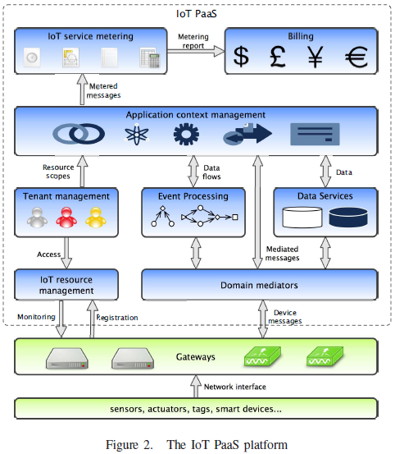
IoT PaaS
The IoT infrastructure consists of networked tags, sensors, actuators, smart devices and so on
Gateways are commonly applied in many IoT solutions to connect heterogeneous, resource-constraint devices
The mechanisms for providing service interfaces for devices are generally referred to as device virtualization, since they effectively translate device and network interfaces to software interfaces

Slide 38
IoT PaaS
IoT resource mgmt provides a registration point for virtualized devices, gateways and control applications
The component monitors the resource status and enforce the access policies through gateways

Slide 39
IoT PaaS
The diversity of exiting domain-specific data models has introduced another layer of heterogeneity
Domain mediators is proposed to mediate the interfaces between different gateways in the same application domain

Slide 40
IoT PaaS
Event processing is to process and analyze realtime events generated by sensory devices
The service is able to produce data flows and detect interested patterns or events according to data users’ specifications
Data service, as a standard service of PaaS, facilitates storing, retrieving and manipulating persisted data while hiding the specifics of the underlying database systems

Slide 41
IoT PaaS
Tenant management provides a consolidated view of the resources that are accessible by each tenant
Application context management is focused on maintaining the optimal runtime resources and software configurations for applications

Slide 42
IoT PaaS
IoT service metering measures the usage of various services that could be involved in the delivery of an application, mainly by monitoring service messages and invocations that are concerned by the platform and stakeholders

Slide 43
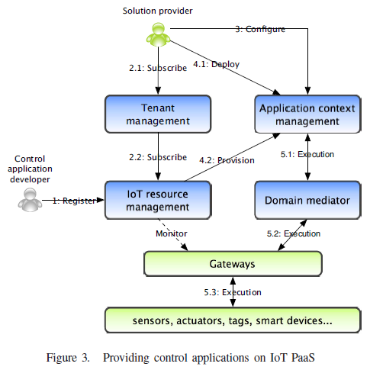
The process of providing control applications
Control applications registered to the IoT Resource management
The provider of each virtual vertical solution needs to subscribe to the applications that will be used in the solution. The subscription is under the agreed tenancy between the solution provider and IoT PaaS platform provider

Slide 44
The process of providing control applications
After subscription, the solution provider can configure each control application with the proper parameters (e.g. goal of control, device IDs) through application context management
At the deployment phase, the solution provider will deploy the solution with subscribed control applications to the configured application context

Slide 45
The process of providing control applications
Finally, the applications are executed in their own contexts and devices are invoked through mediators

Slide 46
A System Model for Energy Efficient Green-IoT
Network
Sarder Fakhrul Abedin,.., CSHong
2015

Slide 47
Introduction
A recent study by Gartner projects that, around 26 Billion devices will be connected to the network by the year of 2020
These devices will produce a lot of electronic waste and will also consume a significant amount of energy in order to execute different tasks
This will eventually pose a challenge in near future to reduce the energy consumption and will also demand for new ways of developing a green communication across the network
This paper addresses the energy efficiency issues across diverse IoT driven networks by proposing a system model for G-IoT and energy efficient scheme for the IoT devices to extend the life expectancy of the whole IoT network

Slide 48
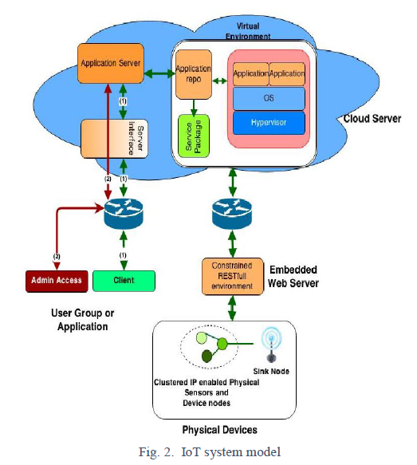
System Model
The proposed system model in Fig. 2 is comprised of conventional device hardware which represents the physical hardware for example sensors, home appliances
These devices will be connected with the embedded web server.
Embedded webserver hosts RESTful web service to communicate with the cloud server for virtualization of objects.
Virtual objects will be transferred to server application for service lookup and will host the virtualized object service executable applications

Slide 49
System Model
Physical Devices :
  In their scenario they devise a cluster of low powered and less capable sensor devices with IP address which act as relay nodes
  On the other hand, devices with better connectivity and capability act as sink nodes that communicate with the embedded devices
  Relay nodes produces the data and send it to the sink node so that the sink nodes can redirect the aggregated flow of data to the embedded web server for further processing

Slide 50
System Model
Embedded Web Server :
  Embedded web server will host IETF constrained RESTfull environment
  This server environment will receive the device specification, for example product id/MAC id, assigning device IP address and will notify the cloud server for creating a virtual object in the cloud virtual environment
  Another task of the embedded web server is to schedule the physical and sensor devices.
  Scheduling will let this type of devices to become energy efficient and the energy consumption will be directly proportional to device utilization

Slide 51
Energy Efficient Scheduling
The algorithm is framed in the proposed system model so that the model can incorporate with the scheduling algorithm and can also serve its’ true purpose
The algorithm has three core stages such as On-duty, Pre-off duty and Off- duty
  On duty: In this state device will be performing with its full fledged capability.
  Pre-off duty: This state will be activated after On-duty state when the device will be idle for sometimes. During Pre-off stage, a device can only receive and transmit the necessary commands from the sink node. In a nutshell, the devices will be activated but with a limited capability of receiving and transmitting
  Off duty: This stage holds three states to save energy in different circumstances and the energy efficiency of the entire cluster or network mainly depends on this state

Slide 52
Energy Efficient Scheduling
Off Duty Types :
  Hibernate: Hibernate state is the state where the device will have small power to only sense the environment before going into more energy efficient state. In this state the device will use only the least amount of power and for the devices that have the renewable energy capability will recharge by that time which will extend the device’s life expectancy
  Sleep : Sleep is a power saving state that has the ability to quickly allow the device to use resume the full-power operation
  Power off : is the most energy efficient state that will put the device into deep sleep. The sink node will directly trigger the device when any necessary task should be performed

Slide 53
Sensor Discovery and Configuration Framework for The Internet of Things Paradigm
Perera, C.; Jayaraman, P.P.; Zaslavsky, A.; Georgakopoulos, D.; Christen, P., "Sensor discovery and configuration framework for the Internet of Things paradigm," Internet of Things (WF-IoT), 2014 IEEE World Forum on , vol., no., pp.94,99, 6-8 March 2014
doi: 10.1109/WF-IoT.2014.6803127

Slide 54
Introduction
Internet of Things (IoT) will comprise billions of devices that can sense, communicate, compute and potentially actuate.
The data streams coming from these devices will challenge the traditional approaches to data management and contribute to the emerging paradigm of big data.
One of the most challenging tasks before collecting and processing data from these devices (e.g. sensors) is discovering and configuring the sensors and the associated data streams.

Slide 55
Research Challenge
A sensor configuration process detects, identifies, and configures sensor hardware and cloud-based IoT platforms in such a way that software platforms can retrieve data from sensors when required.
The major factors that makes sensor configuration challenging are:
  The number of sensor
  Heterogeneity
  Scheduling, sampling rate, and Network Communication
  Data Acquisition
  Dynamicity
  Context

Slide 56
Architectural Design
In this paper, the proposed solution for sensor discovery and configuration is namely: Context-aware Dynamic Discovery of Things (CADDOT). Some step in this model was implemented in SmartLink
The figure show the phase in CADDOT model.

Slide 57
Implementation Strategies
To implement the design, this paper introduce two strategies.
  Usage of static SmartLink strategy
  Usage of mobile SmartLink strategy

Slide 58
System Architecture
The figure show the system architecture of the CADDOT model which consists of three main components: sensors, SmartLink tool, and the cloud middleware.
The interaction is shown in the number order.

Slide 59
Sequence Diagram for Sensor Interaction
The figure shows how the interaction between sensor and the SmartLink application.

Slide 60
Trust Management for Service
Composition in SOA-based IoT Systems
Ing-Ray Chen; Jia Guo; Fenye Bao, "Trust management for service composition in SOA-based IoT systems," Wireless Communications and Networking Conference (WCNC), 2014 IEEE , vol., no., pp.3444,3449, 6-9 April 2014
doi: 10.1109/WCNC.2014.6953138

Slide 61
Introduction
An Internet of Things (IoT) system connects the physical world into cyberspace via radio frequency identification (RFID) tags, sensors and mobile devices.
Trust management (TM) plays an important role in IoT for reliable data fusion and mining, qualified services with context-aware intelligent, and enhanced user privacy and information security.
Service Oriented Architecture (SOA) provides connectivity and interoperability among heterogeneous IoT devices in the physical network.

Slide 62
Introduction
IoT Systems challenge trust management in the following aspects:
  IoT system evolves with new nodes joining and existing nodes leaving.
  Entities of IoT system are mostly human carried or human operated devices.
  A Social IoT system essentially consists of uncensored IoT devices providing a wide variety of services.
To answer the challenge, this paper proposed design of an adaptive and survivable trust management protocol for SOA-based social IoT systems.
The trust management protocol must be executed autonomously by SOA-based IoT devices with little human intervention.

Slide 63
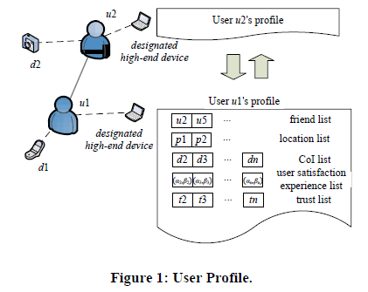
System Model
The proposed trust management protocol consider:
  A social SOA-based IoT environment where nodes are physical connected via communication networks and socially connected via users’ social networks.
  There are two types of nodes: devices and users (or owners). The trustor is a user and the trustee is a device.
  The trust evaluation is computed and stored in a designated high-end device owned by the user.
  Three social relationship: friendship, social contact, and community of interest (CoI).

Slide 64
System Model
In the context of SOA, an owner provides services via its IoT devices.
A malicious IoT device can perform the following attacks for its own gain:
  Self-promoting attacks: it can promote its importance (by providing good recommendations for itself) so as to be selected as the service provider, but then can provide bad or malfunctioned service.
  Bad-mouthing attacks: it can ruin the reputation of a well behaved device (by providing bad recommendations against it) so as to decrease the chance of that good device being selected as a service provider.
  Ballot stuffing attacks: it can collude with a bad device and boost the reputation of the bad device (by providing good recommendations) so as to increase the chance of that bad device being selected as a service provider.

Slide 65
Trust Management Protocol
The proposed trust management protocol for IoT system is distributed means each user maintains its own trust assessment toward devices.
Each user stores its profile in a designated high-end device. The profile of users u_{x} includes:
  A “friend” list including all friends of u_{x}, denoted by a set F_{x} = {u_{a}, u_{b}, …};
  Locations that u_{x} frequently visited for social contact, denoted by a set P_{x} = {p_{x,1}, p_{x,2}, …};
  List of devices that u_{x} has directly interacted with and the corresponding user satisfaction experience values, denoted by set D_{x} = {d_{i}, d_{j}…} and set B_{x} = {(α_{x,i}, β_{x,i}), (α_{x,j}, β_{x,j}), …} where α_{x,I} and β_{x,I} are the accumulated positive and negative user satisfaction experiences of user u_{x} towards device d_{i};
  Trust value of user u_{x} towards IoT devices, denoted by a set T_{x} = {t_{x,i}, t_{x,j}, …}.

Slide 66
Trust Management Protocol
Trust values is calculated through:
  Direct Interaction Experiences
  Indirect Interaction Experiences
Direct Interaction Experiences
  A service user could rate a service provider after direct interaction based on nonfunctional characteristics such as user-observed response time, failure probability, prices, etc.
  Adopting Bayesian Framework as the underlying model for evaluating direct trust from direct user satisfaction experiences.
  The current user satisfaction of user u_{x} toward device d_{i} is represented by a value, f_{x,i}.

Slide 67
Conclusion
This paper design and analyze an adaptive and survivable trust management protocol for user-centric IoT systems.
A user performs trust evaluation based on its past direct user satisfaction experiences and trust feedbacks from other users sharing similar social interest.
Three social relationship, i.e., friendship, social contact and community of interest was considered to measure social similarity and filtering trust feedbacks based on social similarity.
An adaptive filtering technique is developed which the best way to combine direct trust and indirect trust feedback can be determined dynamically, allowing each node to adaptively select its best trust parameter to minimize convergence time and trust bias.

Slide 68
Discussions
Ownership vs Service Model
  Private
  Public
Consumer vs Service Provider
How about Network Issue?
Naming? Addressing?

