Slide 1

2015 Spring：Future Internet Class
2015.6.9
ICN for Future Internet
Jun Bi
Tsinghua University

Slide 2
Outline
Why ICN, even IP is such a great success?
  It is the data that users concern about essentially
  End-to-end restrictions to data distribution
How is ICN designed?
  Naming the data: unique and independent from location/path
  Retrieving the data: discover the data, and then transmit it
  Securing the data
Debate: Only a few consensuses
  Self-certifying v.s. Hierarchical name
  Edge v.s. in-network caching
Conclusions

Slide 3
Why ICN?
IP is already a great success
The Internet is turning to data distribution infrastructure, while IP is designed for connecting two ends

Slide 4
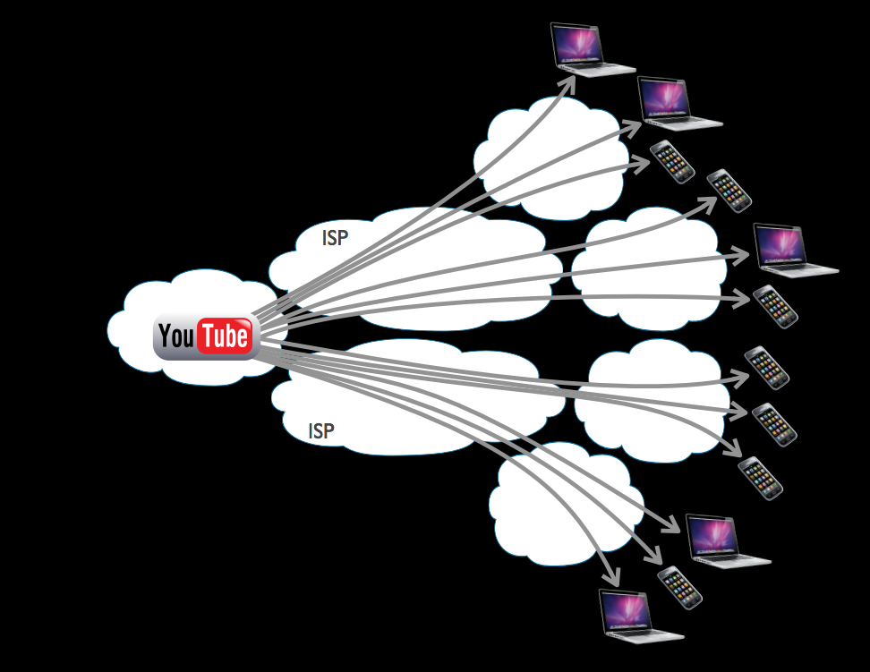
Data Distribution Context
End-to-end TCP/IP semantic restricts data distribution from utilizing data replicas or redundant paths
  Patches do not get widely deployed: IP multicast, multipath TCP, SCTP, DCCP, Tng.
  Overlay suffers from trust, heterogeneity, path stretch, link stress, etc: CDN, p2p, ALM

Slide 5
Data Distribution Context
Basic Observation in current era:
  End users essentially concerns about the data as long as it is genuine; instead of where the data residents, how the data is reached, or from which path the data is transferred

Slide 6
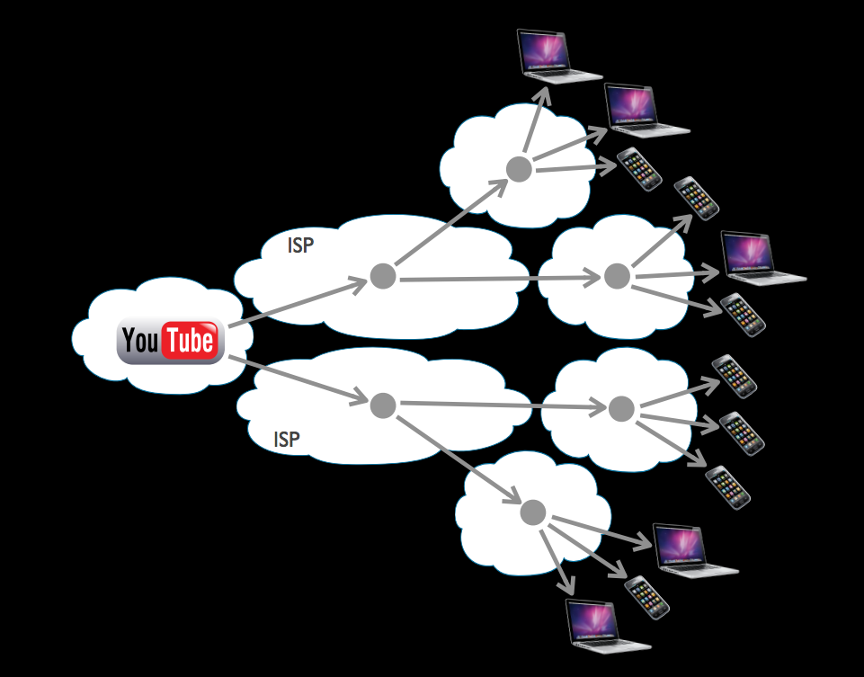
Information-centric Networking
ICN, which names the data directly, breaks through the restrictions of end-to-end IP semantics
  Multiple copies: authoritative sources or delegation
  Multiple path & multicast & broadcast on broadcast channel
  Identical request aggregation

Slide 7
How to Design an ICN Architecture ?
Retrieve and secure the data via name-based primitives

Slide 8
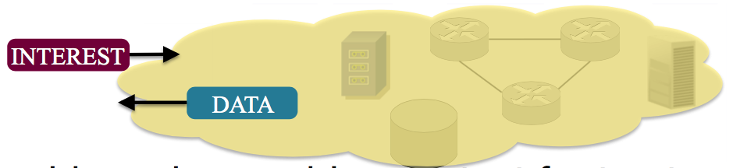
Design: Three implications of ICN
Naming the data independent from its container
Another two implications of ICN from the perspective of Internet architecture
  Retrieving the data
    Data Discovery: deliver the requests to the target data producer
    Data Delivery: transmitting the data to requesters
  Securing the data
    Validity: the data is a complete, uncorrupted copy
    Provenance: the data is produced by a trusted party
    Relevance: the received data is the desired one
Primitives of retrieving and securing data are based on given name

Slide 9
Naming the Data
Hierarchical/Human-readable (HR) name
  Introduce the binding between the desired data (entity in human mind) and its ICN name (entity in cyberspace)
  e.g., www.google.com/news/xxx
Self-certifying (SC) name
  Hashing is the simplest form, and general form contain public key digest of producer
  Introduce the bing between the name and the data (both are cyberspace entities)
  e.g., 23azdad:alda23ad

Slide 10
Retrieving the Data
Two Steps, both are about routing/forwarding:
  Data Discovery: Deliver the request to target replica(s)
  Data Delivery: Deliver the data to requester
Name of data as routing identifier (RID)
  Name-based routing: just like IP routing, but with another name namespace
Name basked Routing + IP (locator) based routing
  Name based Routing to find the content
  IP based routing to retrieve the data
Soft State (no RID):
  Routers maintain the state that needed to forward packets from source to the target

Slide 11
Securing the Data
Goals: Validity, Provenance, Relevance
Three Steps to verify Validity, Provenance and Relevance
  Verifying content-name mapping is signed by a particular key
  Determining something about who that key belongs to whom, in our term, the producer
  Deciding whether or not that is an acceptable producer for this particular data
Availability: defend DoS led by caching poisoning:
  Caching Poisoning: data is faked and distributed among the network

Slide 12
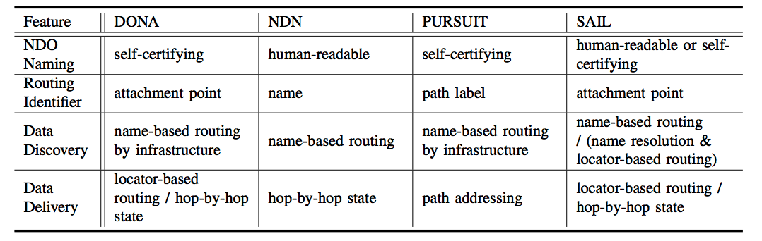
Summary of ICN Proposals
Different proposals advocate different design,
Only a few consensuses

Slide 13
ICN Examples

Slide 14
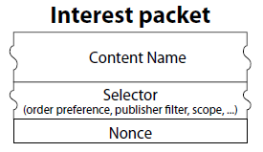
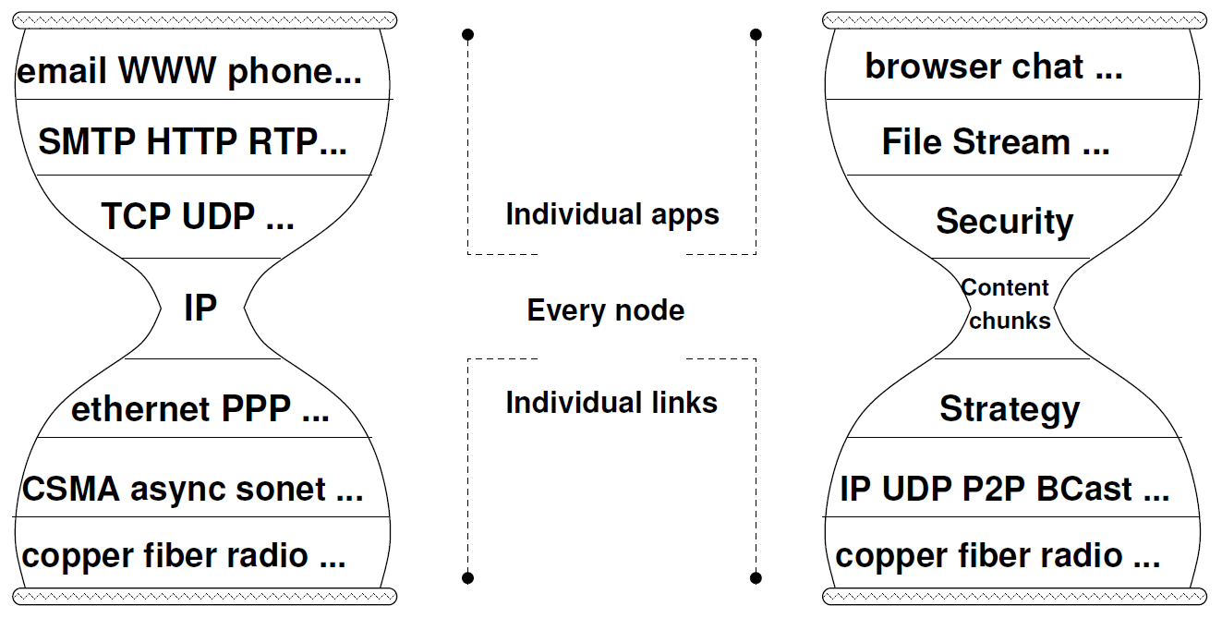
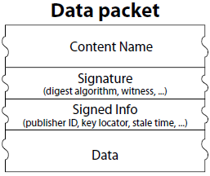
NDN
Where -> What
Internetworking -> Named Data Networking (NDN)

Slide 15
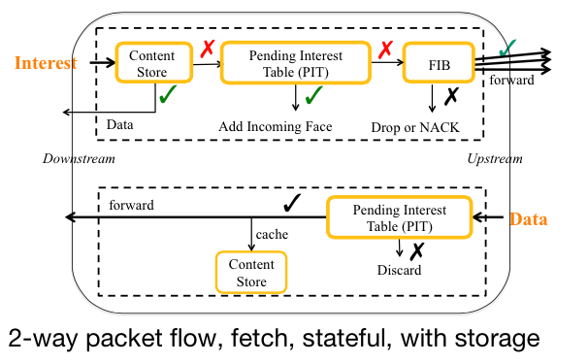
NDN Router
15

Slide 16
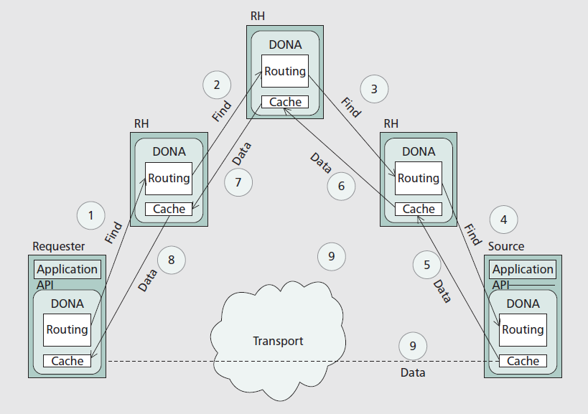
DONA
(Route by name + IP based data forwarding)

Slide 17
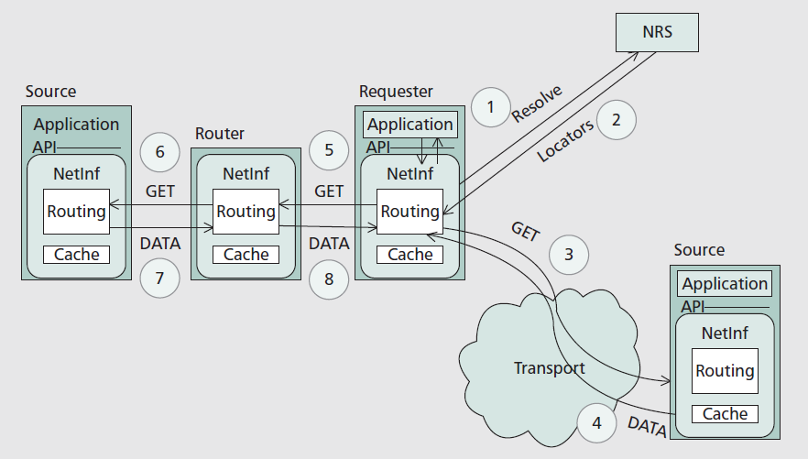
NetInf (mixed)

Slide 18
Very Different Design
Which is the best?
It is all about assumptions and trade-offs

Slide 19
Debate: SC v.s. HR Naming
SC name
  relies on prior provenance and relevance in the first place
  Hard to be aggregated – scalability problem
HR name provide weak intrinsic relevance
  By adding self-certifying component, public key or its pointer which sign the NDO, to provide availability
  Easy to be aggrated

Slide 20
Debate: Caching
S. Shenker et al [sigcomm’13] argue that edge-based caching is enough for ICN based on a dataset from Akamai, where requests follow zipf distribution
C. Imbrenda et al [ICN’14] conclude very different conclusion based on the dataset from access and back-haul Orange S.A., wherein requests follows combination of Weibull (head&tail) and zipf (middle)
Thus, request distribution is the key factor for caching storage placement – We don’t know the real ICN traffic distribution yet!
Edge or In-network ?

Slide 21
Conclusions
ICN is about content delivery
ICN Design
  Naming the data
  Retrieving the Data
  Securing the Data
Different ICN designs
ICN is still on-going research.
  There are not too many consensuses on the designing of ICN, even for those fundamental design
Reference
  Xiaoke Jiang, Jun Bi, et. al., A Survey on Information-Centric Networking: Concept, Design and Debate, China Communications (IEEE), Vol.12, No.7, 2015

