Slide 1
OneM2M Challenges of M2M Security and Privacy

Slide 2
Overview
M2M Abbreviation
oneM2M Architecture: a quick review
Security Architecture of M2M
Security Challenges
Large variety of scenarios
Any device in any deployment
A device cannot make autonomous “judgement calls” on privacy
The solutions

Slide 3
Abbreviation
AE: Application Entity
CoAP: Constrained Application Protocol
CSE: Common Service Entity
CSE-ID: Common Service Entity Identifier
Mca: Reference Point for M2M Comm with AE
Mcc: Reference Point for M2M Comm with CSE
Mcc’: Reference Point for M2M Comm with CSE of different M2M Service Provider.
Mcn: Reference Point for M2M Comm with NSE
NSE: Network Service Entity
TLS: Transport Layer Security
DTLS: Datagram Transport Layer Security
PSK: Pre-Shared Key
PKI: Public Key Infrastructure

Slide 4
M2M Architecture Model
General Concept
M2M Layered model comprises three layer as shown in the picture:
Application Layer
Common Services Layer
Network Service Layer

Slide 5
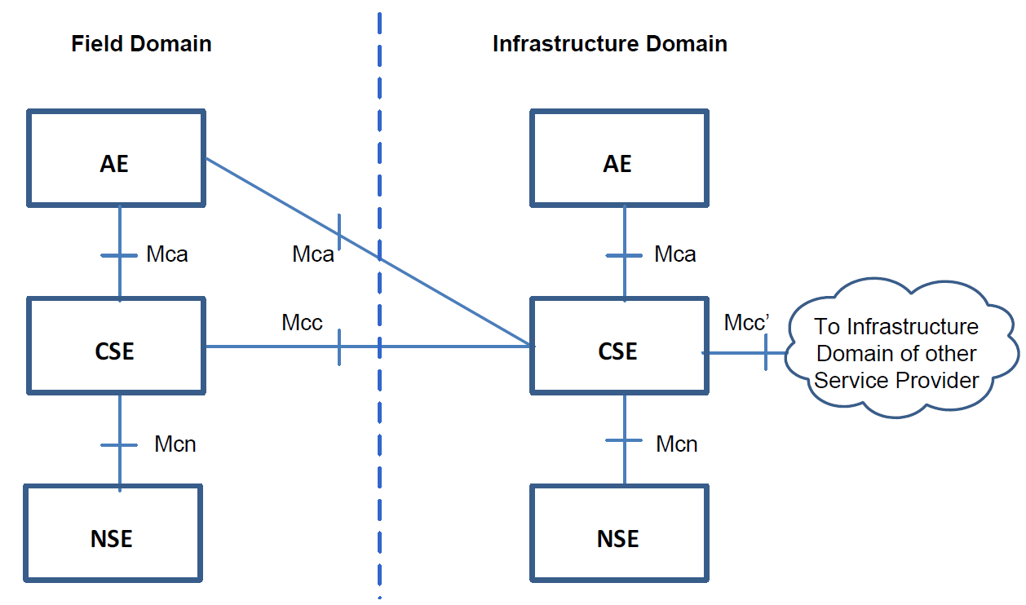
M2M Architecture Model
Functional Architecture

Slide 6
M2M Architecture Model
The entity of each layer:
Application Entity (AE), an entity in the application layer that implements an M2M application service logic.
Common Services Entity (CSE), represent an instantiation of a set of “common service function” of the M2M environments.
Network Services Entity (NSE), provides services from the underlying network to the CSEs.

Slide 7
M2M Architecture Model
Reference Points
Describe the links between entity.
Mca, the links between an Application Entity (AE) and a Common Services Entity (CSE)
Mcc, the links between two Common Services Entity (CSE)
Mcn, the link between a Common Service Entity (CSE) and the Network Service Entity (NSE).
Mcc’, the link between two Common Services Entities (CSE) from one M2M domain to different M2M domain.

Slide 8
Security Architecture
Security Services
Security API (Mca, Mcc) (not specified in the present document)
Security Functions Layer
Identification and Authentication
Authorization
Identity Management
Security Association
Sensitive Data Handling
Security Administration
Secure Environment Abstraction Layer (not specified in the present document)
Security Environments Layer
Secure Environment n
Sensitive Data
Sensitive Function

Slide 9
Security Architecture
Security Function Layer
Contains a set of security function that are exposed at reference point (using security API)
These security functions can be classified into six categories :
Identification
Authentication
Authorization
Security Association
Sensitive Data Handling
Security Administration

Slide 10
Security Architecture
Security Environment Abstraction Layer
Implements various security capabilities such as key derivation, data encryption/decryption, signature generation/verification, security credential read/write from/to the Security Environments
The security function in this layer invoke the functions in order to do operations related to Secure Environments
In addition, this layer also provides physical access to the Secure Environments

Slide 11
Security Architecture
Secure Environment Layer
Contains one or multiple secure environments that provide various security services related to sensitive data storage and sensitive function execution
Example of sensitive data : SE capability, security keys, local credentials, identity information, and so on
Example of sensitive function : data encryption, data decryption, and so on

Slide 12
Design Principles of Security Architecture
Security Services are modular and configurable according to the needs of the hosting Common Service Entity
The architecture is split into several components and sub-components providing a modular design which enabled mapping of the architecture to different nodes and entities
The Secure Environment within the Common Service Entity is accessed via the Secure Environment Abstraction layer and shall hold all sensitive resources
The architecture may need to be adapted to be suitable for implementation in different entities
Security should consist of components relevant to fulfil the requirements of the respective node or entity and the intended use case

Slide 13
Security Challenges
Large variety of scenarios
“Assets” that need protecting can be unique to a deployment
Content confidentiality, content integrity, anonymity, traffic efficiency
Environment can be unique to a deployment
Does wired or wireless transport layer provide adequate security?
Tamper-resistance considerations
Variety of authentication scenarios
Pre-shared Key provisioned to both by end-points
PKI/Certificate (asymmetric cryptography)
Centralized authentication

Slide 14
Security Challenges
Any device in any development
Interoperability: agree on minimal set of cipher suites
Credential management
Provisioning at manufacture
Human-assisted provisioning during deployment
Remote provisioning of fielded devices
Derivation from pre-existing credentials (e.g. transport network)

Slide 15
Security Challenges
A device cannot make autonomous “judgement calls” on privacy
M2M/IoT may expose information about our lives without our awareness
Privacy = who can access information about me
CSE needs to determine: “Should I allow access?”
Can’t ask human to make case-by-case judgment call
CSE needs clear rules

Slide 16
Challenges & Solutions
Large variety of scenarios
Any device in any deployment
A device cannot make “judgment calls” on privacy
Secure communication
various authentication options
Remote provisioning
various authentication options
Access Control Policies
expresses wide variety of rules

Slide 17
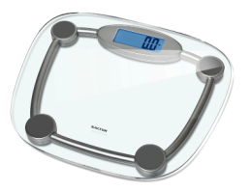
Secure Communication: Example
Field Domain
Sensor
Gateway
AE1
CSE1
E-Health Web-application
AE2
CSE2
M2M SP’s Server
Web App
Server
Infrastructure
Domain

Slide 18
Secure Communication: Example
Field Domain
CoAP
UDP
AE1 passes sensor reading to CSE1
Sensor
Gateway
AE1
CSE1
AE2
CSE2
M2M SP’s Server
Web App
Server
Infrastructure
Domain

Slide 19
Secure Communication: Example
Field Domain
CoAP
UDP
AE1 passes sensor reading to CSE1
CSE1 forwards sensor reading to CSE2
Sensor
Gateway
AE1
CSE1
HTTP
TCP
AE2
CSE2
M2M SP’s Server
Web App
Server
Infrastructure
Domain

Slide 20
Secure Communication: Example
Field Domain
CoAP
UDP
AE1 passes sensor reading to CSE1
CSE1 forwards sensor reading to CSE2
AE2 retrieves sensor reading from CSE2
Sensor
Gateway
AE1
CSE1
HTTP
TCP
AE2
CSE2
M2M SP’s Server
Web App
Server
HTTP
TCP
Infrastructure
Domain

Slide 21
Secure Communication
Field Domain
Hop-by-Hop
Transited CSEs see clear text
Trusted to behave
Sensor
Gateway
AE1
CSE1
AE2
CSE2
M2M SP’s Server
Web App
Server
Infrastructure
Domain

Slide 22
Secure Communication
Field Domain
CoAP
DTLS
UDP
Hop-by-Hop
TLS/DTLS v1.2
DTLS if UDP transport
Sensor
Gateway
AE1
CSE1
AE2
CSE2
M2M SP’s Server
Web App
Server
Infrastructure
Domain

Slide 23
Secure Communication
Field Domain
Hop-by-Hop
TLS/DTLS v1.2
DTLS if UDP transport
TLS if TCP transport
Sometimes write (D)TLS or just TLS for both
Sensor
Gateway
AE1
CSE1
HTTP
TLS
TCP
AE2
CSE2
M2M SP’s Server
Web App
Server
HTTP
TLS
TCP
Infrastructure
Domain

Slide 24
Secure Communication
Field Domain
Hop-by-Hop
TLS/DTLS v1.2
AE-CSE
AE: TLS Client (C)
CSE: TLS Server (S)
Sensor
Gateway
C
S
AE1
CSE1
C
S
AE2
CSE2
M2M SP’s Server
Web App
Server
Infrastructure
Domain

Slide 25
Secure Communication
Field Domain
Hop-by-Hop
TLS/DTLS v1.2
AE-CSE
AE: TLS Client (C)
CSE: TLS Server (S)
CSE-CSE
CSE1: TLS Client (C)
CSE2: TLS Server (S)
Sensor
Gateway
C
S
AE1
CSE1
C
S
C
S
AE2
CSE2
M2M SP’s Server
Web App
Server
Infrastructure
Domain

Slide 26
Authentication Options
Pre-Shared Key (PSK)
TLS Client & Server provisioned with a shared key#
Certificate
TLS Client & Server both have certificates
M2M Authentication Function (MAF)
MAF operated by 3rd Party or M2M Service Provider
TLS Client and MAF provisioned with a shared key#
MAF assists authentication of TLS Client & Server
#This shared key can be remotely provisioned

Slide 27
Certificates
Somewhat aligned with CoAP Security RFC7252
X.509/PKIX (RFC 5280)
RawPublicKey Certificates
Contains only X.509 SubjectPublicKeyInfo element
Suits less complex deployments & debugging
Certificates chaining to a trust anchor. E.g.
Device Certificate (e.g. manufacturer issued)
M2M SP issued certificate identifying CSE or AE

Slide 28
Remote Provisioning
Process provisioning a shared key to two entities
M2M Enrolment Function (MEF)
Assists remote provisioning
Operated by 3rd Party or M2M Service Provider
Mechanisms for establishing shared key
TLS Client & MEF perform (D)TLS, export shared key
PSK
Certificates
Derived from Network Access credentials
Network Access Provider assists in mutual authentication
Generic Bootstrapping Architecture (GBA) 3GPP TS 33.220
Remote Provisioning goals are to generate Master Credential (Km) and corresponding Master Credential Identifier (KmId), shared by a CSE/AE and an M2M Authentication Function, to establish security associations between the CSE/AE and other CSEs and/or AEs

Slide 29
Remote Provisioning
Defined by Remote Security Provisioning Framework. Remote Security Provisioning Framework consists of:
Bootstrap Credential Configuration: phase of a Security Provisioning Framework in which the Bootstrap Credentials are pre-provisioned to the Enrolee and the M2M Enrolment function.
Bootstrap Instruction Configuration: phase of a Security Provisioning Framework in which the Enrolee and M2M Enrolment Function are provided with identities (and any other relevant credentials) to enable the M2M Enrolment function to establish a Master Credential between the intended Enrolee and M2M Authentication Function.
Bootstrap Enrolment Handshake: phase of a Security Provisioning Framework in which the Enrolee and M2M Enrolment Function perform mutual authentication.
Enrolment Key Generation: phase of remote security provisioning Framework in which the Enrolee and M2M Enrolment function establish an Enrolment Key and Enrolment Key identifier.
Integration to the Association Security Handshake

Slide 30
Remote Provisioning Example
M2M Enrolment
Function
Enrolee
Enrollee: AE or CSE that requires remote provisioning of a symmetric key to be shared with an enrolment target.
Enrolment Target: CSE or AE with whom an Enrolee wishes to establish a symmetric key (master credential or pre-provisioned secure connection key) using remote security provisioning.
Enrolment Target

Slide 31
Remote Provisioning Example
M2M Enrolment
Function
Enrolee
Mutual Authentication
Enrolment Target

Slide 32
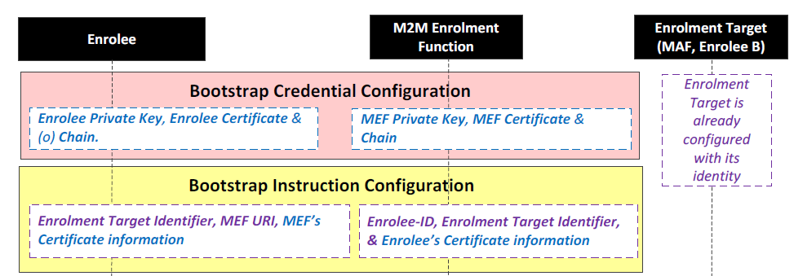
Remote Provisioning Example
Mutual Authentication Process

Slide 33
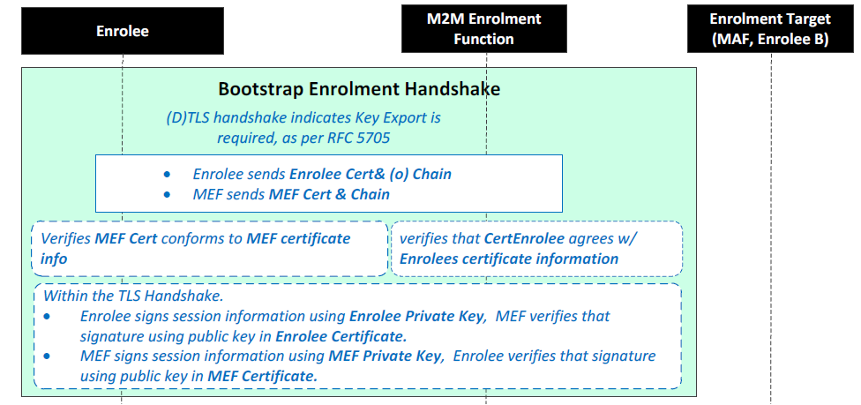
Remote Provisioning Example
Mutual Authentication Process

Slide 34
Remote Provisioning Example
M2M Enrolment
Function
Enrolee
Ke, KeId
Ke, KeId
Mutual Authentication
Generate Ke, KeId
Generate Ke, KeId
Enrolment Target
Ke: Enrolment Key
KeId: Enrolment Key Identifier

Slide 35
Remote Provisioning Example
Enrolment Key Generation Process
MEF FQDN: M2M Enrolment Function Fully Qualified Domain Name.

Slide 36
Remote Provisioning Example
M2M Enrolment
Function
Enrolee
Ke, KeId
Ke, KeId
KeId in (D)TLS Handshake
Enrolment Target

Slide 37
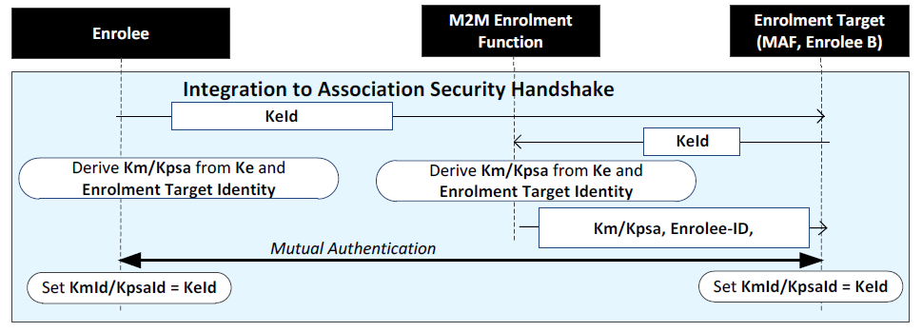
Remote Provisioning Example
KeId (D)TLS Handshake process
Km: Master Credential
KmId: Master Credential Identifier
Kpsa: provisioned credential for M2M Security Association Establishment
KpsaId: provisioned credential for M2M Security Association Establishment Identifier

Slide 38
Remote Provisioning Example
M2M Enrolment
Function
Enrolee
Ke, KeId
Ke, KeId
KeId in (D)TLS Handshake
KeId
Enrolment Target

Slide 39
Remote Provisioning
M2M Enrolment
Function
Enrolee
Ke, KeId
Ke, KeId
+ Enrolment
Target ID
+ Enrolment
Target ID
Shared Key
Shared Key
KeId in (D)TLS Handshake
KeId
Enrolment Target

Slide 40
Remote Provisioning Example
M2M Enrolment
Function
Enrolee
Shared Key
Shared Key
KeId in (D)TLS Handshake
KeId
Enrolment Target
Shared Key
Shared Key: a Pre-Shared Key that used to authenticate the enrollee
and Enrolment Target so the secure communication will establish.

Slide 41
Remote Provisioning Example
M2M Enrolment
Function
Enrolee
Shared Key
Complete (D)TLS using Shared Key to verify provisioning
Enrolment Target
Shared Key

Slide 42
Access Control Requirements
oneM2M uses a RESTful architecture
API: request to perform an operation on a resource
Operations: Create, Retrieve, Update, Delete
CSEs can’t make resource access judgement calls
CSE need clear rules dictating, for each resource
WHO (which CSEs and AEs) are authorized to access,
WHAT operations (see above), and under…
WHICH circumstances (e.g. time, location of entity)

Slide 43
Access Control Policies (ACP) Resources
links
contains
Resource1
ACP1
ACP Rule1
Resource2
Resource3
ACP2
ACP Rule2
Resource4
ACP3
ACP Rule3
Resource access is authorized upon satisfying at least one ACP rule in one of the linked ACPs

Slide 44
Access Control Policies (ACP) Resources
links
contains
with conditions on
Resource1
ACP1
ACP Rule1
WHO: entities
CSE-ID
AE-ID
Resource2
WHAT: operations
Create,
Retrieve
Update
Delete
Resource3
ACP2
ACP Rule2
WHICH: circumstances
Time,
location,
IP address
Resource4
ACP3
ACP Rule3
ACP rule is satisfied if WHO and WHAT and WHICH are satisfied by requesting entity, requested operation and circumstances

